Slide 1


Slide 2

Notes:
// REPLACE WITH THE LOGOS FOR YOUR COHORT //

Slide 3

Notes:
// REPLACE WITH YOUR LOGO

Slide 4
Where
Notes:
Some of you have come a long way. Where exactly are you?

Slide 5
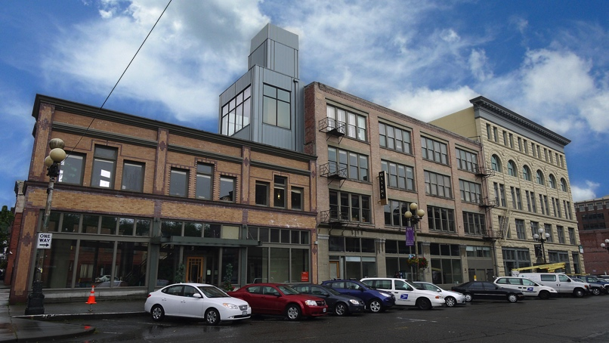

Notes:
// REPLACE WITH YOUR BUILDING //

Slide 6
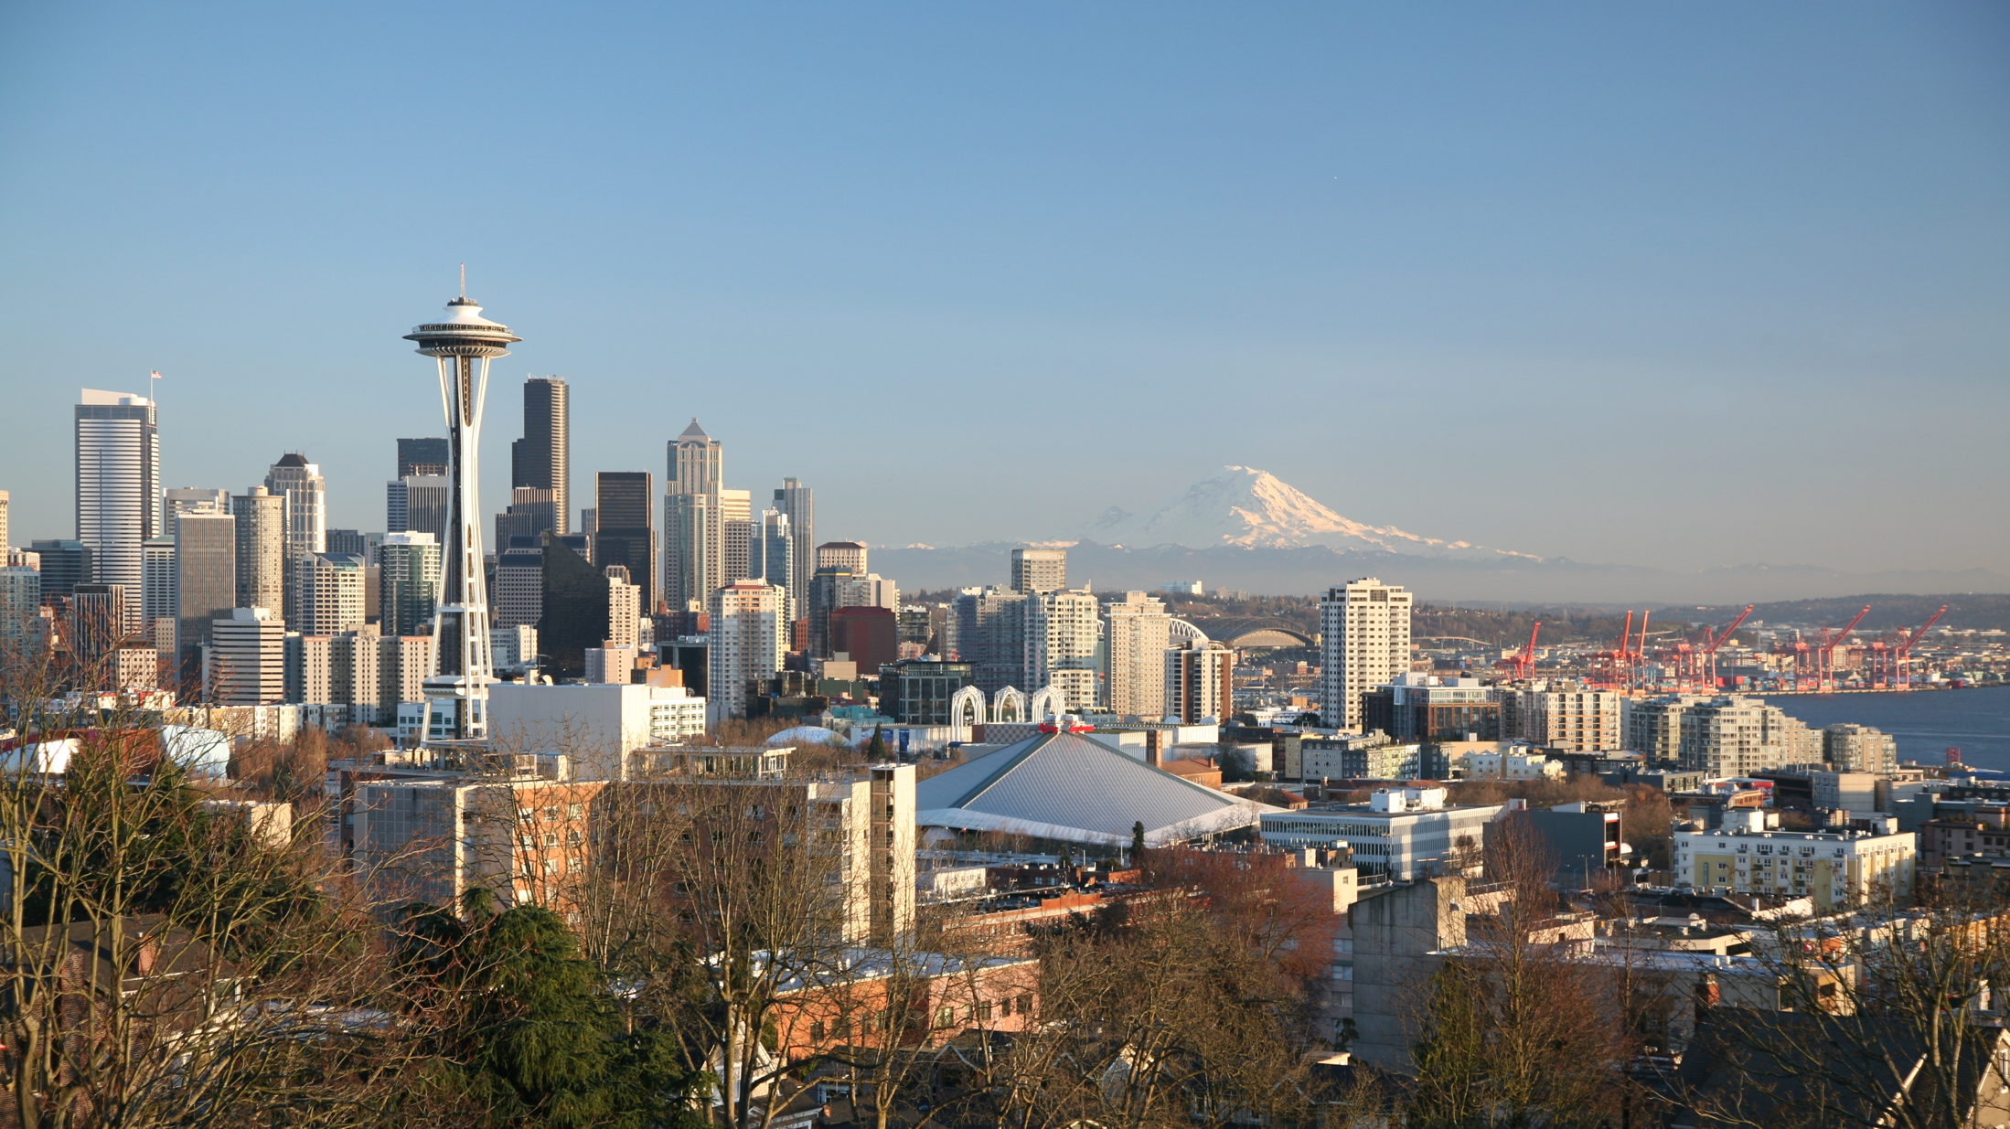
Seattle
Notes:
// REPLACE WITH YOUR CITY SKYLINE //

Slide 7
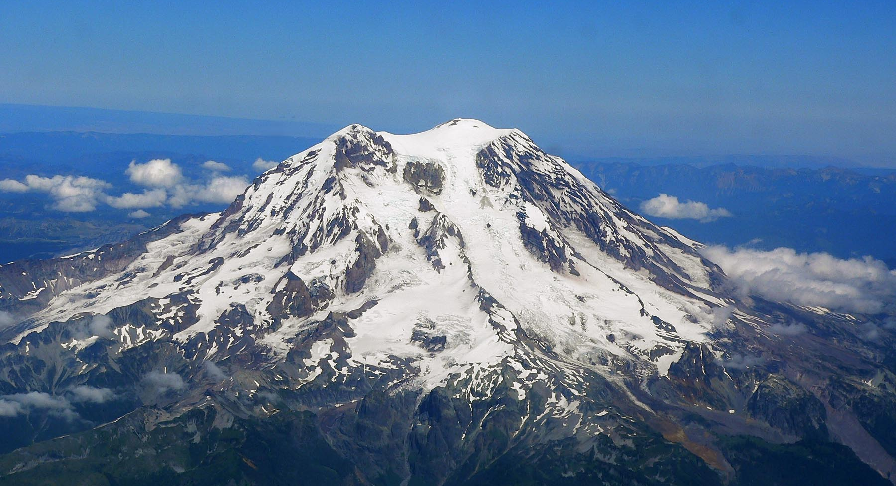
Mt. Rainier
Notes:
// REPLACE WITH A KEY LANDMARK// In Seattle, we like to point out that we’re less than 100 km from an active volcano, and that it’s visible on a clear day (which more than likely isn’t the day of orientation)

Slide 8
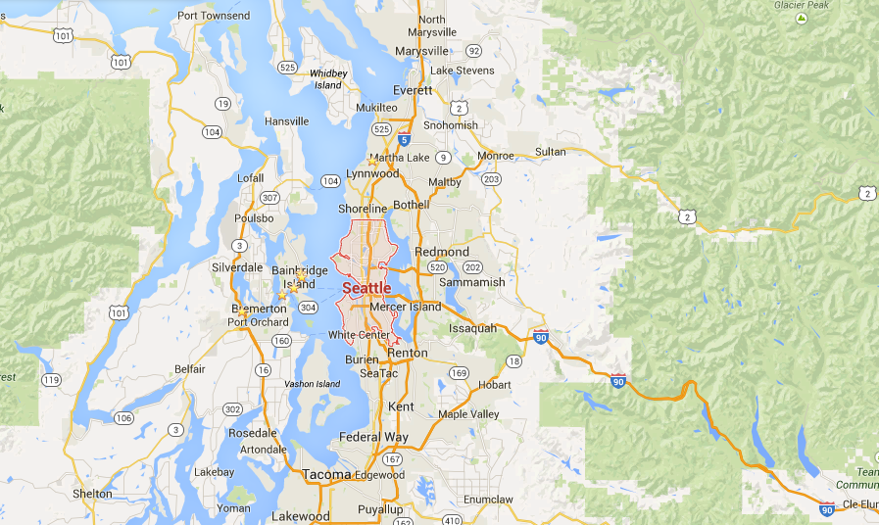
Seattle
Notes:
// REPLACE WITH A MAP OF YOUR CITY // In Seattle we like to point out we’re on an isthmus between the Pacific Ocean and a large lake, and that while Puget Sound is part of the Pacific Ocean, it’s a 3-4 hour drive to get to the big expansive part

Slide 9
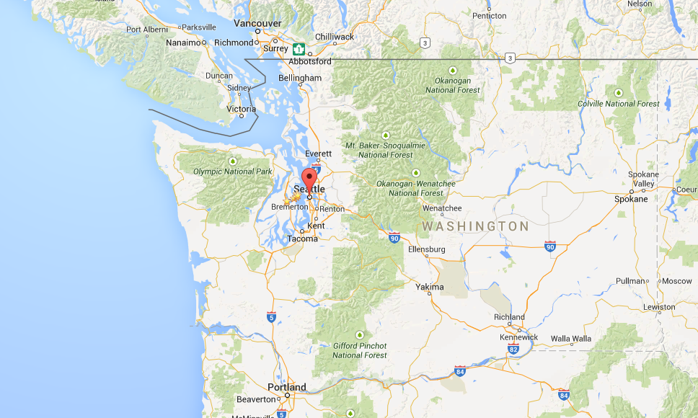
Seattle
Notes:
// REPLACE WITH YOUR REGION // In Seattle we like to point out we’re a city not near any other major U.S. city, that Vancouver in Canada is the next nearest city

Slide 10
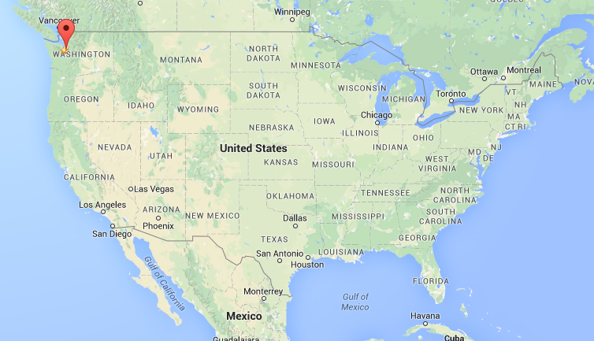
Notes:
// REPLACE WITH YOUR COUNTRY // In Seattle we also point out that we’re far from where all the other Americans live, that most of the fledglings spent 6 hours crossing the continent to get out to Seattle

Slide 11
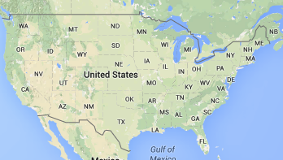

Notes:
// REPLACE WITH THE REGIONS WHERE THE FLEDGLINGS ARE FROM // In Seattle we end the progression of maps with the US, Africa, and other continents, all screen shot at the same resolution off of Google Maps. What Africans tend not to realize is how huge their continent is vs. the U.S. and what Americans tend not to know is how huge each African country is as compared to the U.S. states. Tanzania is the same size as California

Slide 12
What
Notes:
What are we going to do for the next 8/9/10 weeks?

Slide 13
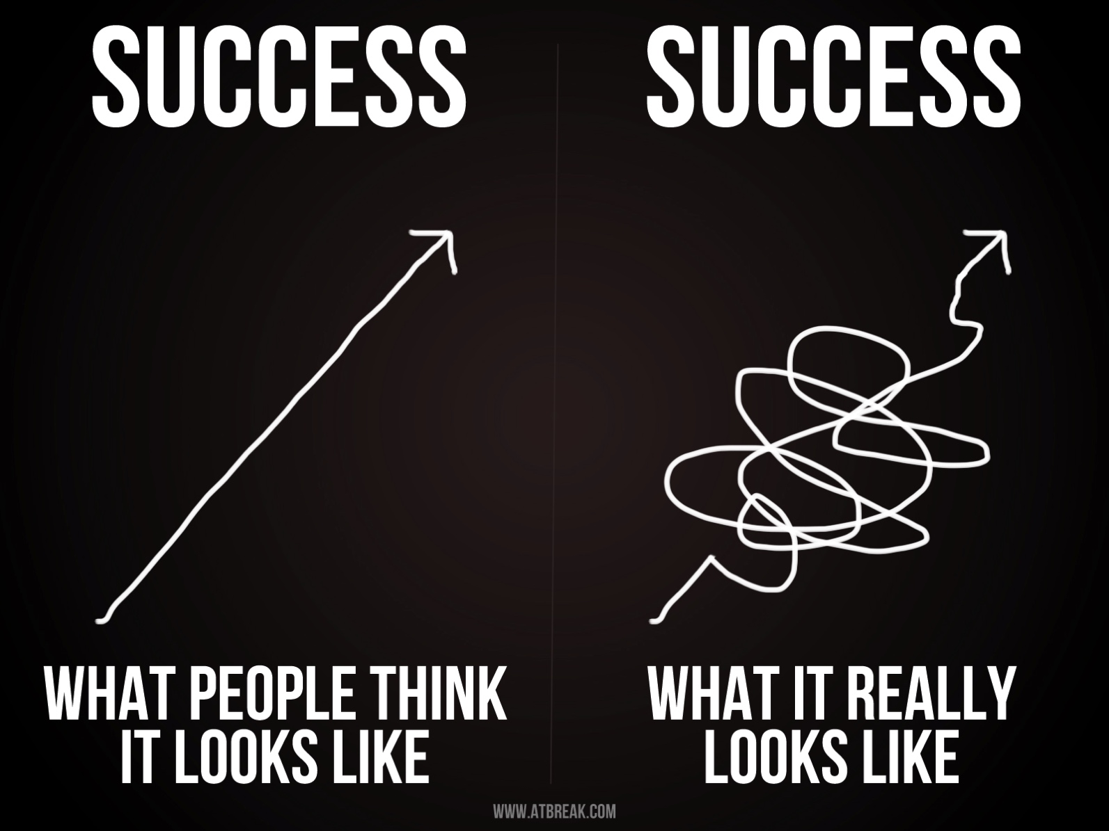
Notes:
Accelerators exist because the stories told about startups are wrong. Startups are hard. The path from idea to success is not a straight line. Never once, in the history of corporations has an entrepreneur had a great idea, put it in the market, and not had to make changes before it was a success. The reality is that most startups die in that tangle of otherwise minor failures, running out of money to try the next idea. The point of an accelerator is to snip off a few of those loops, to improve the odds that your companies make it to the road toward success.

Slide 14
More In → More Out
How much you get out of this program is up to you…
Notes:
Fledge is not school. It’s not like anything else you’ve been to before. We will provide some structure, some curriculum, some introductions, but we will not force any of it upon you. It is up to you to make the most of what we provide, and it is up to you to ask for more. If you want to get the most out of Fledge you need to put the most effort you can into the program while you are here. Of the dozens of graduates, a few walked away unhappy, all of which didn’t even do everything we asked of them, let alone asking us for more. Most walked away calling Fledge a life-changing program, all of which who didn’t just sit back and wait for us to bring them ideas, but proactively asked for introductions, for field trips, for reviews of their plans. These are the people who were on-time to every event and who were the last to leave at night. The more you put in, the more you will get out of this program.

Slide 15
Advice & Assistance
Luni
HUB
Fledglings
Mentors
Natalia
Sarah
Notes:
// REPLACE LUNI, NATALIA, SARAH, and HUB WITH NAMES FROM YOUR TEAM //
While you are here, you are going to get advice from many people. The YOUR-TEAM-NAME team, the mentors, and from the other fledglings.

Slide 16
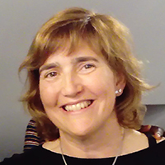








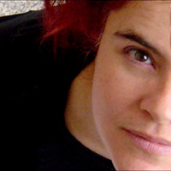


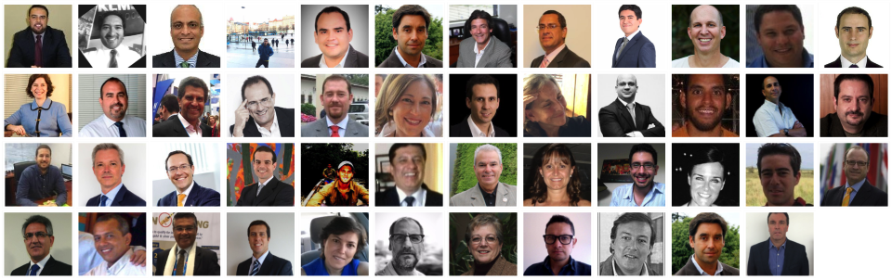





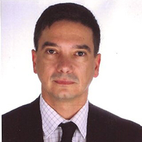






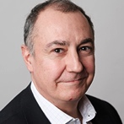
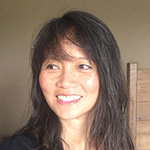



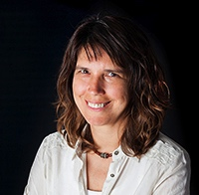

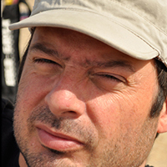
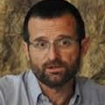




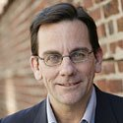








600+ “Mentors”
Notes:
// UPDATE 600 WITH THE LATEST NUMBER //
Hundreds of “mentors” want to help you succeed. You’ll start meeting them // TOMORROW // and continue meeting more until you tell us to stop making introductions

Slide 17

73 Graduate “Fledglings”
Notes:
// UPDATE 73 WITH THE LATEST NUMBER //
Dozens of entrepreneurs have sat in the seat you now find yourself in. Some of them will help you too. If there are any you specifically want to talk to, just ask and we’ll make an introduction.

Slide 18
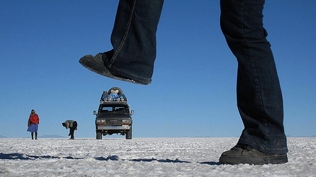
Notes:
What you should work on with them, and with us is unpacking your assumptions. Specifically, there are parts of your plans that you are taking for granted. Don’t. You need to make those assumptions explicit and question them like you are questioning everything else in your plan.

Slide 19
How
Notes:
How exactly does the program flow over the next 8/9/10 weeks?

Slide 20
10
Weeks
W1-3
Planning & Re-thinking
W3-8
Validation
W6-9
Story Telling
W9
Demo Day
W10+
Goals & Execution
Notes:
There are four parts. For the first few weeks we dig into business planning, questions your assumptions, fill in any gaps in your entrepreneurship knowledge, and start down the path of creating a viable plan for the upcoming year(s). Part two is to validate that plan, talk to potential customers, launch and test ideas, and continue polishing your plans. Part three we do all that plus we teach you how to tell a story. Our goal is for your to give a 5 minute TED-quality talk at Demo Day. TED speakers take months to prepare their talks. We’ll do it in 2/3 weeks. Finally, when you go home, it’s time to turn all these ideas into reality. Fledge doesn’t end on Demo Day, that is just the climax of the few intense weeks while you are here. Fledge ends for you years from now when you either have a company so large and successful that our assistance is no longer needed or after you’ve failed, given up, and don’t want to try again with a new idea.

Slide 21
Weekly Cadence
Event | Description | When
10@10 | “Stand up” Status Meetings | Monday, Wednesday, Friday, 10am
The Next Step | Entrepreneurial Education | Tuesday, Thursday, 10am
Lunch | Problem solving over Lunch | Monday, noon
HUB Member Lunch | Networking | Thursday, 12:00-1:30pm
Story Telling | Learning how PIXAR is PIXAR | Friday, 1pm
Luni’s Office Hours | Weekly check-in’s | On-demand
Mentors | Advice and opinions | Any other times
Potential partners | Potential revenues | Any time at all
Notes:
// UPDATE TO MATCH YOUR PROGRAMMING //
Each day has some structured programming. Three times per week we have a quick, stand-up status meeting. Twice per week we have classes in entrepreneurship. Once per week we each lunch together. Once per month the whole building eats lunch together. Outside of the structured times we are open for Office Hours with the team, we’ll schedule meetings with mentors, we’ll go on field trips, and you’ll be busy working on the pile of homework we’ll be assigning from the class. Plus many of you have companies to run while you are here, and you can do that in your free time.

Slide 22



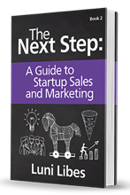




on lunarmobiscuit.com
Notes:
The twice-weekly classes are from The Next Step, a series of books and lectures from Fledge’s founder, Luni.

Slide 23
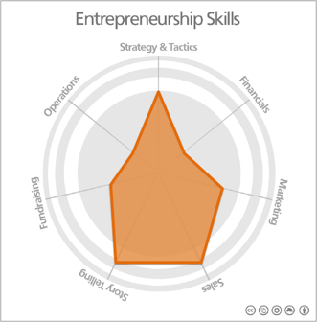
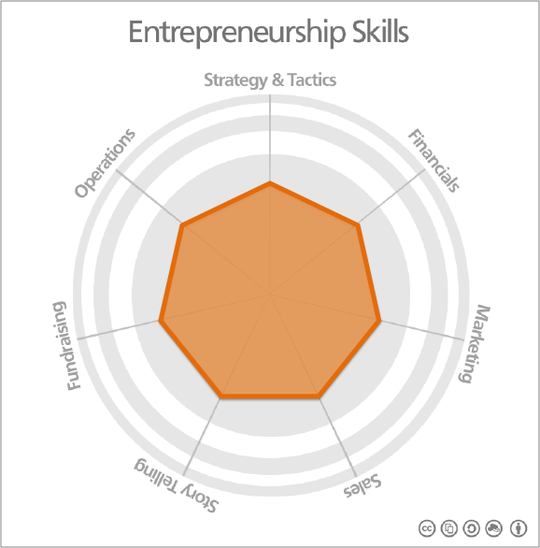
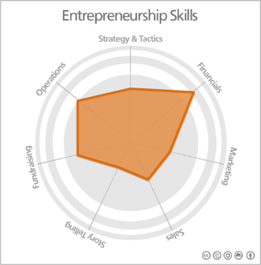
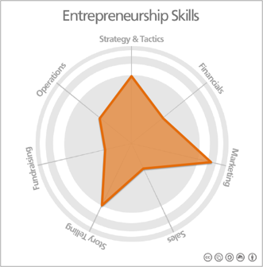
Notes:
The idea behind the class is to fill in any gaps in your entrepreneurship skills. Entrepreneurs need to be proficient at a variety of skills.
// POINT THE FLEDGLINGS TO lunarmobiscuit.com/skills FOR ACCESS TO THIS TOOL, ASK THEN FOR A COPY OF THE RESULTS, AND PUSH THEM TO FILL IN THEIR GAPS //

Slide 24
Fledgling Book
Culture
Expectations
Keep Organized
  Goals
  Status
  Notes
Notes:
// THIS BOOK IS PRINTED BY AMAZON IN SEATTLE, PRINTED LOCALLY IN PERU, AND IS ACCESSIBLE BY THE FLEDGLINGS ONLINE //
The book in front of you is to help you stay organized for the next 8/9/10 weeks. It includes a short overview of some of the material in this orientation, then includes blank pages in the back to help you prepare for the status meetings, to keep track of your goals, and to take notes.

Slide 25
Feedback
Co-creation
Openness
Notes:
One key piece of culture at Fledge is “co-creation.” We want and need your feedback, and that feedback is best provided now. It’s no use to you saving it up for the end. It’s no use complaining about anything behind our back.

Slide 26
X didn’t work
Speak Up!
Have you tried Y?
Z was great
I have a problem
I’m stuck
Mentor X was great/waste of time
Notes:
Instead, tell us what is working and especially speak up if something isn’t working or if you have an idea for something that doesn’t exist.
Much of The Next Step curriculum is based on conversations Luni had with entrepreneurs and early fledglings.
Much of the Fledge curriculum is based on feedback from past fledglings.
If you need something, tell us. Ideally today. Tomorrow if you have to wait. The day after is too late.

Slide 27
Questions?
?????
Notes:
Any questions on any of that?

Slide 28
Who
Notes:
Who are you?

Slide 29










“Luni” Libes
Entrepreneur/Investor
Mentor/Author
Fledge’s founder
Entrepreneur
in Residence
& Faculty
Fledge
Entrepreneur
in Residence
1992 1996 2001 2005 2009 2012
Mobile Market Research
Mobile Search & Advertising
Mobile Games & Apps
Enterprise web collaboration
Nimble
Tablet, PDA, smartphone software
…
Notes:
// REPLACE WITH LOCAL TEAM //
Luni is a 25+ year serial entrepreneur. He loves helping turn ideas into startups. He loves figuring out what customers actually want to buy. He started Fledge so that he can help dozens of entrepreneurs per year, and hundreds in the next few decades rather than keeping his old pace of 5 companies in 20 years.

Slide 30
Who are you?
(plural)
Notes:
Who are you? Plural you. You are now not just an entrepreneur with a startup, you are now part of a cohort of entrepreneurs and a global network of fellow entrepreneurs.

Slide 31
Who are you?
(singular)
Notes:
Who are you? Singular.

Slide 32
Who are you?
Your background?
  Your passion(s)?
    Your experiences?
      Your path to Fledge?
Notes:
How did you get here? What caused you to want to start a company? What past experience do you have that might be useful for the others?

Slide 33
Who are you?
Your background?
  Your passion?
    Your experiences?
      Your path to Fledge?
Pair up with someone you don’t know
Interview them for 3 minutes
Swap interviewer and interviewee
Introduce them in 2 minutes or less
Notes:
Rather than have you tell us these stories, pick a partner, learn their story in the next 3 minutes, then swap for the following 3 minutes, then share your partner’s story with the whole group in less than 2 minutes each.

Slide 34
Why are you here?
Notes:
Why are you here? Why Fledge?

Slide 35
Why are you here?
Your idea’s state of existence?
  Your struggles?
    Your expectations?
      Your pressing needs?
Notes:
What is the state of your business? What are its three biggest issues? What do you hope to get out of Fledge?

Slide 36
Why are you here?
Your idea’s state of existence?
  Your struggles?
    Your expectations?
      Your pressing needs?
Tell us in 1 minutes or less
You have 1 minute to prepare
Notes:
Explain all that in just 60 seconds. Don’t worry, we’ll have plenty of time to learn the details. Today we just want to get an idea of why you are here and to share those needs around the room in case multiple teams have common needs.

Slide 37
What are your goals?
Notes:
This intense part of Fledge is 8/9/10 weeks long. That time will fly by faster than you can possibly imagine.

Slide 38
What are you goals?
Your goals for each week?
  Customer validation?
    “Big rocks”?
      “Must have” for Demo Day?
Notes:
The program is split into weeks. It is best to take some time, today, and set up goals for each week.
It is also useful to think about what you want to say on stage at Demo Day. What accomplishment do you hope to share with the world on that day?
New web site? Close specific customers? Start a crowdfunding campaign? Sign a specific partner?
It helps to set goals to accomplish milestones.

Slide 39
What are you goals?
Your goals for each week?
  Customer validation?
    “Big rocks”?
      “Must have” for Demo Day?
Do this today after lunch
Notes:
// UPDATE LUNCH DEPENDING ON YOUR SCHEDULE //

Slide 40
What is your status?
We meet for 10@10 most M,W,F’s?
  Come prepared!
      What did you do this week?
      What is your goal this week?
      What is blocking your progress?
Notes:
// UPDATE M,W,F to match your schedule // UPDATE 10@10 to match your time //
Three times per week we’ll start the day with a stand-up status meeting. “Stand up” as in everyone stands in a circle. We do that to keep it short. We also expect everyone to come prepared with what they are going to share. Think about that 15 minutes before the meeting and write it down! Typical updates are: What did you do since the last meeting, What are you doing today, and Is anything blocking your progress. This is also the time to share stories from mentor meetings, updates from customers, learnings, pivots, etc. We’ll also have time for announcements and reminders. As often as possible, we’ll invite outsiders into this meeting, and when that happens we’ll ask you to start with a 1-sentence pitch describing your company. That’s a useful line to have and expect to hone those words over and over and over again in the next many weeks.

Slide 41
To Do #1
Goals
Finish filling out your weekly goals
Create a Demo Day goal
Notes:
The first To Do’s. Set your weekly goals. Set your Demo Day goal.

Slide 42
To Do #2
The Next Step
Watch Welcome. Letting Go.
Watch Measuring Your Skills
Watch Lesson 0. Why?
Watch Lesson 1. Lean.
Read The Next Step: Steps 1-9
Notes:
Tomorrow is the first class. Watch up through Lesson 1 on The Next Step online classroom and read chapters 1-9 in the book (which you’ll also find online).
Luni sent you a login to lunarmobiscuit.com/the-next-step

Slide 43
To Do #3
Prepare for 10@10
Wednesday morning, promptly at 10am,
we will meet for our first 10@10
Be prepared to share your goals, and provide any updates
  You get 1-2 minutes. WRITE IT DOWN!
Notes:
Our first status meeting is on Wednesday. Remember, be on time and be prepared.

Slide 44
To Do #4
Prepare for Meet the Fledglings
Tonight, 5pm-8pm
Be prepared to meet 30-50 mentors,
investors, and supporters
Be in the triangle by 4:30, smiling, ready to mingle, and with a 2 minute verbal pitch prepared and practiced
Notes:
// UPDATE WITH YOUR DETAILS //
Lastly, tonight ends with “Meet the Fledglings”. We’ll have about NN people here who want to meet you. Be ready with a 2-minute pitch (no slides) to share with the crowd. Let’s meet at // NN:00 // to practice those.

Slide 45
More In → More Out
How much you get out of this program is up to you…
Notes:
One final reminder, how much you get out of Fledge is up to you. I just gave you four To Do’s. Are you going to get all of those done before the event tonight? Does that include three drafts of your 1-sentence pitch, as you’ll be using that at least a dozen times at the event? Ask for help on that too when you have a free moment. That is just one small example of doing more than is asked of you and getting more from the program.

Slide 46
Questions?
?????
Notes:
Any questions?

