Slide 1


Slide 2
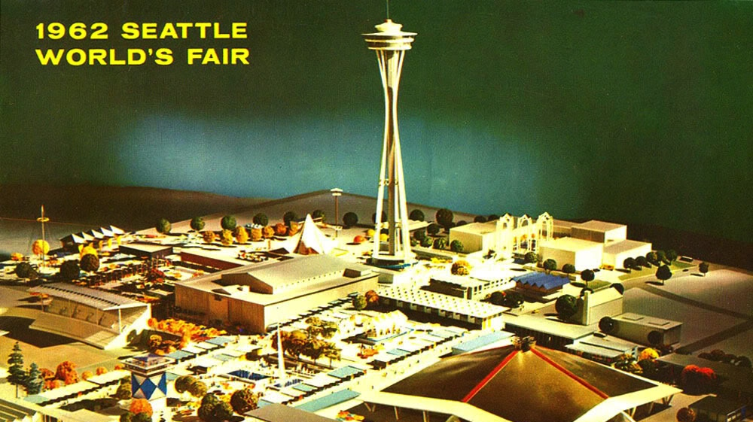
Notes:
[Extracted from Luni’s talk at the very first Demo Day, September 2012]
Fledge was founded in 2012, 50 years after the 1962 World’s Fair.. where Seattle invented the future.

Slide 3
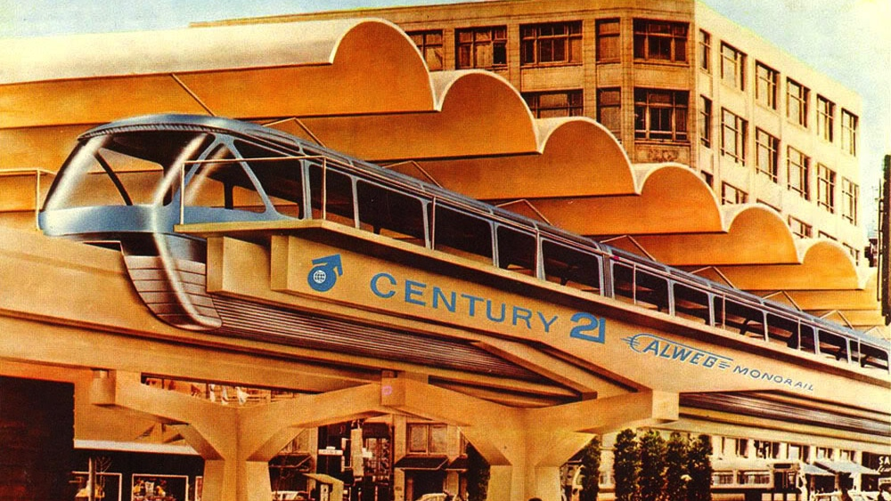
Notes:
This event was officially called the “Century 21 Exposition”… an event that was looking forward, 50 years into the future, into the 21st Century

Slide 4
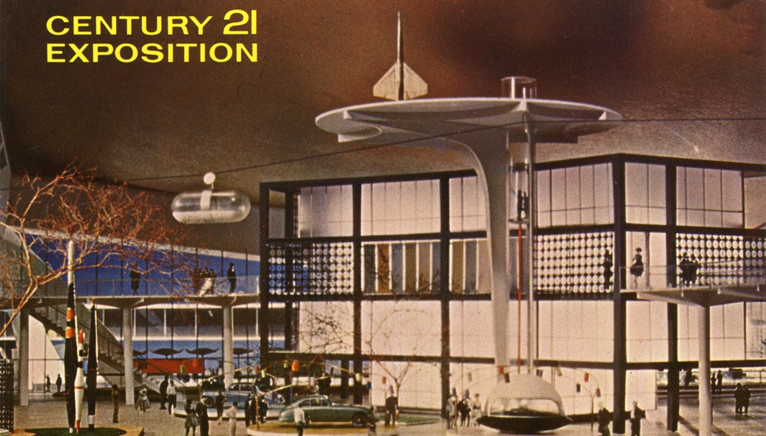
Notes:
The event showcased a bright, utopian future, where technology solved all the world’s problems.

Slide 5
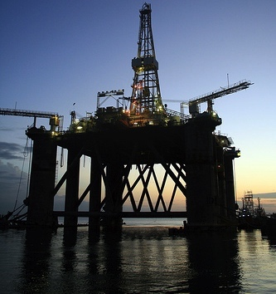
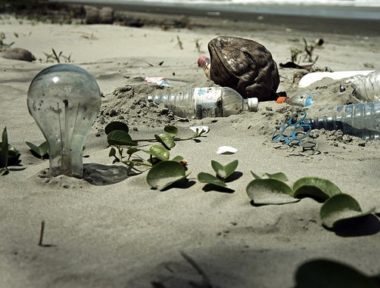
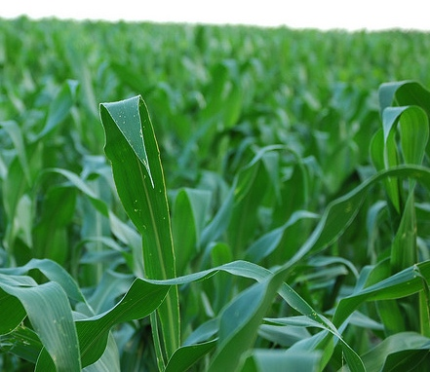
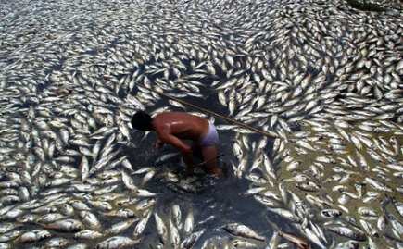
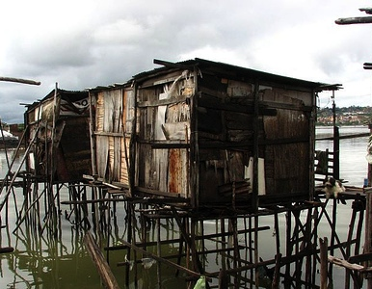
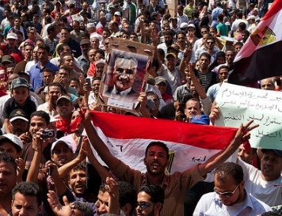
Notes:
Here we are, more than 50 years later, the world is still full of problems. In that time, the world’s population has more than doubled. Back in 1962, more than half of the 3.2 billion people on the planet lived in poverty. Today, more than half of our 7.5 billion live on less than $5 per day. Percentage are better, but total number of people suffering has grown. And… the 3 billion who live “first world” lives consume more than the planet can sustain. … This has created planet-wide issues of sustainability, environmental degradation, and social justice and injustice. It’s time we solve these problems in a new way…

Slide 6
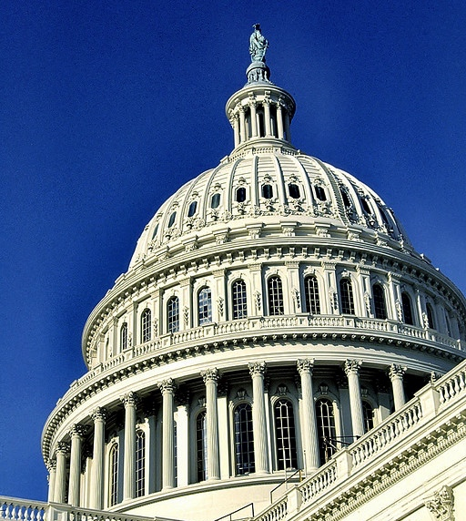
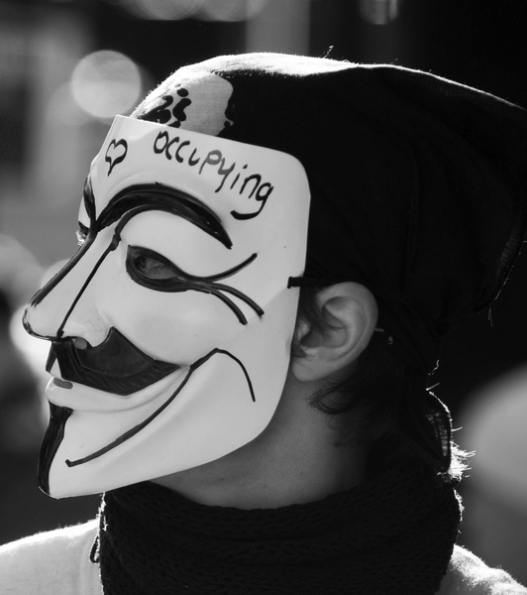
Notes:
The old way is to sit back and let the solutions to flow from the governments of the world, occasionally taking to the streets to prod this slow process along. We gave that process more than 50 years. It proved itself repeatedly not to work. We can’t give it another 50 years to find solutions. Instead, we need to use new tools…

Slide 7
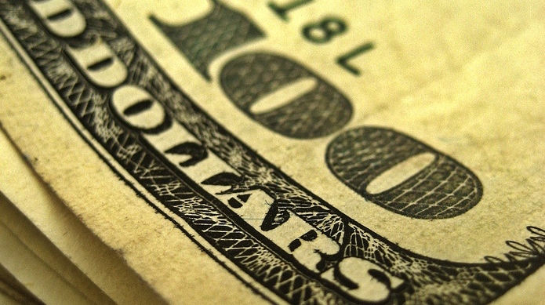

Notes:
Specifically, the tool that brought 3 billion people out of poverty, a tool that bring solutions to paying customers, which then creates profits to bring solutions to yet-more customers. In short, it’s time to use Capitalism to solve the world’s problems… and specifically mission-driven for-profit companies that do good, through doing business.

Slide 9
Image Credits
Fledgling- http://www.flickr.com/photos/nosha/3756324758
Staircase - http://www.flickr.com/photos/seier/2780704352
Oil Rig - http://www.flickr.com/photos/trevor_page/2950921533
Cooling Tower - http://www.flickr.com/photos/cslingerlanddrummer93/3661656921
Fish - http://www.flickr.com/photos/mesaxena131/3292688171
Vegetables - http://www.flickr.com/photos/mpk/174162462
Granville Island - http://www.flickr.com/photos/ecstaticist/3391966234
Trash - http://www.flickr.com/photos/epsos/5444678656
Steel Mill - http://www.flickr.com/photos/gsgeorge/3821931444
Streetcar - http://www.flickr.com/photos/stephen_rees/5732203255
Circle Irrigation - http://www.flickr.com/photos/balvarius/3860526976
Favela - http://www.flickr.com/photos/eflon/4404716468
Droplet - http://www.flickr.com/photos/ecstaticist/2884635654
Urban Decay - http://www.flickr.com/photos/10071683@N04/2420084361
$100 - http://www.flickr.com/photos/68751915@N05/6355308765
Walmart - http://www.flickr.com/photos/walmartcorporate/5266815680
Denali - http://www.flickr.com/photos/blmiers2/6167391543
Money - http://www.flickr.com/photos/68751915@N05/6355336039
Leaf over Hand - http://www.flickr.com/photos/smanography/2299171379

