Slide 1


Slide 2
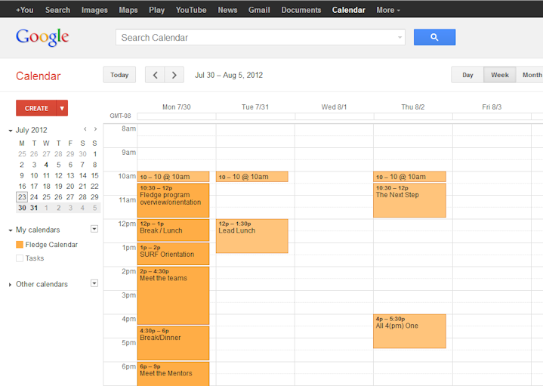
Fledge Google Calendar
calendar.fledge.co
Notes:
Plans change, and that includes the calendar of events at Fledge. To help ensure everyone knows when the events are happening, we have a shared, online Google Calendar.

Slide 3
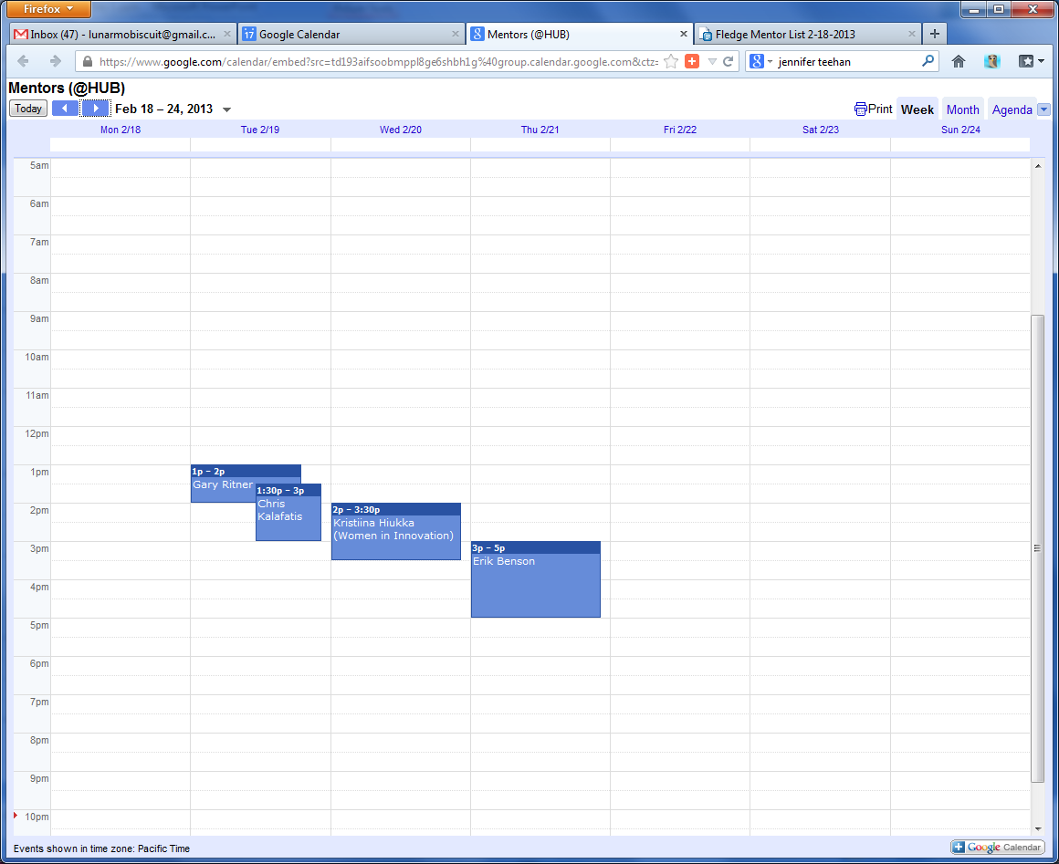
Mentor Google Calendar
https://fledge.co/mentor-calendar
Notes:
To help ensure you don’t miss a mentor meeting, we have a separate share calendar for mentors.

Slide 4

Google Drive
Notes:
To share documents, we have a shared Google Drive.

Slide 5
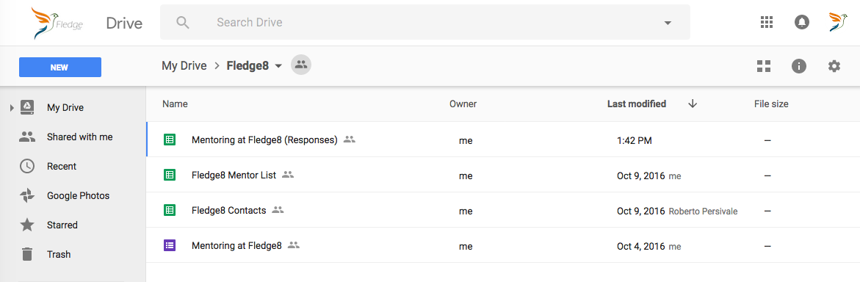
Google Drive
Notes:
In that drive you’ll find the Contact list for this cohort, the form we sent to the mentors, all the responses from that form, and soon we’ll add a list of all the mentors for you to peruse for additional connections

Slide 6
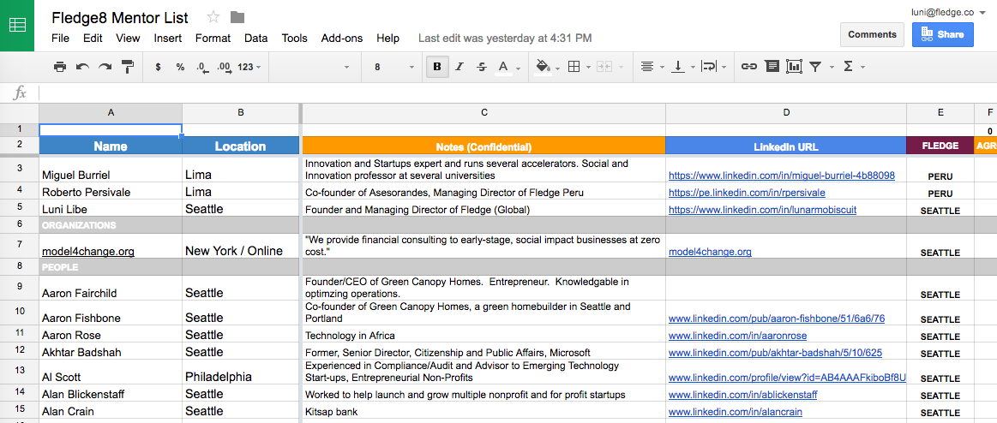
Mentor List
Notes:
That mentor list has over 600 entries. Most with a 1-line description of how they can help you. Most with a link to the mentor’s LinkedIn profile.
Remember that fact about the more you put in the more you get out. Some fledglings look at hundreds of LinkedIn profiles. Feel free to do the same.

