Slide 1


Slide 2

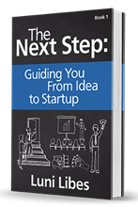
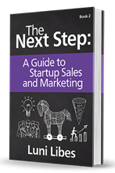
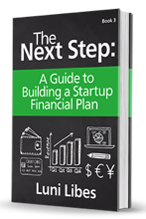

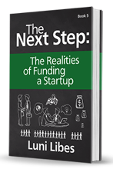


Slide 3
Overview
IDEA
Problem
Solution
Customer
Product
Market
Competition
Pricing
Uniqueness
Financials
Marketing
Team
The Pitch
Funding
The Launch
STARTUP

Slide 4
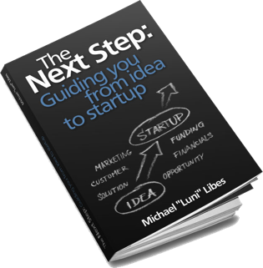
Step 1. Why
Why are you doing this?
What do you expect your company to look like in 5 years? ($1 million, $10 million, or $100 million in sales? How many employees?)
What do you personally want to be doing in 5 years? 3 years? 2 years? Next year? (CEO, CTO, sales, product development, advisor to the company, etc.)
At work, what makes you happy? Excited? Eager to start a new day?
Notes:
Before proceeding into the business plan, first step back and answer a few very important questions…
You might want to be the next Facebook, the next Apple, the next Whole Foods, but you may not have the funding to reach that goal, but at the same time, you may want to just create a company of 5 people, or 10, or 100, and you should make that size part of your plan, and keep it in mind as you answer the rest of these questions…
Not all companies need to be 10’s of thousands of employees. In fact, most are not.
What do you personally want to be doing in 5 years, 3 years, next year? The founder is often the CEO of the company, but not always. What are your skills, what are your weaknesses?
How many people do you feel comfortable managing?
Lastly, looking back at your career… what makes you happy? What makes you excited? It’s best if you can focus on that, and hire others to do the work that you do not enjoy. Hire these people either as co-founders, as employees, or as consultants or contractors.

Slide 5
Step 2. Help?
You have an idea, that was the easy part…
Can you do this yourself, or
should you seek help?
Notes:
The idea really is the easy part. It may feel otherwise. Most entrepreneurs feel like their idea is the one that will change the world, that if they share the idea, it is so great that others will steal it and run with it. In reality, that rarely happens, as coming up with the idea is actually the easy part, no matter how hard it may have seemed. The fact is (with a few exceptions aside) that it takes years of effort to create a success company. The fact is that it usually takes a bunch of people working long hours to make a company succeed.
So… the question at hand is… at this early stage, can you alone, or you and your partners get moving forward, or do you need additional help?
Help, as in people who can fill in gaps in your knowledge, or your experience.
Again, starting a company is a crazy thing to do. It takes all of everyone’s time who is involved. If you need help, seek help.

Slide 6
Step 3. Excitement & Passion
Is this idea so exciting, you can't sleep at night?
  Do you wake up in the morning eager to get going?
  Do you think about solutions to the day’s issue in your morning shower?
  After a long day at work, are you ready to continue?
  Do you think about the days’ successes and failures as you doze off to sleep at night?
  Do you bore your friends talking about your company?
Notes:
Is your idea so exciting that you think about it every morning and every night.
This chapter came about from a conversation in a coffee shop, where I met an entrepreneur (I meet entrepreneurs over coffee quite often)…
If this idea is not “all consuming” in your life, then seek a different idea.
The reason you need such excitement and passion is that you need that drive to make it through the startup process. It is difficult. There will be massive hurdles to overcome. And the drive to see this idea through to reality is the only thing you have to make it over those hurdles.
To be clear, this passion needs to be so strong that you not only think about this idea all the time, but talk about it with your friends all the time. For example, at my wedding…

Slide 7
Step 4. The Problem
Describe the problem you are solving.
Within 5 minutes, in layman’s terms… 1 minute… 1 sentence
IDEA
Problem
Notes:
Finally, we begin the actual planning process.
We do that by breaking the “idea” into multiple components, the first of which is “the problem”.
In less than five minutes, can you describe the problem you are solving. WITHOUT MENTIONING ANY SOLUTION!
Can you describe it in one paragraph?
One sentence?

Slide 8
Step 5. Whose Problem?
Who are the people with the problem?
  One, two, or three-sided business?
  Do they know they have a problem?
  How do they solve this problem today?
Notes:
Great, now we know what they problem is… WHO’S problem is it?!
Usually, the problem is not problem for all seven billion people on Earth.
Who are these people? Where do they live? What do they do?
Sometimes, you have a business where you serve multiple types of customers, with your company in the middle, and you are solving problems for each of these groups.
Sometimes, you are selling to a business, an organization, or to the govn’t. If so, remember these entities are just collections of people. People in specific roles. So… which people within those organization have this problem? What role do they play for their organization?
Do all these people know they have this problem?
How are they solving this problem today?
Often, entrepreneurs say that no one is solving this problem today (which is a wrong answer we’ll get to later), but to the point, of no one is solving this problem it may be that the people with the problem know about it, but it isn’t sufficiently large to do anything about. Or at least not sufficiently bothersome to pay someone to fix it.

Slide 9

Customer
Pain?
fears
frustrations
obstacles
Gain?
wants/needs
efficiency benefits
social benefits

Slide 10
Customer (Empathy Map)
Think & Feel?
preoccupations
worries, concerns
Hear?
boss / spouse
co-workers
influencers
See?
environment
market
Say & Do?
attitude, appearance,
behavior

Slide 11

Step 6. An Important Problem?
Hugh MacCleod
Notes:
Back to Hugh MacCleod… life is too short not to do something that matters.
I used to say… “you might as well do something large as small…”
Thank to my work at Bainbridge Graduate Institute, #SocEnt Weekend, and Michael "Luni" Libes, I now say… “you might as well do something important…”
IT TAKES THE SAME AMOUNT OF EFFORT

Slide 12
Step 6. An Important Problem?
Are you solving an important problem?
  Solves an environmental issue?
  Solves a health-related issue?
  Solves a community-related issue?
  Does more than save time or kill time?
Will your solution create more problems than it solves?
  List the positive and negative externalities
Notes:
Are you just saving someone a minute or saving them a dollar, or are you making the world better?
What big problem are you solving?
And then… as you work through your plan… make sure you are not doing more harm than good.
For example… 100 years ago, cars solved an important problem. There was tons of manure in the streets. There were dead horses left rotting in the streets. Cars solved this problems. And at first this was great… but with 100’s of millions of cars, the “net impact” of this solution does not seem to be positive for the planet.

Slide 13
Step 7. Your Solution
Describe your solution.
Within 5 minutes, without jargon… 1 minute… 1 sentence
IDEA
Problem
Solution
Notes:
Finally, we begin the actual planning process.
We do that by breaking the “idea” into multiple components, the first of which is “the problem”.
In less than five minutes, can you describe the problem you are solving. WITHOUT MENTIONING ANY SOLUTION!
Can you describe it in one paragraph?
One sentence?

Slide 14
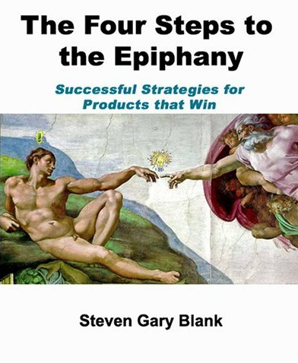
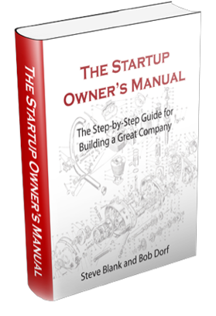
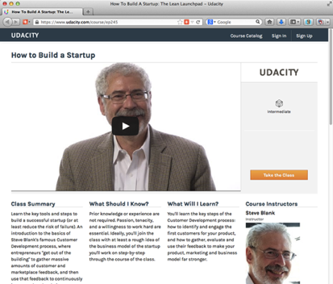
The Four Steps to the Epiphany
Steve Blank
  Startup Owner’s Manual
  Lean Launchpad

Slide 15
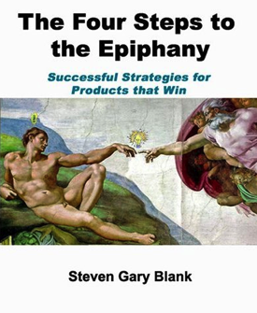
Product Development Model
Research
Design
Build
Alpha/Beta-test
Launch
Hope

Slide 16
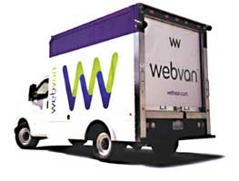
E.g. Webvan

Slide 17
Lack of…
Few startups fail due to
lack of product
Most startup failures due to
lack of customers

Slide 18

Customer Development Model
Customer Discovery
Customer Validation
Customer Creation
Company Building

Slide 19
Customer Discovery
The potential customers
  Who are they?
  What do they do?
  What do they need?
  What are their pains?
  What gains do they seek?
Customer Discovery

Slide 20

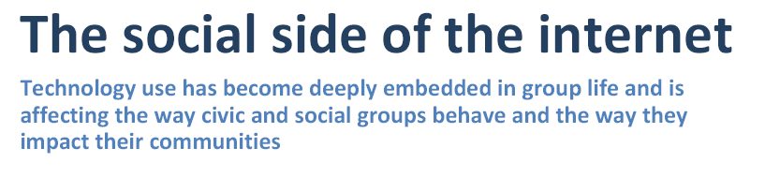
Online Research
Customer Discovery

Slide 21
Get
Outside the Building
And Talk to Them

Slide 22
Customer Interviews
Get out of the building!
  Create a list of question
  Get answers
  Refine
  Repeat
Customer Discovery

Slide 23
Not One
Not Three
10, 20, 50, or MORE for a web service, 500.. 1,000.. 10,000

Slide 24
Proceed or Iterate?
Customer Discovery
Customer Validation
Customer Creation
Company Building

Slide 25
Customer Validation
Talk to potential customers
  Did you hear them correctly?
  Will they buy your product?
  If free? $1 million?
  What is missing from your proposed product?
Customer Validation

Slide 26
(Quick) Paths to Validation
SurveyMonkey
Facebook
Twitter
wufoo.com
Feedback
Data
Brainstorm
Gather quick opinions
Talk to potential stakeholders
Quora
polldaddy.com
Google
aytm.com

Slide 27
AND Get
”Outside the Building”
And Talk to Them

Slide 28
Get
”Outside the Building”
And Talk to Them
5, 10, 25, 50 potential customers for a web service, 5,000.. 10,000.. 50,000

Slide 29
Proceed, Iterate or Pivot?
Customer Discovery
Customer Validation
Customer Creation
Company Building

Slide 30
The Second Half
Customer Discovery
Customer Validation
Customer Creation
Company Building

Slide 31
Customer Creation
Talk to potential customers
  Present the (validated) sales pitch
  Did that work?
    If no, iterate
    If yes, iterate
  Are the customers eager to buy?
    Do they want to buy the MVP?
    Are they thrusting their money upon you?
Customer Creation

Slide 32
Company Building
Recruit the team
(sales & marketing)
Sell the product
Increase revenues
a.k.a. only then build the company
Company Building

Slide 33
Customer Development Model
Customer Discovery
Customer Validation
Customer Creation
Company Building

Slide 34
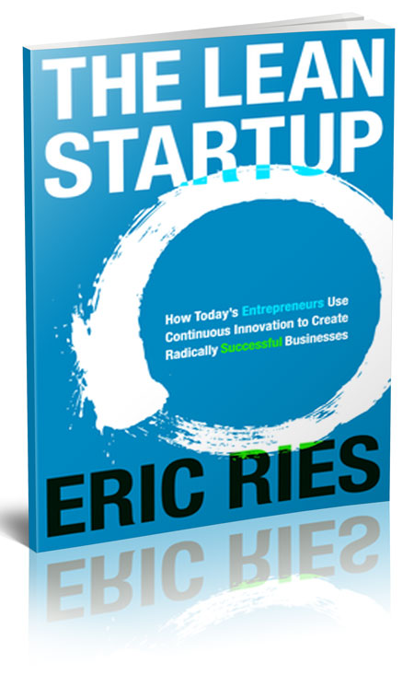
“The Lean Startup” by Eric Ries

Slide 35
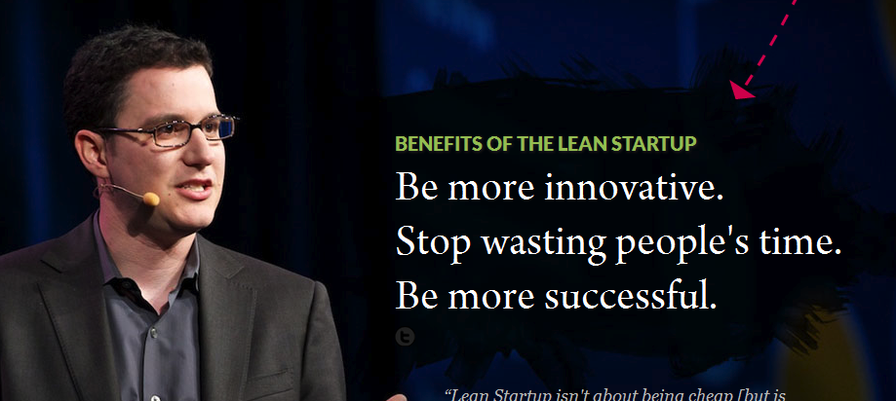
Benefits

Slide 36
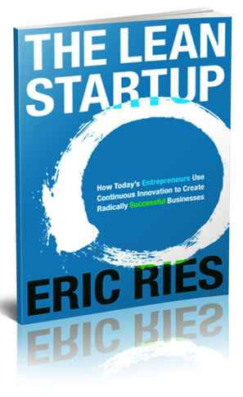
Failure?
Why do startups fail?
  Bad assumptions
  Wrong product
  Poor sales/marketing
  All of which point to…
  Too good of a plan

Slide 37
Entrepreneurial Management
Too often considered an oxymoron
It is true:
  General management practices do not often apply to startups
So…
  Apply relevant practices

Slide 38
Scientific Method
Create a hypothesis
  Forms a prediction
Test the hypothesis
  Were you right?

Slide 39
Two Hypothesis
Value Hypothesis
  Is my product useful/valuable?
Growth Hypothesis
  Is there a market for the product?

Slide 40
Iterate
Hypothesis
Create
Launch
Measure
Learn
Notes:
And the key is that launching the MVP is not the goal. The goal of launching the MVP is to prove or disprove your hypothesis, to learn something about the market, to make your product better, to create a new hypothesis and repeat this process… as quickly as possible.
Successful companies are those that optimize this loop, iterating this process repeatedly, at as fast a pace as the company can operate.
For Facebook, they ship every Tuesday, 50 times per year. For other companies, it’s monthly. For those with long sales cycles, it can be quarterly, or even yearly. The longer this cycle, the less you’ll learn, and thus the less chance you’ll have for success. The lesson is to push hard to iterate with small changes as often as you can.

Slide 41
Begin with an MVP
Start with a
minimally viable product (MVP)
  Minimum of features
  But still viable a.k.a. sellable

Slide 42







Groupon MVP
Hand-built blog
Cheap database
Emailed PDFs

Slide 43




Zappos MVP
Pictures of shoes from local stores
Hand-built web site
Great service

Slide 44


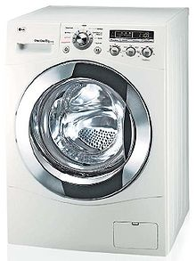
Village Laundry Service MVP
Pickup track
Washing machines
Brought to India villages

Slide 45

Dropbox MVP?

Slide 46
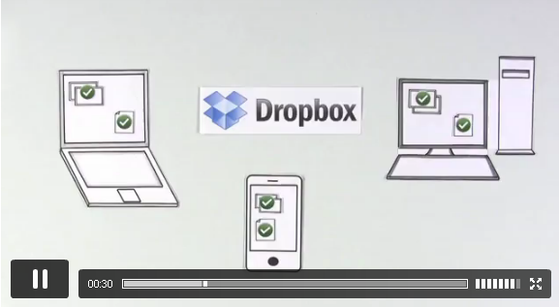
Dropbox MVP
4 minute video

Slide 47

Arrow MVP?

Slide 48
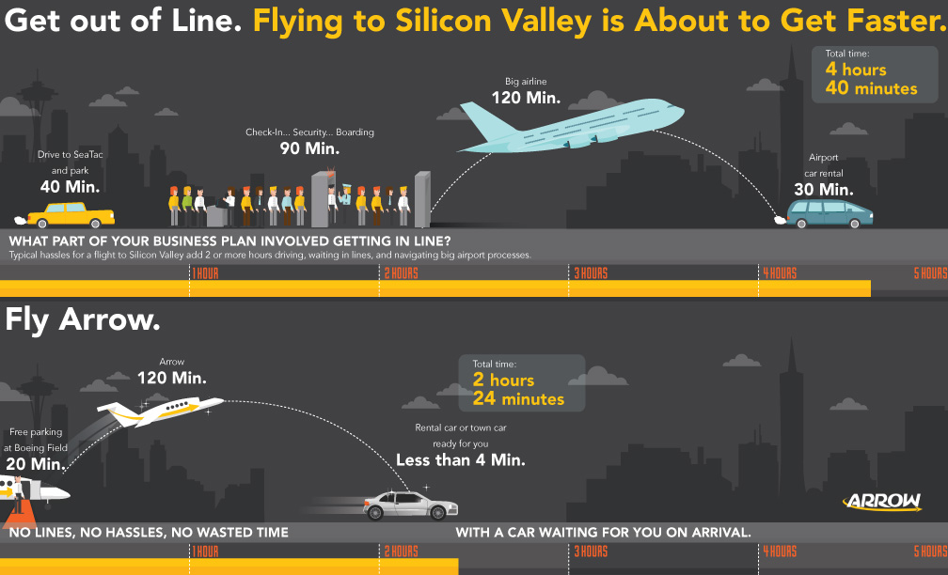
Arrow MVP

Slide 49
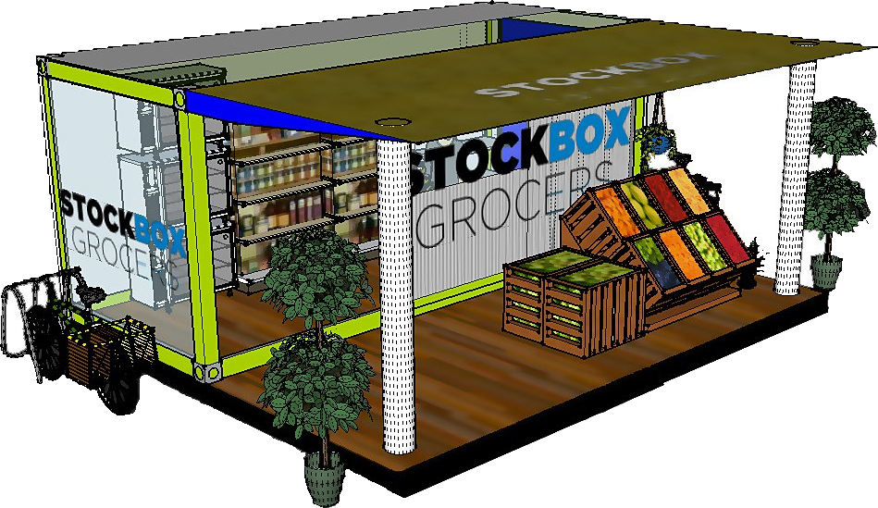
Stockbox MVP?

Slide 50
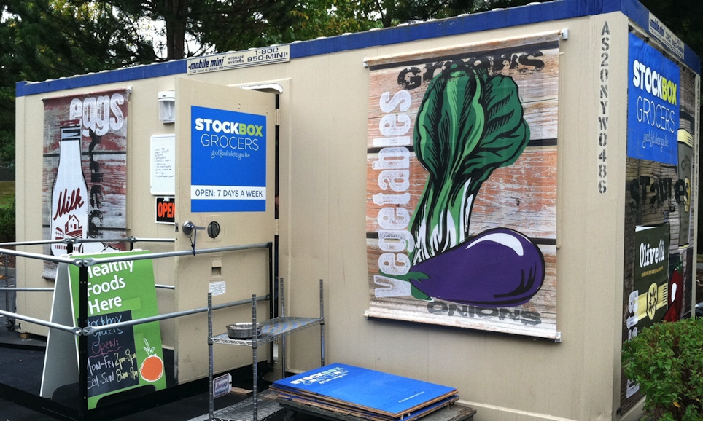
Stockbox Prototype

Slide 51
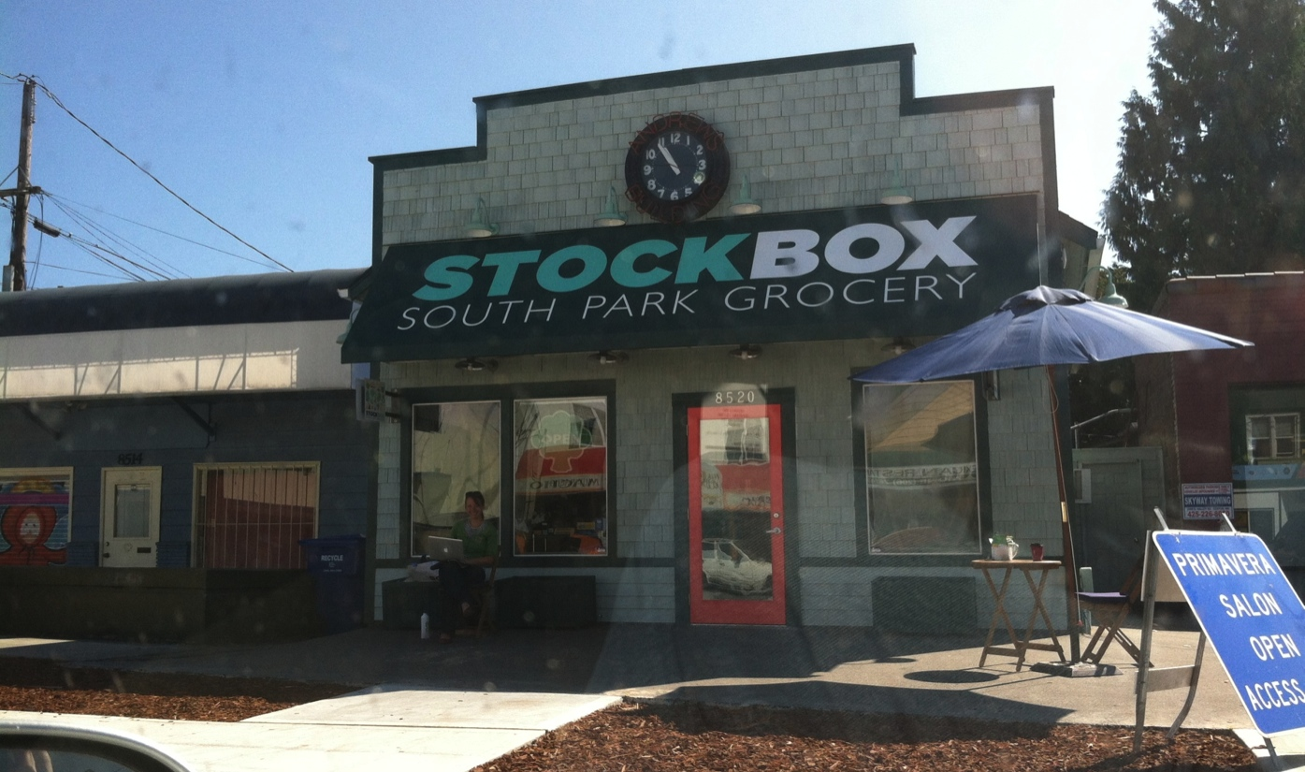
1st Stockbox Grocery

Slide 52

2nd Stockbox Grocery

Slide 53
Iterate
Iterate as quickly as possible
  Facebook ships every Tuesday
  50 iterations per year
Test, try, retest, retry
  Google runs hundreds of experiments

Slide 54
Validated Learning
Validated learning is the key
measure of progress for startups
  “Progress in manufacturing is measured by the production of high quality goods. The unit of progress for Lean Startups is validated learning – a rigorous method for demonstrating progress when one is embedded in the soil of extreme uncertainty.”

Slide 55
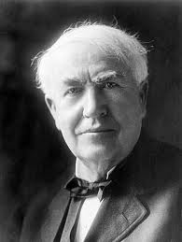
Tomas Edison
I am not discouraged, because every wrong attempt discarded is another step forward.
Many of life's failures are men who did not realize how close they were to success when they gave up.

Slide 56
Summary
IDEA
Problem
Solution
Customer
Notes:
Finally, we begin the actual planning process.
We do that by breaking the “idea” into multiple components, the first of which is “the problem”.
In less than five minutes, can you describe the problem you are solving. WITHOUT MENTIONING ANY SOLUTION!
Can you describe it in one paragraph?
One sentence?

Slide 57
Lesson
Ship!
Measure
Ship!
Hypothesis
Create
Do
Measure
Learn
Notes:
And the key is that launching the MVP is not the goal. The goal of launching the MVP is to prove or disprove your hypothesis, to learn something about the market, to make your product better, to create a new hypothesis and repeat this process… as quickly as possible.
Successful companies are those that optimize this loop, iterating this process repeatedly, at as fast a pace as the company can operate.
For Facebook, they ship every Tuesday, 50 times per year. For other companies, it’s monthly. For those with long sales cycles, it can be quarterly, or even yearly. The longer this cycle, the less you’ll learn, and thus the less chance you’ll have for success. The lesson is to push hard to iterate with small changes as often as you can.

Slide 58
Your Next Steps?
Talk to customers
  What are their needs, wants, desires?
What is your MVP?
  What hypothesis will it test?
  What is the measure of success?
How will you get your MVP in front of customers?
  By when and how many?

