Slide 1


Slide 2







Pitching
and
story telling

Slide 3
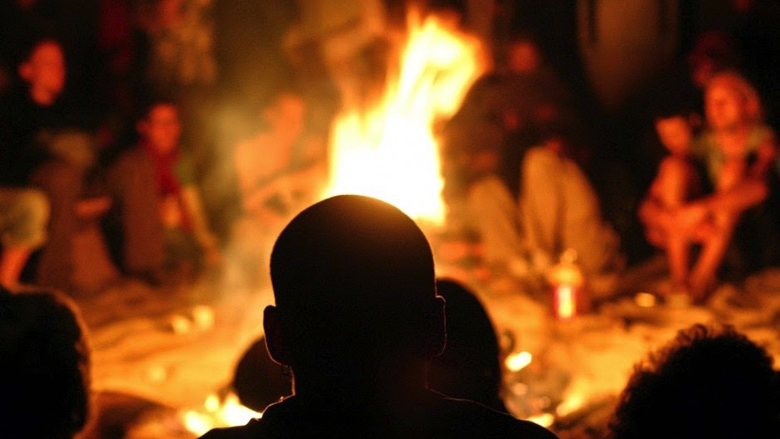

Slide 4
Storytelling
Once upon a time…
Naming is a
group exercise

Slide 5
Storytelling
Imagine a world where…
Naming is a
group exercise

Slide 6
Storytelling
A long time ago in a galaxy far,
far away
Naming is a
group exercise

Slide 7
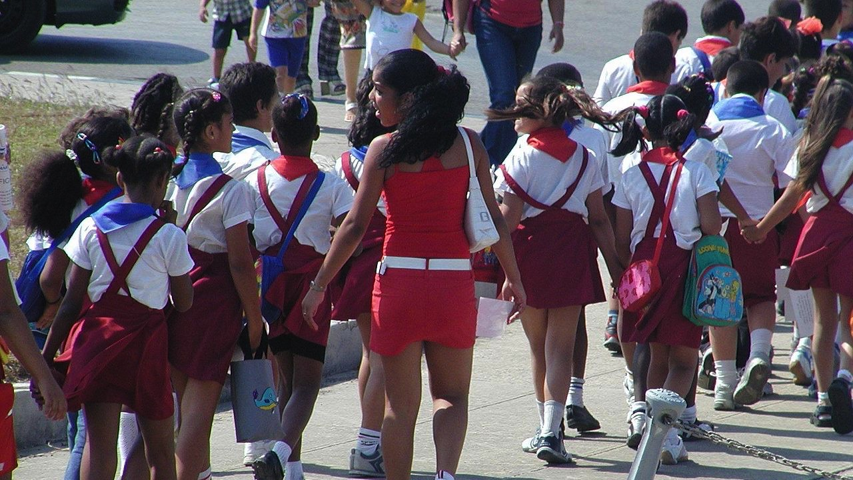

Slide 8
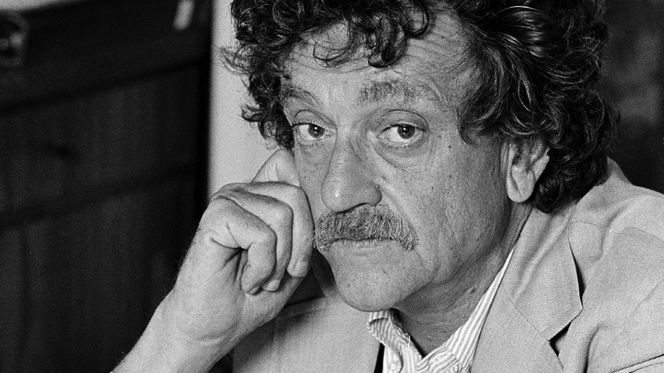

Slide 9
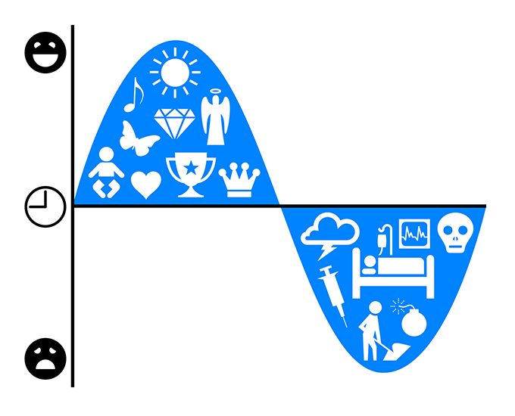
The Shapes of Stories

Slide 10
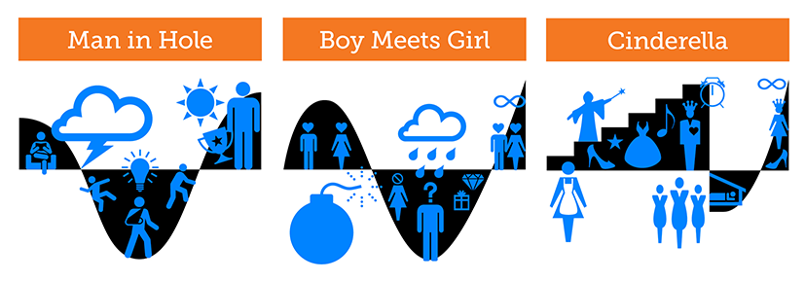
The Shapes of Stories

Slide 11
One hole!
Problem
Solution
Problem #2
Reprise the solution

Slide 12
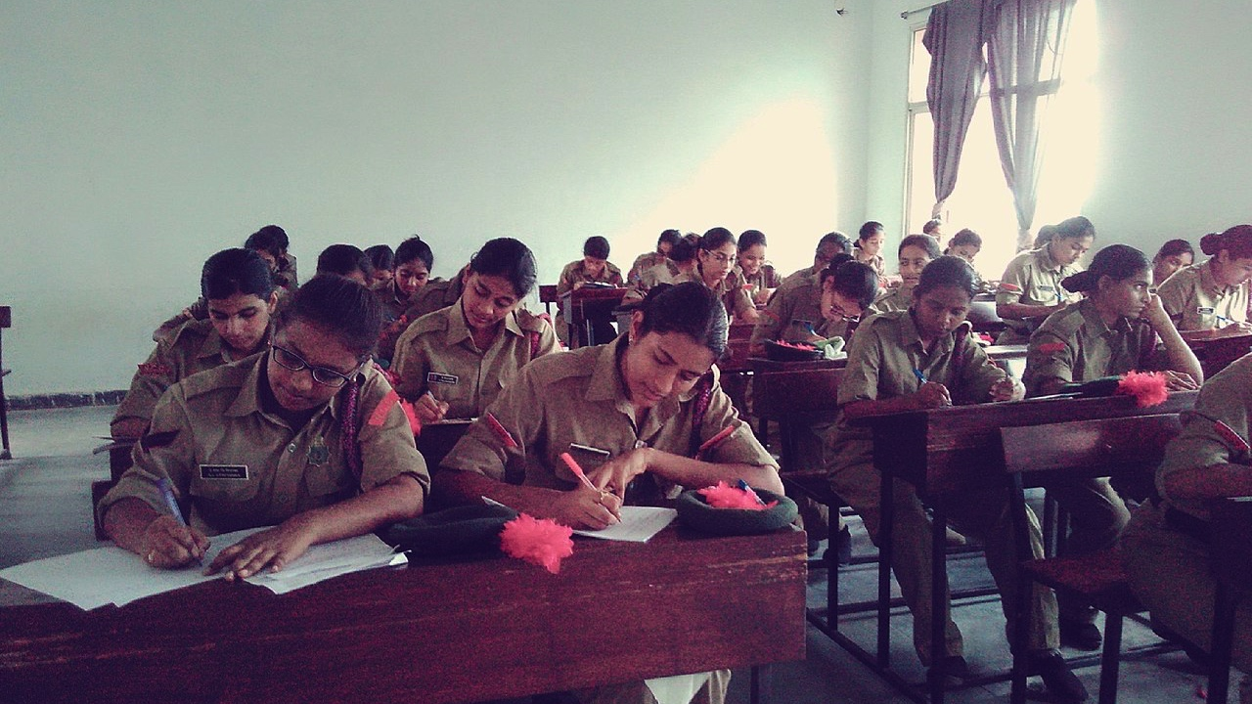

Not an essay!

Slide 13
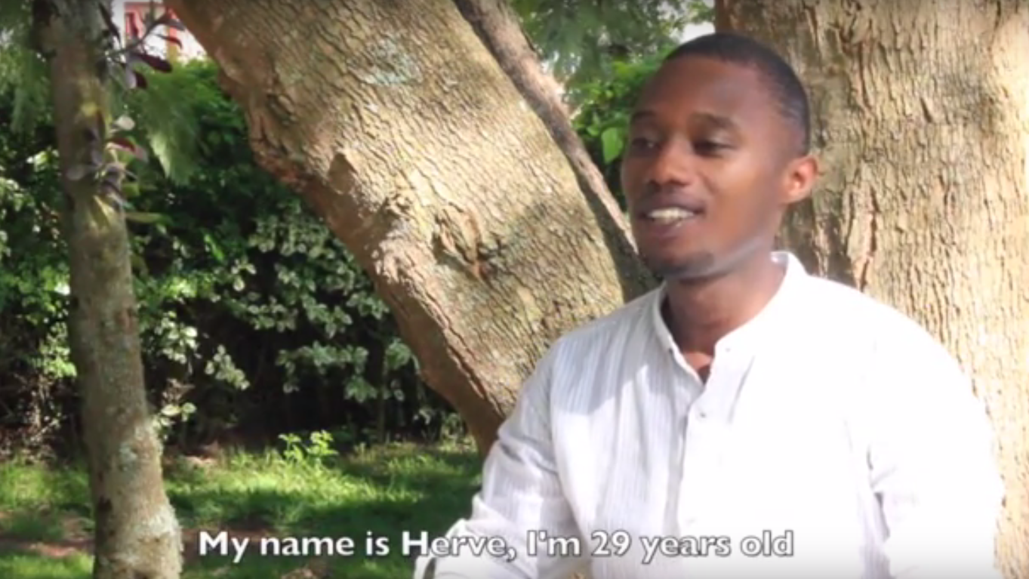
Herve

Slide 14
NOT an Essay!
Hello, my name is Herve Tuyishime. I am from Rwanda in East Africa. In my country we are 13m people, 90% living by agriculture 60% under the poverty line. In rural areas 70% of these farmers own at least one livestock: goat, sheep, pork, rabbit or cattle.

Slide 15
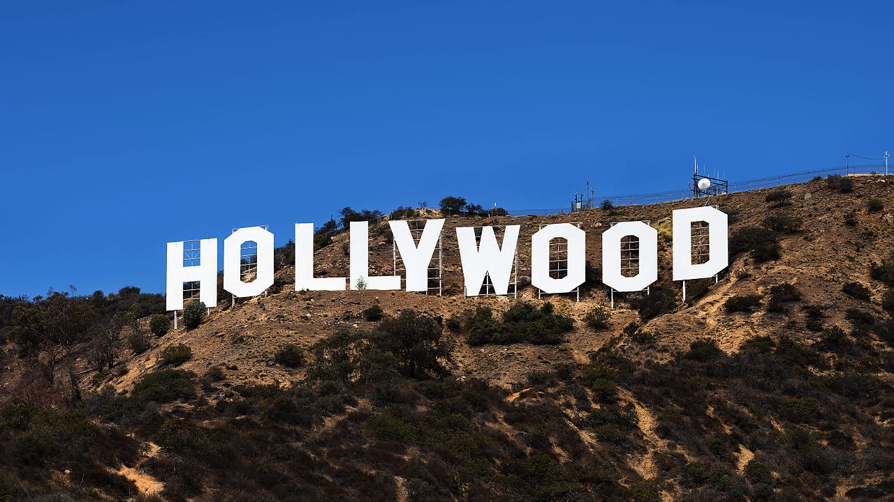

Slide 16
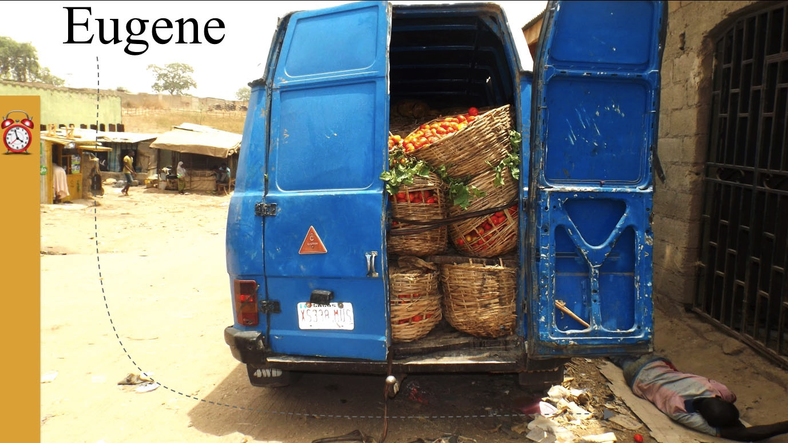

Slide 17

Notes:
it’s a problem happening all over Nairobi

Slide 18
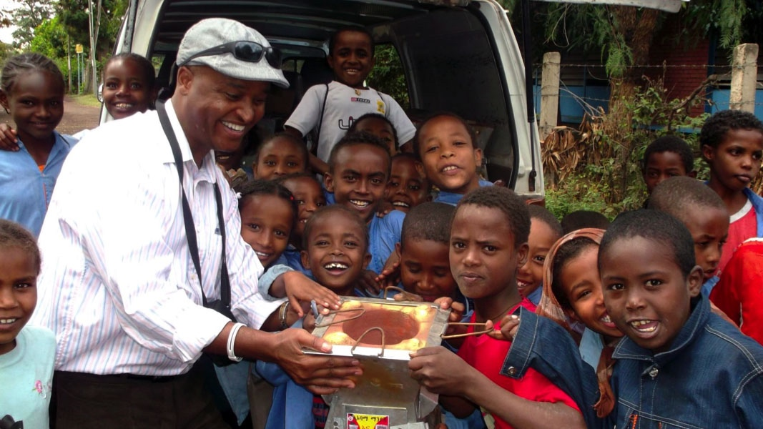

Slide 19

Begin in the MIDDLE

Slide 20

MULTIPLE Versions

Slide 21
Multiple Versions
Your best
Next best
Go Wild!
Write a first draft
Put it aside
Write a second draft, not looking at the first
Put it aside
You have two good drafts, so be creative.
Go wild!
Now you have at least three versions. Mix and match to turn your good idea into some great!

Slide 22




Slide 23


Slide 24

Zr
Zirconia
The end of rust
Notes:
[APPLAUSE]

Slide 25
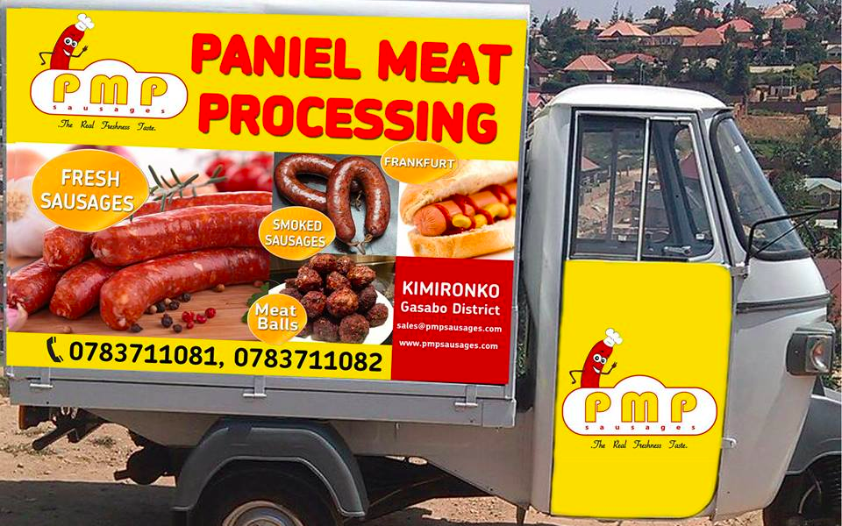


Slide 26
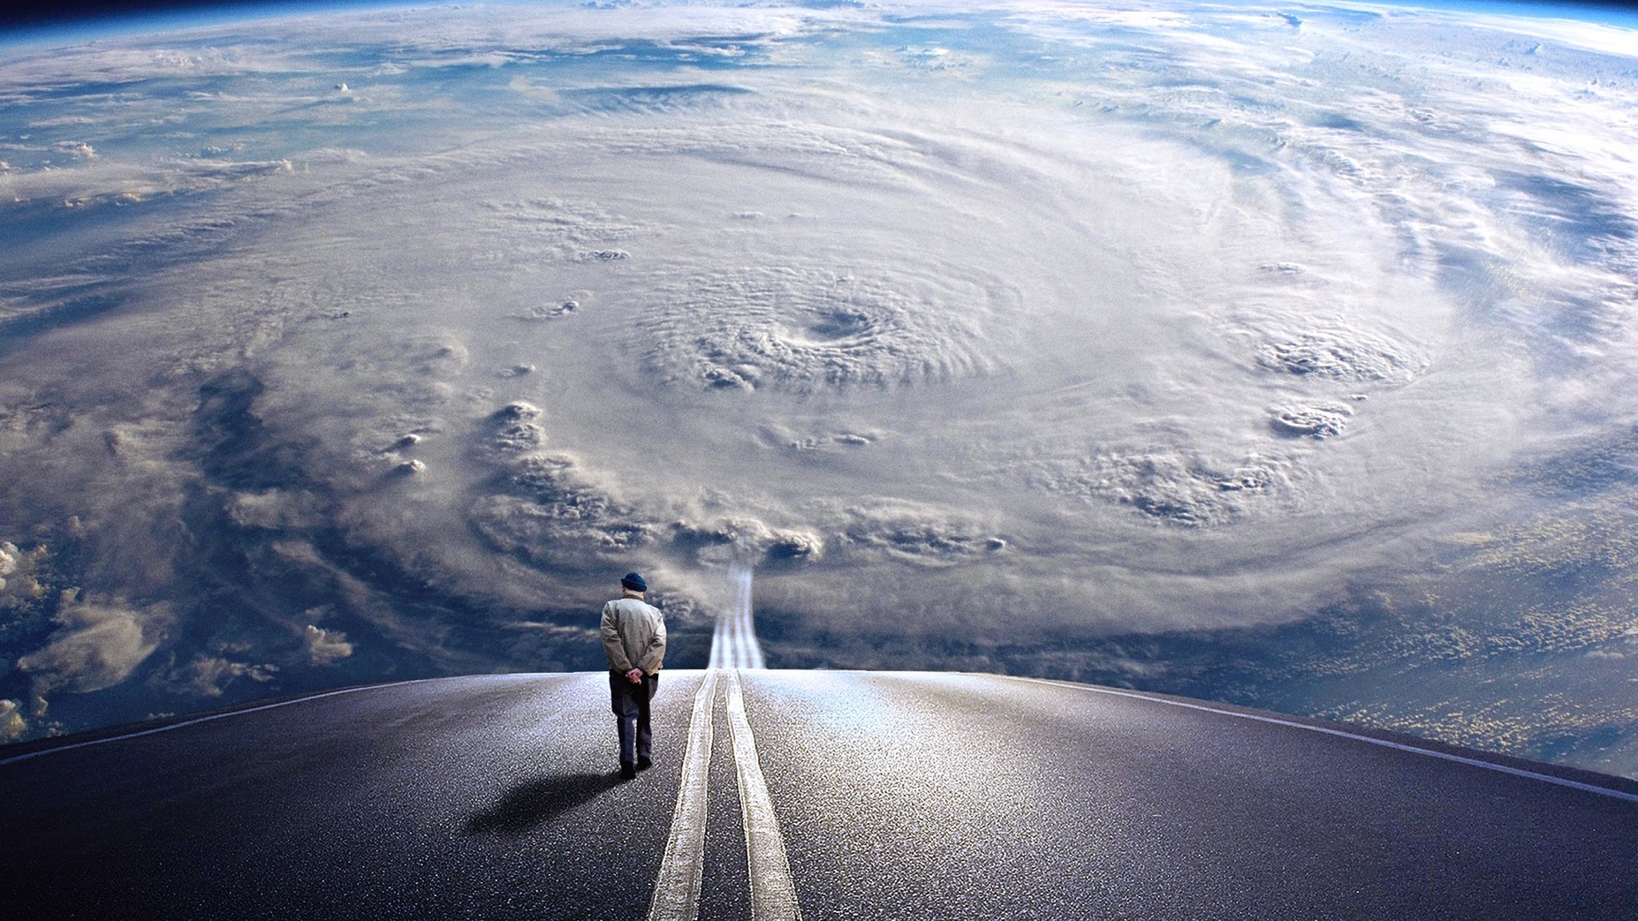
Suspense

Slide 27
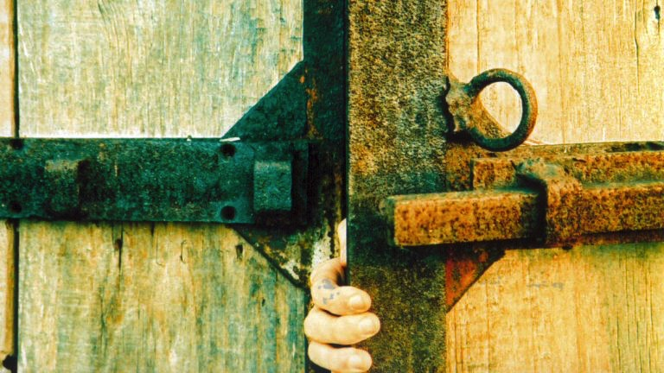

Slide 28
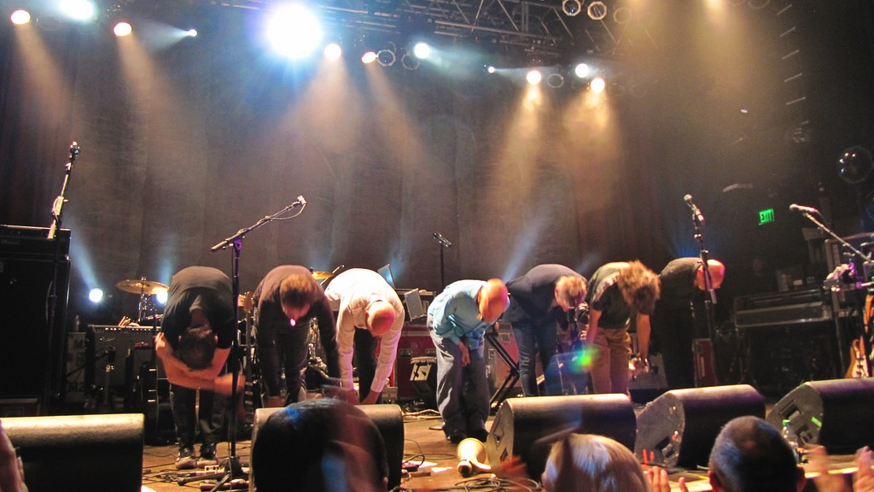

Slide 29


Slide 30
NO slides until after the story is written

Slide 31
NO READING the audience should be listening

Slide 32
Video slides can be much more compelling

Slide 33

youtube.com/FledgeLLC

Slide 34
