Slide 1


Slide 2

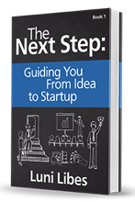
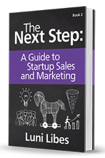
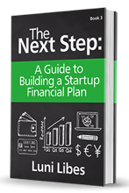
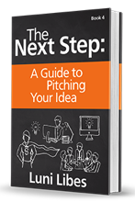
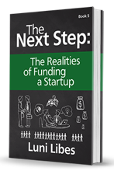
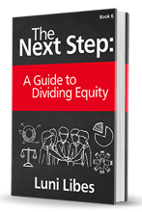

Slide 3
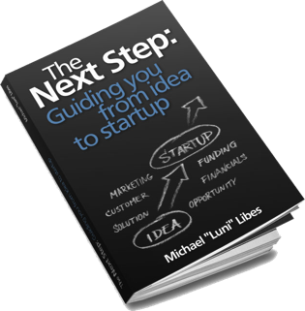
Step 13. Competition
What other companies are solving the same problem?
How does your product compare to the competition? How does it compare feature by feature?
How does the price of your product compare to the competition? Which pricing model are they using (high-price/high-service or low-price/low-service)?

Slide 4

American Red Cross
Competition & Competitive Advantage
Competition
iGive Blood
SG Blood
BloodCo
American Blood Centers
American
Red Cross
Phone application
Geography Based Alerts
Social Media
Push Notifications
Gamification
Scheduling
Geography Based Alerts
Social Media
Phone App
Notifications
Gamification
Notes:
The results of your competitive analysis can be summed up in a competitive matrix
This is a common method of displaying this information
To create one of these, put your company in the leftmost columnn, and 3 or 4 or 5 competitiors in other columns
These columns can either be specific competitors, or categories of competitors
Then think about 5 or 6 or 7 key benefits of your solution and all your competitors solutions, and list them out in rows.
Do note that while it is reasonable to list the companies as rows and benefits as columns, for some reason, these diagrams are far easier to read when the companies are in the columns, so avoid that misstep and do it this way.

Slide 5
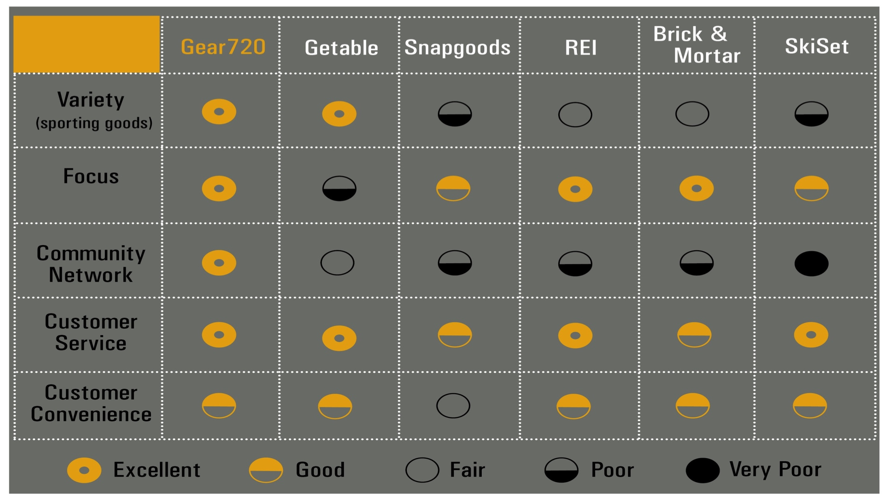
Notes:
The competitive matrx can be a bit more complex, rating each customer benefit, using “Harvey Balls” like you’ve seen on Consumer Reports
Note that when you pick the customer benefits, do so such that your companies does not do everything, or at last is not listed as doing everything perfectly. If you do that, then the investors, potential buyers, etc. will discount your analysis, and wonder what you left out that your competitors do better than you.
In the previous example, the company claims to do everything better than the competition. Here, the last benefit is only rated as Good, and that alone makes this matrix more believable. Even more believable would be a benefit that the company does not do at all, which you then point out when presenting this matrix as being far less important than the other benefits.

Slide 6
 | Concrete Flywheel | Active Power | Pentadyne | Beacon | R&D Solutions
Kinetic-based storage | ✓ | ✓ | ✓ | ✓
“Instant” input & output | ✓ | ✓ | ✓ | ✓ | ✓
Industrial-scale | ✓ | ✓ | ✓ | ✓ | ✓
Low-tech (low cost) | ✓ |  |  |  | ✓
High-tech (high cost) |  | ✓ | ✓ | ✓
Government loans |  |  |  | ✓

Slide 7
 | Concrete Flywheel | Active Power | Pentadyne | Beacon | R&D Solutions
Kinetic-based storage | ✓ | ✓ | ✓ | ✓
“Instant” input & output | ✓ | ✓ | ✓ | ✓ | ✓
Industrial-scale | ✓ | ✓ | ✓ | ✓ | ✓
Low-tech (low cost) | ✓ |  |  |  | ✓
High-tech (high cost) |  | ✓ | ✓ | ✓
Government loans |  |  |  | ✓

Slide 8
 | Concrete Flywheel | Active Power | Pentadyne | Beacon | R&D Solutions
Kinetic-based storage
“Instant” input & output
Industrial-scale
Low-tech (low cost)
High-tech (high cost)
Government loans

Slide 9
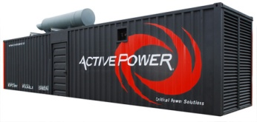


Competition
Concrete
Battery
Low-cost
Pumped Water
Pb Batteries
Low-tech
High-tech
Compressed Air
Li-Ion Batteries
High-cost

Slide 10
Step 14. Uniqueness
What is unique about your solution?
a.k.a. your secret sauce?
What do you do better than anyone else?

Slide 11
Step 15. Sustainable Advantage
What is the long term, sustainable, competitive advantage?
  Patents
  Contracts (customers, partners, vendors)
  Scale (pricing, market share, mind share)
  Network effect
  Experience

