Slide 1


Slide 2

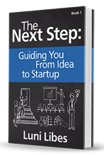
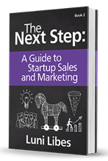
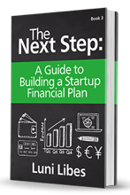
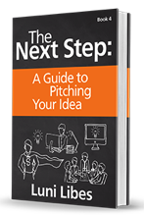
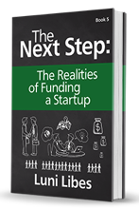
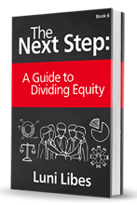

Slide 3
The Next Step
Plan B
http://lunarmobiscuit.com/the-next-step
Notes:
The second half of The Next Step, Book #1 uses The Business Model Canvas to help you find your Plan B

Slide 4
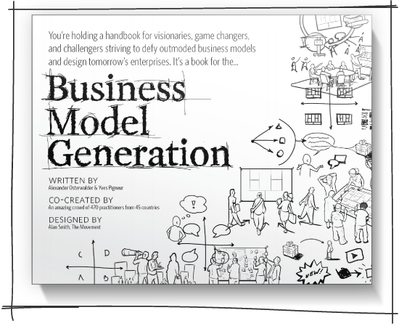
Notes:
The Business Model Canvas is described in this book, Business Model Generation

Slide 5
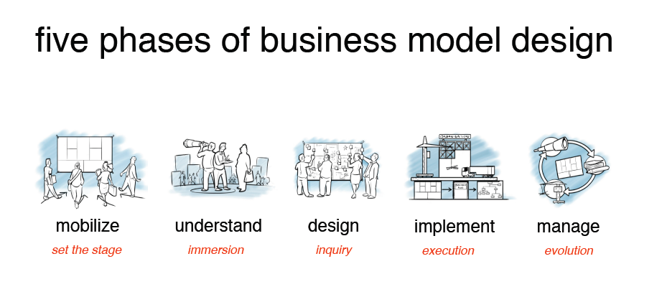
Notes:
The Canvas was designed to help document business models. It’s not a complete business plan. The book talks a bit about iteration, but doesn’t really tell you what to do with your Canvas once it’s done. This lesson will show you a highly useful process for that tool.

Slide 6
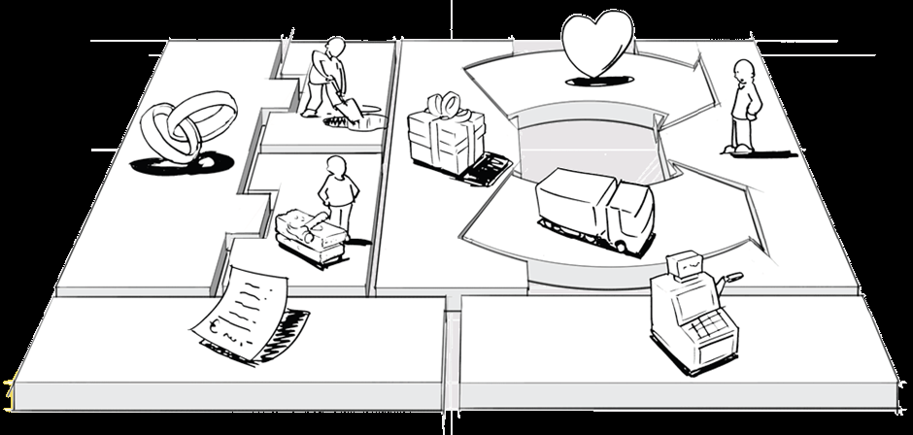
The Business Model Canvas

Slide 7
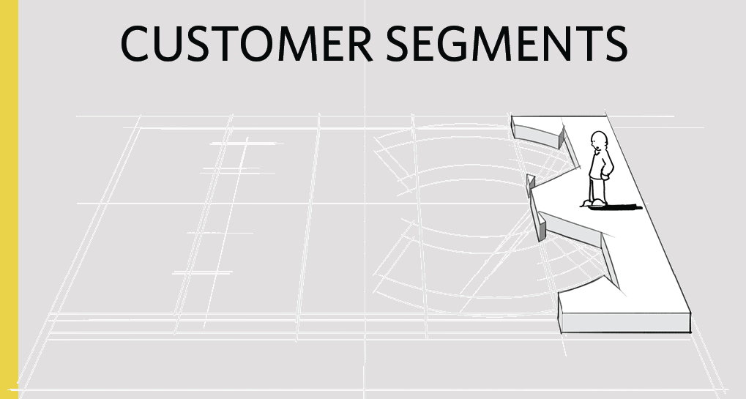


Slide 8
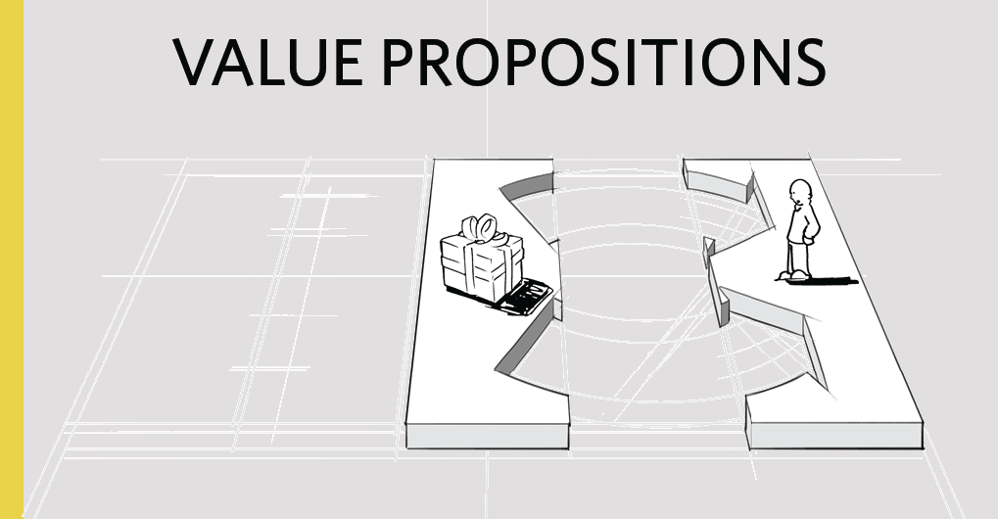


Slide 9
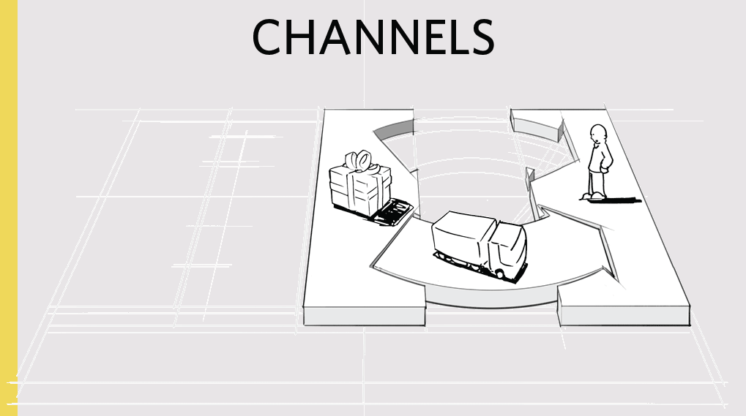

Slide 10
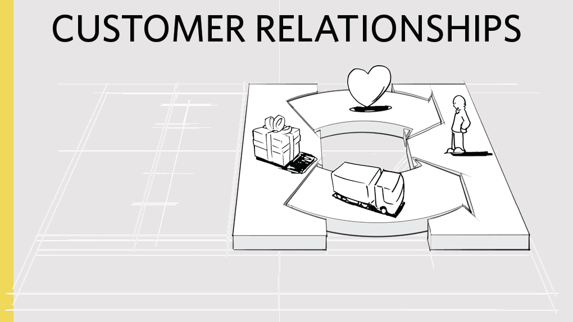

Slide 11
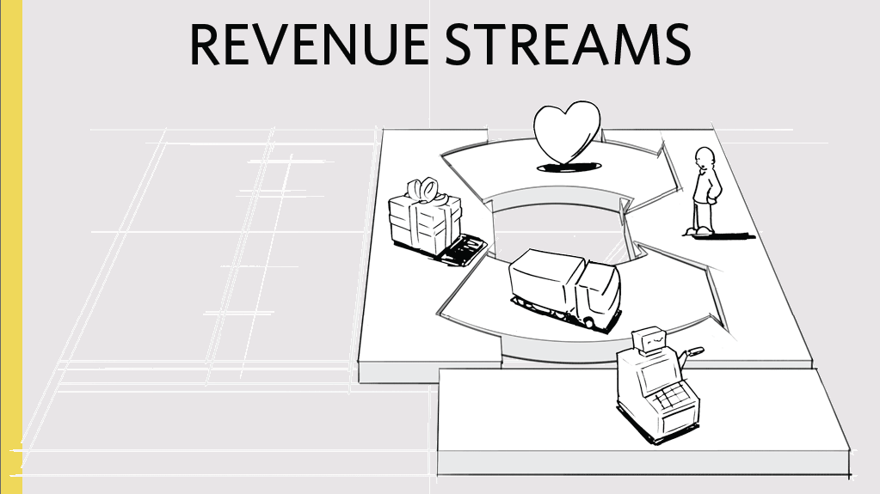

Slide 12
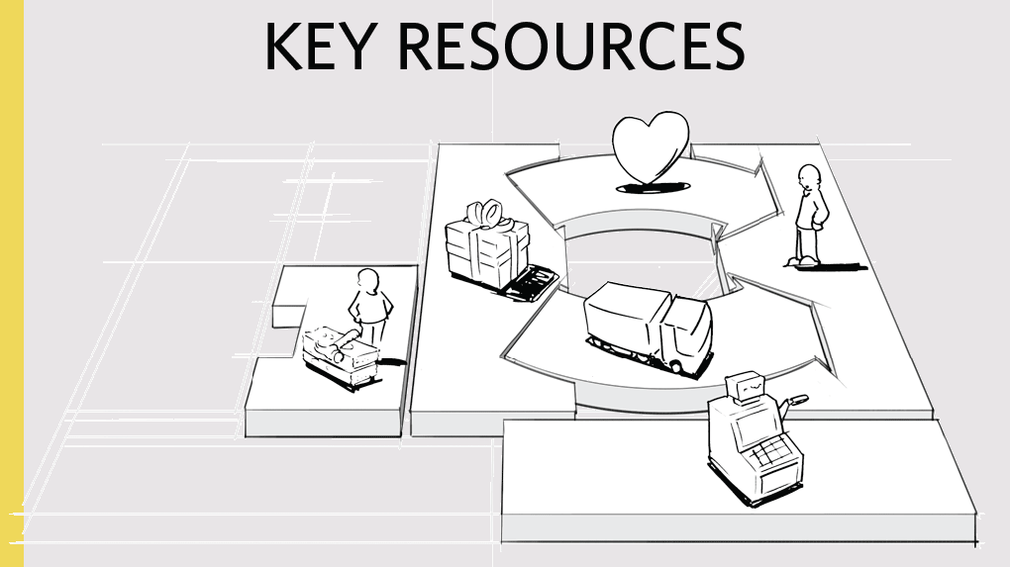

Slide 13
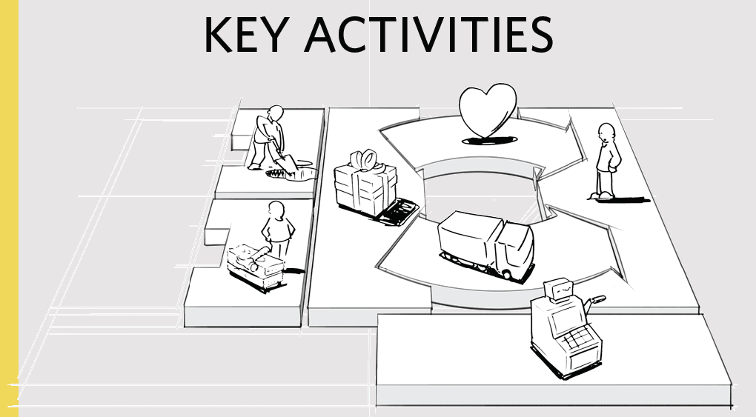

Slide 14
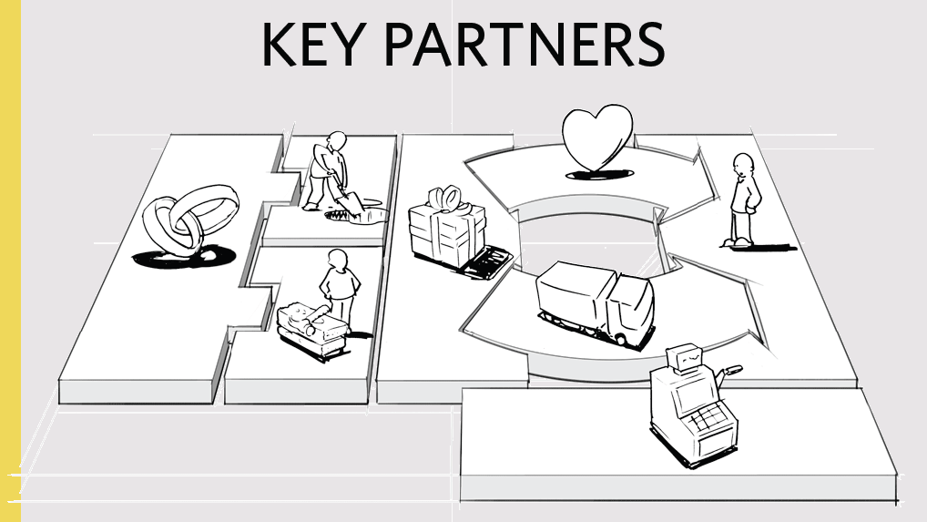

Slide 15
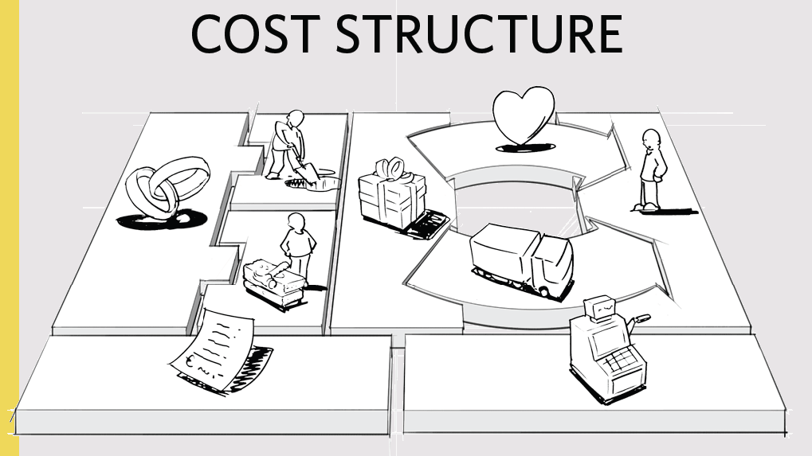

Slide 16
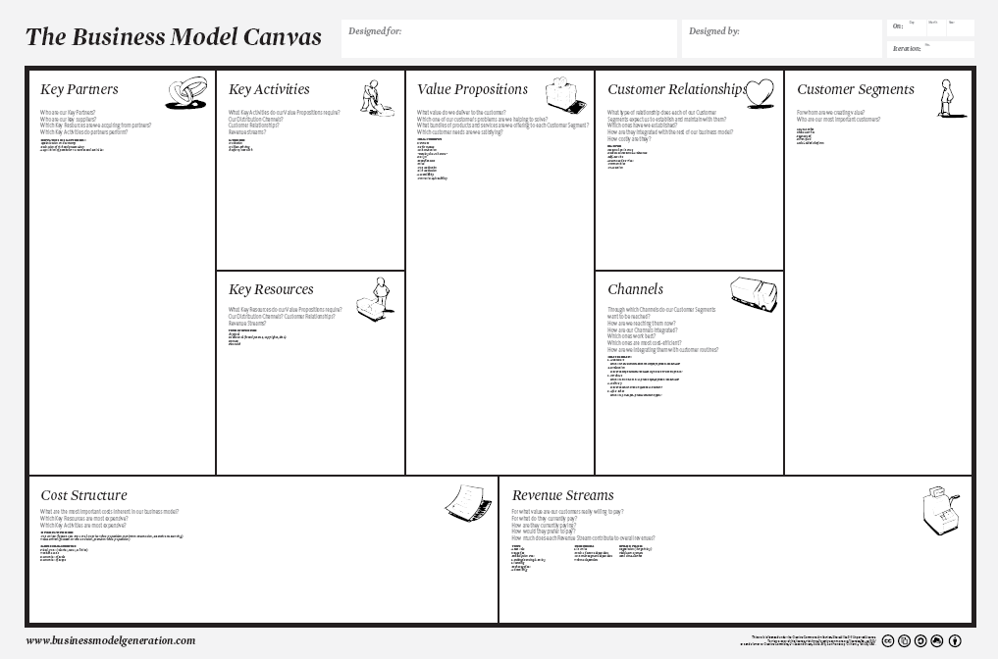

Slide 17
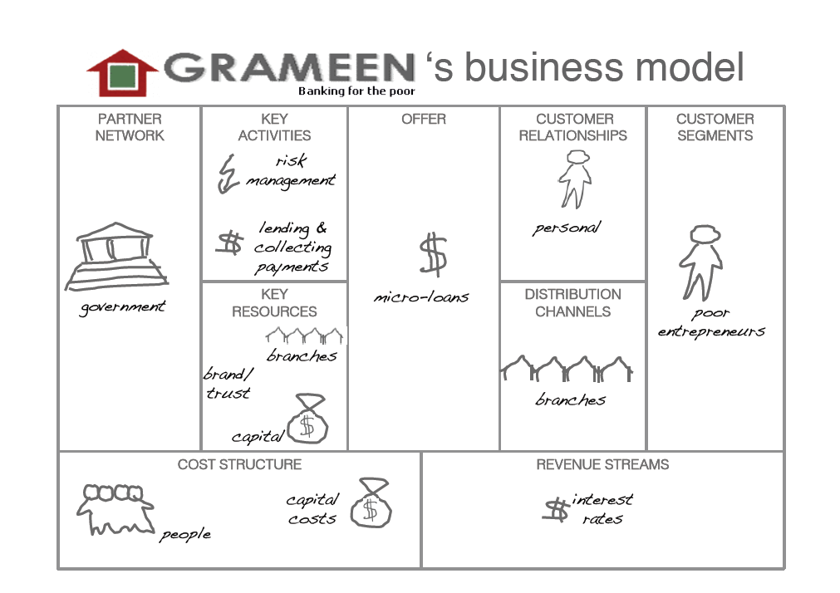
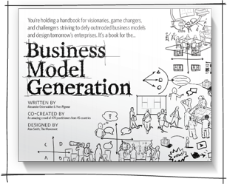

Slide 18
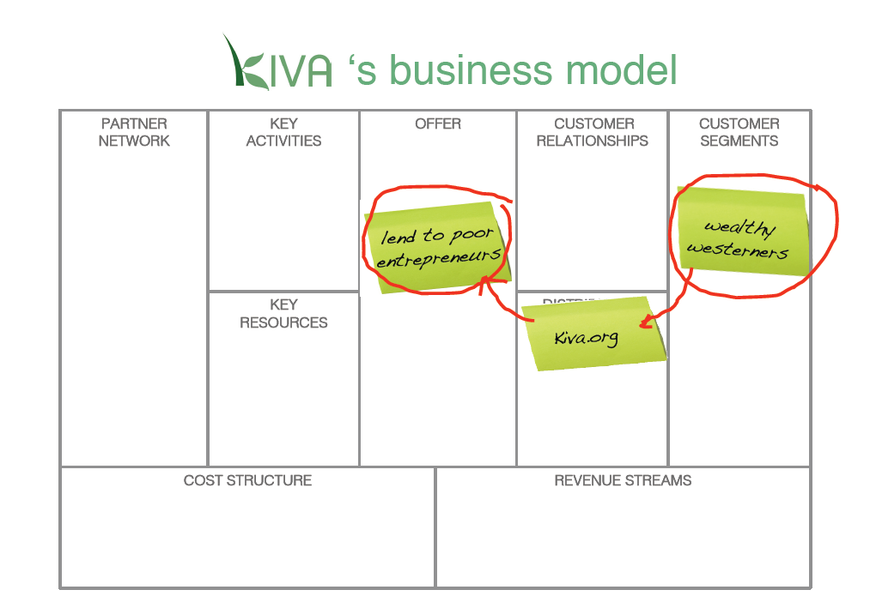

Slide 19
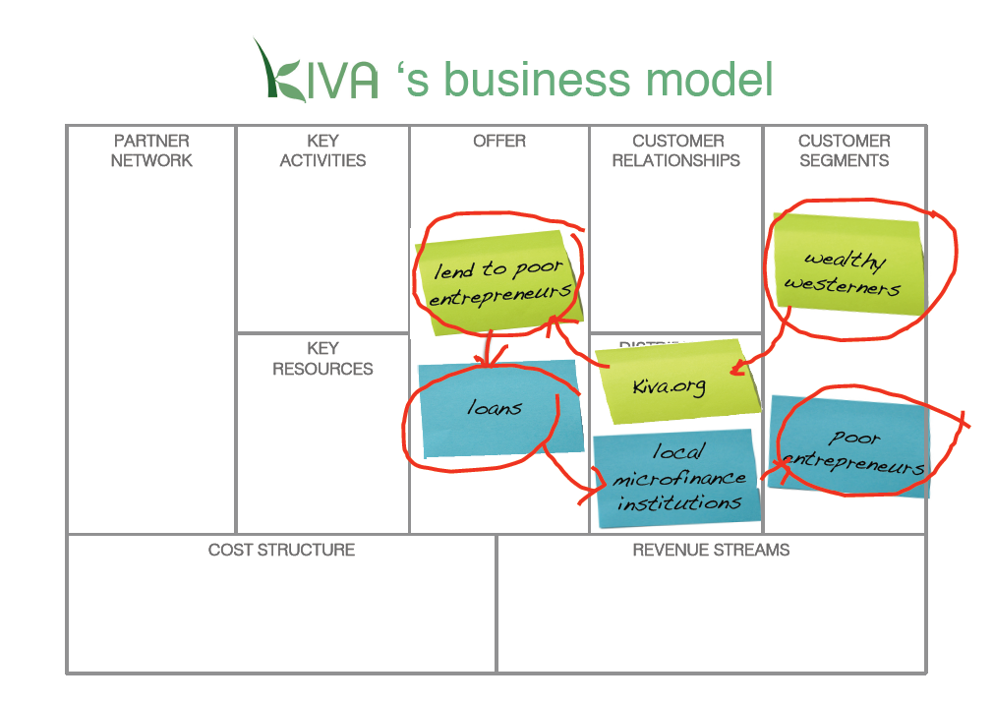

Slide 20
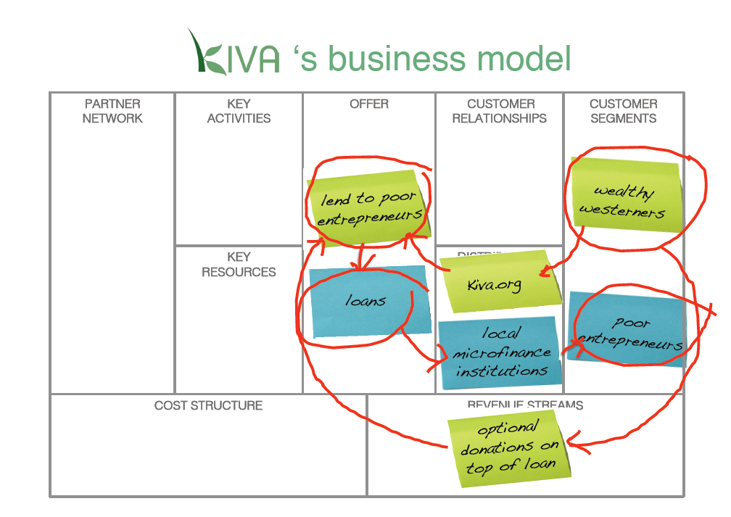

Slide 21
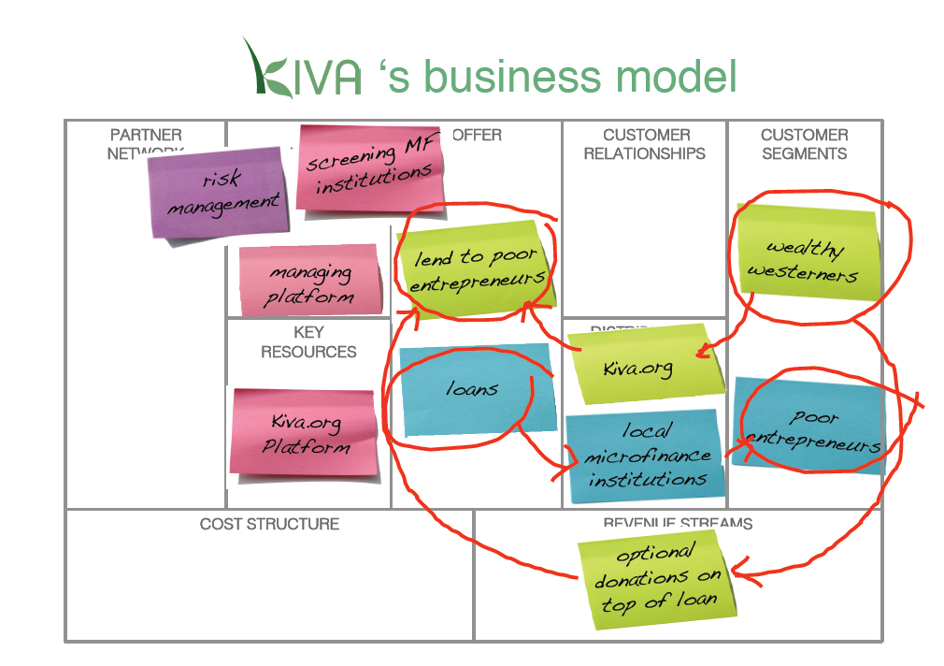

Slide 22
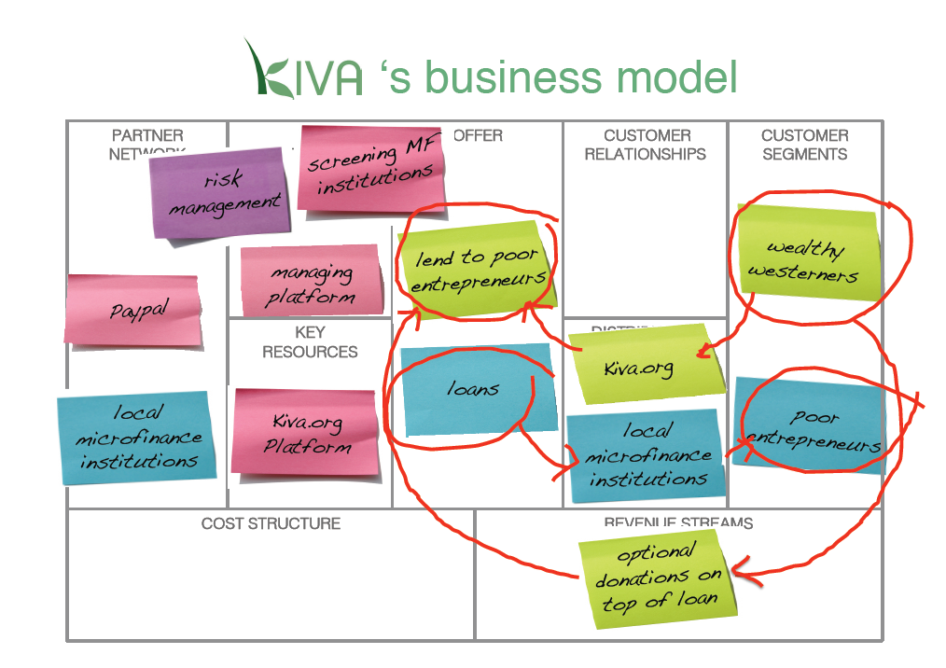

Slide 23
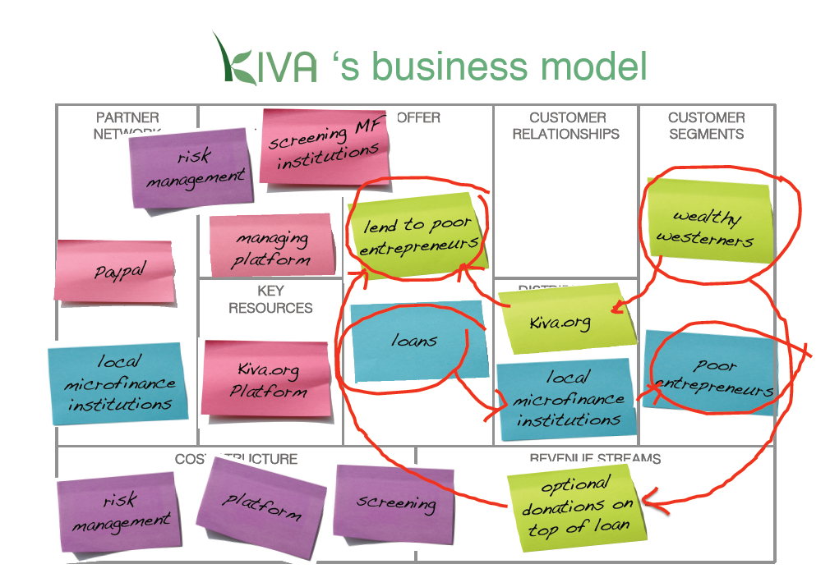

Slide 24


Slide 25
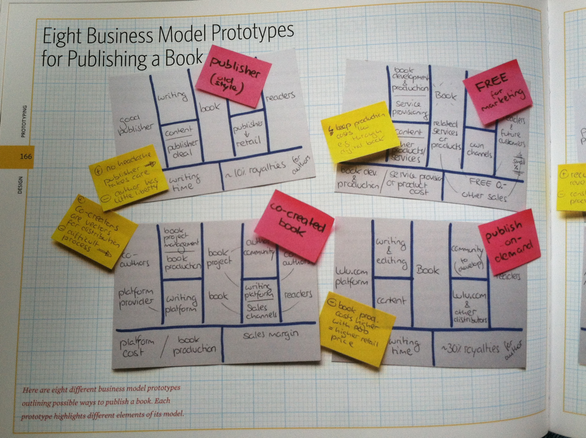

Slide 26
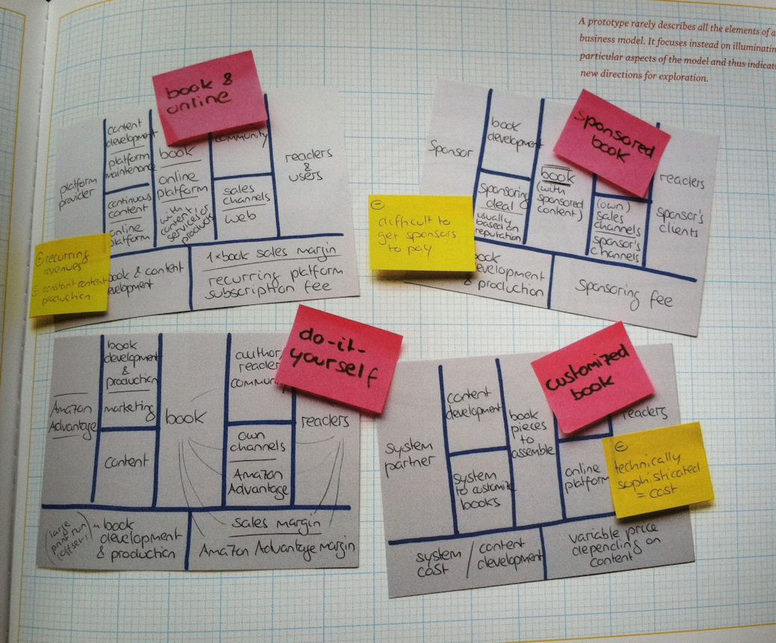

Slide 27
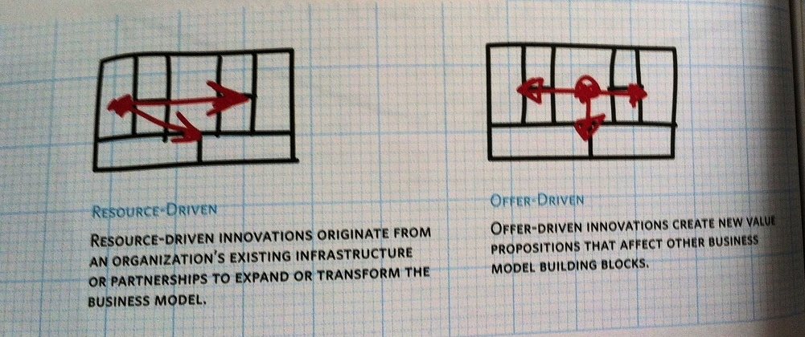
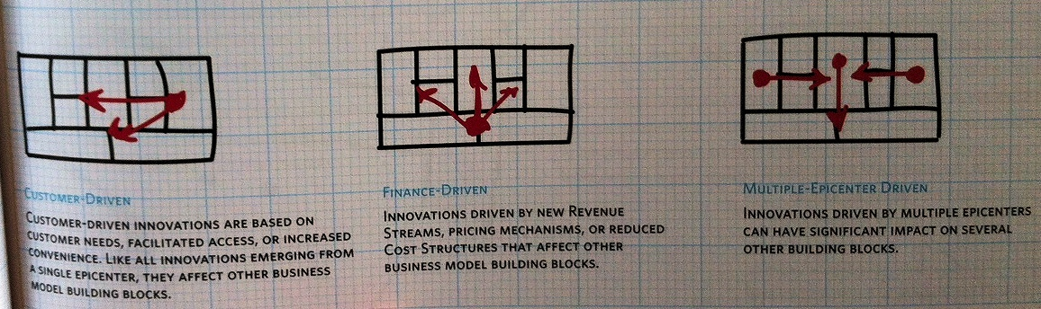

Slide 28
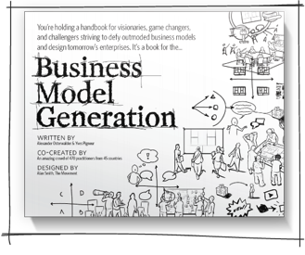
Customer
Pain?
fears
frustrations
obstacles
Gain?
wants/needs
efficiency benefits
social benefits

Slide 29
Customer (Empathy Map)
Think & Feel?
preoccupations
worries, concerns
Hear?
boss / spouse
co-workers
influencers
See?
environment
market
Say & Do?
attitude, appearance,
behavior

Slide 30
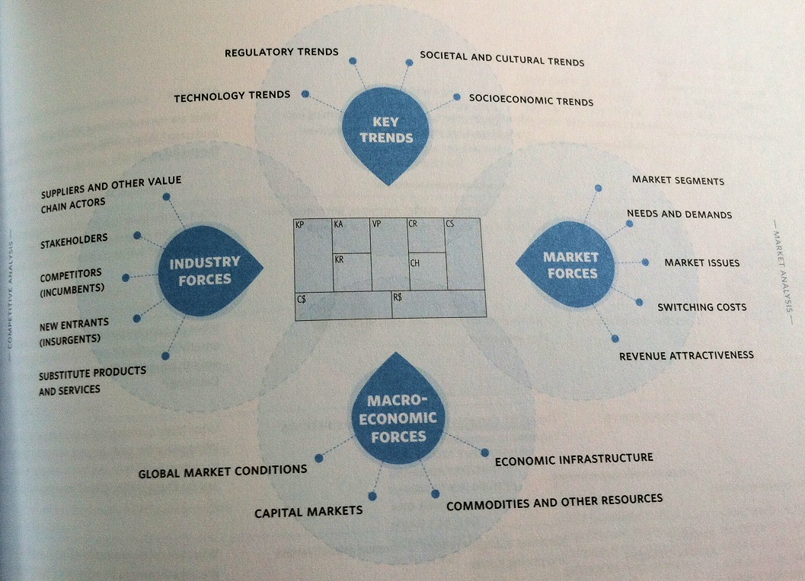

Slide 31
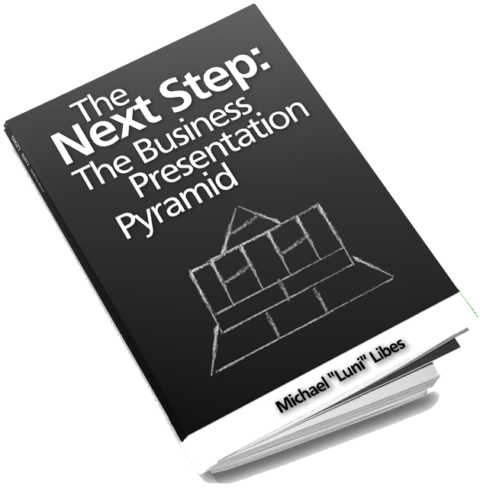

Slide 32
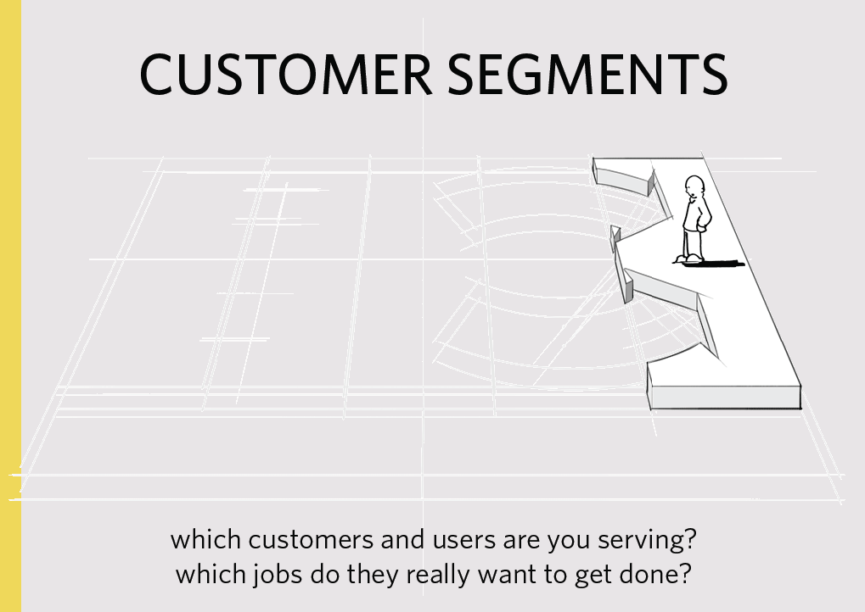


PURPOSE
Why is this business worth the bother?
What good will it do for the customers and the world?

Slide 33
OPPORTUNITY
How big is the market?
Is this business worth the bother?

Slide 34
FINANCIAL PLAN
Can this business earn a profit?
When, and how?

Slide 35
COMPETITION
Who else is pursuing this opportunity?
What does their plan look like? How is yours different?

Slide 36
IMMEDIATE NEEDS
What do you need to execute your plan?
Cash, people, and what other resources?

Slide 37
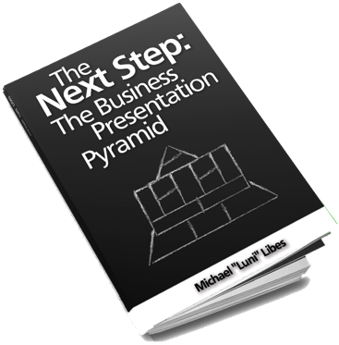
The Business Presentation
Pyramid
Purpose
Opportunity
Partners
Key
Activities
Value
Proposition
Customer
Relationships
Customer
Segments
Key
Resources
Channels
Costs
Revenues
Financial Plan
Immediate Needs
Competition

