Slide 1


Slide 2

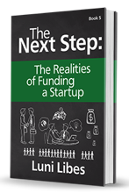

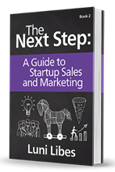
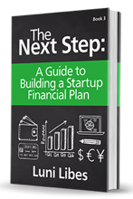

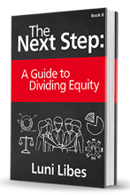
Funding

Slide 3
What is Funding?
?

Slide 4
What is Funding?
Time

Slide 5
What is Funding?
“Runway”

Slide 6
Sources of Funding
 | Seed | Startup | Early-Growth | Rapid-Growth | Exit
Self
Friends/Family
Crowdfunding
Grants
Angel
Angel Groups
Venture Capital
SBA Loan
Bank Loan
Mezzanine
Public Debt
Acquisition
IPO

Slide 7
Self
How deep is your savings?

Slide 8
Friends & Family
Trading social capital for financial capital
BEWARE: non-accredited investors

Slide 9
Crowdfunding
Kickstarter = Donations
  Limited to physical products
Indiegogo = Donations
  Limited to social enterprises
Crowdfunder = N/A
  None of the JOBS Act sites are up and running
Angel.co / WeFunder = Investments
  Limited to accredited investors & growth stage

Slide 10
Grants
Everywhere and Nowhere
Most often tied to a “program” or contest
  Specific criteria and dates
  Unique application
6-24 month process

Slide 11
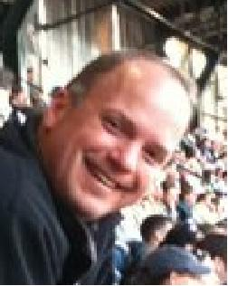
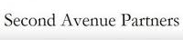
Angels
A spectrum of flavors
  Unsophisticated (new) Angels
  Professional Angels
  Super Angels
  Seed Venture Capital Funds

Slide 12
Angel Groups
Typically invest individually
Seattle Angel Groups
  Alliance of Angels
  Keiretsu Forum
  Northwest Energy Angels
  Puget Sound Venture Club
  ZINO Society
  Seraph Capital

Slide 13
Why do Angels Invest?
To make more money
  But most Angels lose money
Giving back
  Supporting new businesses in general
  Supporting industries they care about
  Sharing prior experiences
Living vicariously
  The fun of startups without the effort

Slide 14
Venture Capital
Professional investors
Seattle VCs
  Madrona Venture Parnters
  Voyager Capital
  Ignition Partners
  Maveron
  Founder’s Co-op

Slide 15
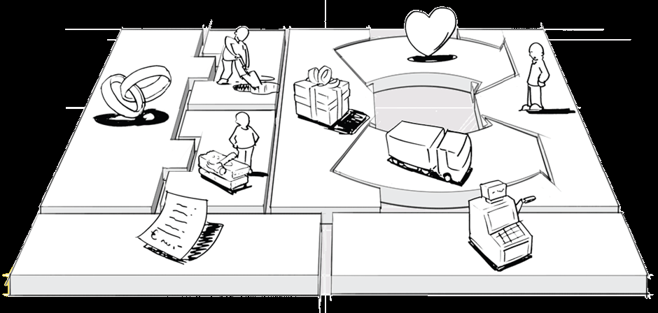
The VC Business Model
Venture Capital funds are a business
  They invest capital to make more capital

Slide 16
The VC Business Model
Partnership
  General Partners (management)
  Limited Partners (investors)
$50,000,000-$1,000,000,000
fund of “callable” capital
10 years
15-20 investments
2%/year management fee
20% “carry”
Per 10 investments
1 | “home run” | 10x+
2 | “double/triples” | 5x
3 | “singles” | 1x
4 | zeros | 0x
Average (10%*10x)+(20%*5x)+(30%*1x) |  | 2.3x

Slide 17
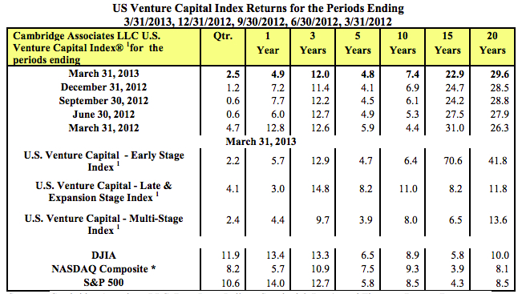
The Broken VC Business Model

Slide 18
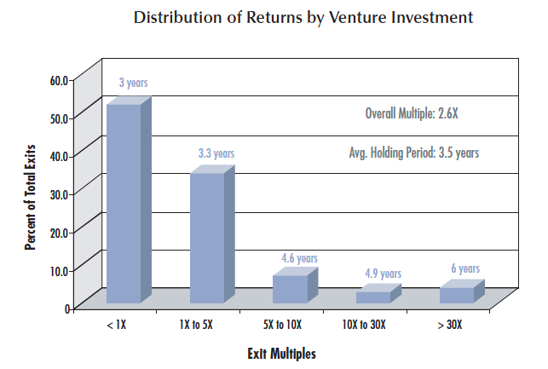
Angel Group Actuals
“Returns to Angels in Groups”
Robert Wiltbank & Warren Boeker

Slide 19
Raising Money is Sales
The product is your company
The process is analogous to sales
  What value do you bring the customer?
    What is the opportunity size?
    Whose services are they renting? (Team)
    What are their pains/gains? (Return on investment)
    Who is the competition? (Other deals)

Slide 20
Realities of Funding
500,000
startups per year

Slide 21
Realities of Funding
50,000
pitch to VCs

Slide 22
Realities of Funding
1,000
funded by VCs

Slide 23
Realities of Funding
30,000
funded by Angels

Slide 24
Realities of Funding
450,000
“bootstrapped” by self, friends & family

Slide 25
Forms of Funding
Debt
  Bank Debt
    $X, repaid at Y% APR for Z months
  Convertible Debt
    $X, earning Y% interest, convertible to equity upon the next “round” of financing, at a Z% discount
Equity
  $X for Y shares of your company (Z%)
  Typically as “preferred” shares

Slide 26
Forms of Funding
Revenue-based Financing
  $X, repaid from Y% of revenues, until $Z
  (typically Z = 2x-4x of $X)

Slide 27
Preferences
Board seats
Approval of specific actions
Liquidation preferences
Right of first refusal
Drag along rights
…

Slide 28
Valuation
Equity investments set a share price
How?
  Discounted Cash Flow (DCF)
  Internal Rate of Return (IRR)
  Comparables

Slide 29
Valuation
Need ÷ 0.67

Slide 30
Valuation
Need ÷ 0.67
Justification:
  To achieve a 10x return,
  investors needs to own 15%-20%
  You need two at least investors
  Thus you need to sell 30%-40%
Post-money = Cash + Pre-money
  Value = 40% + 60%

Slide 31
Valuation
40%
Need ÷ 0.67
40%:60%
  4/6 =
  2/3 = 0.67
60%

Slide 32
Valuation
Need ÷ 0.67
E.g.:
  You need $1 million
  Pre-money value = $1.5 million
  Post-money = $2.5 million
  $2.5 million * 40% = $1 million
  $1 million ÷ (2/3) = $1.5 million

Slide 33
Valuation
Valuation changes over time
Year | Range
1999 | 25%-30%
2001 | n/a
2004 | 40%-50%
2010 | 30%-40%

Slide 34
Valuation
Valuation changes by stage
Stage | Range | Time
Seed | 10x+ | 5-7 years
Startup | 10x+ | 5-7 years
Revenues | 5x | 3-4 years
Expansion | 3x | 2-3 years
Mature | 1.25x | 12 months

Slide 35
What Do Investors Want?
“Traction”

Slide 36
What Do Investors Want?
“Traction”
  Prototype
  Customers
  Revenues
  Profits

Slide 37
What Do Investors Want?
“Traction”
  Prototype
  Customers
  Revenues
  Profits
Traditional Thesis:
  Large Opportunity
  High Growth Model
  Team to Deliver
Impact Thesis:
  Varies

Slide 38
What Do Investors Want?
“Traction”
  Prototype
  Customers
  Revenues
  Profits
Traditional Thesis:
  Large Opportunity
  High Growth Model
  Team to Deliver
Impact Thesis:
  Varies
Planned use of funds
  12-18 months

Slide 39
Before Asking for Funding
Validate your plan
  Customers willing to talk to investors
  (Ideally) Paying customers
Show growth
  Growth in sign-ups
  Growth in sales
Clear plan of milestones
  Within 12-18 months plus a roadmap

Slide 40
After Receiving Funding
You are now on a clock
  “Burn rate” and “Runway”
You now have a boss
  CEOs work for the board
Your now need to “make” your plan
  Deliver your promises

Slide 41
Alternative: Bootstrap+
Your savings
Friends & family
Crowdfunding
Grow at the “natural” rate

Slide 42
Funding

Slide 43
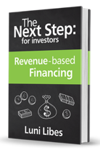
for investors

Slide 44

You are doing it wrong...
investing in startups without waiting for exits
lunarmobiscuit.com
fledge.co
“Luni” Libes
luni@fledge.co

Slide 45

500,000
New startups per year
(U.S. SBA & Kauffman Foundation)
4,115
funded by
venture capitalists
(Pitchbook 2016)
726
exits
(Pitchbook 2016)
45

Slide 46
500,000
New startups per year
(U.S. SBA & Kauffman Foundation)
0.8%
funded by
venture capitalists
(Pitchbook 2016)
0.1%
exits
(Pitchbook 2016)
46

Slide 47
492,000
“unfundable”
startups
47

Slide 48
Does the VC model work?
99%
of startups are
“uninvestable”
83%
of VC investments
are “failures”
48

Slide 49
SUCCESSFUL Angel/VC returns per 10 investments
1/10 | “Home Run” | >10x
2/10 | “Double/Triples” | 5x
3/10 | “Singles” | 1x
4/10 | Zeros | 0x
Average (10%*10x)+(20%*5x)+(30%*1x) |  | 2.3x
see fledge.co/webinars
49

Slide 50
Debt
Company Revenues
Revenue
Investor Capital
Investor Return
Time
50

Slide 51
Debt
Company Revenues
Revenue
Investor Capital
Unaffordable to the Company
Investor Return
Too Little for
the Investor
51

Slide 52
Equity
Company Revenues
Future Investor Return
Revenue
Investor Capital
Time
52

Slide 53
Equity
Company Revenues
Acquisition or IPO
Future Investor Return
Revenue
Investor Capital
Years of Time
53

Slide 54
Revenue-based
Company Revenues
Revenue
Investor Capital
Investor
Return
Time
54

Slide 55
Revenue-based
Company Revenues
Revenue
Percent of Revenue
Investor Capital
Investor
Return
Time
Fixed Total Return
55

Slide 56
E.g. Revenue-based Loan
$100,000 investment
Payments of 5% of future monthly revenues
Totaling $200,000
Providing a 2x return
56

Slide 57

E.g. Revenue-based Equity
$100,000 buys 10% ownership
Company repurchases half those shares for $200,000
Using 5% of future quarterly revenues
Providing a 2x+ return
57

Slide 58
Key Variables
% of revenues
  single digit percentage
X cash-on-cash return
  typically 2x-4x for seed stage
  commonly 2x for growth stage
Other considerations:
Debt or Equity
  tax rates and deductions
Residual equity
  upside upon exits
Optional or Mandatory
  who chooses
Other preferences
58

Slide 59
500,000
“investable” startups
Given the right investment structure
59

