Slide 1


Slide 2

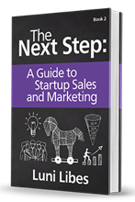
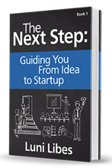
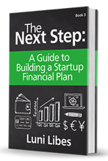


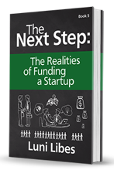
Marketing

Slide 3
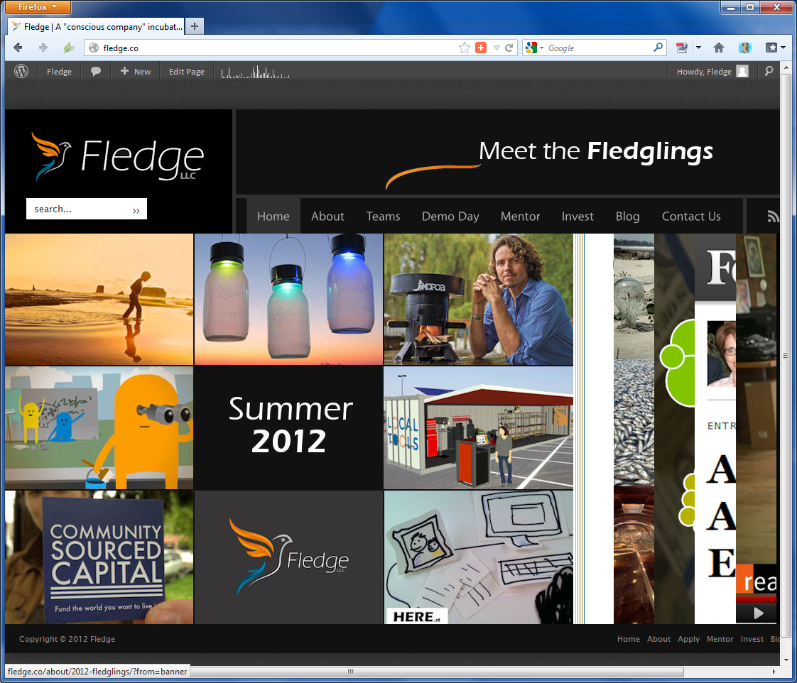
Rule A – Look Established

Slide 4
Rule B – Speak in the Present Tense
NewCorp
… runs …
… sells …
… operates …

Slide 5
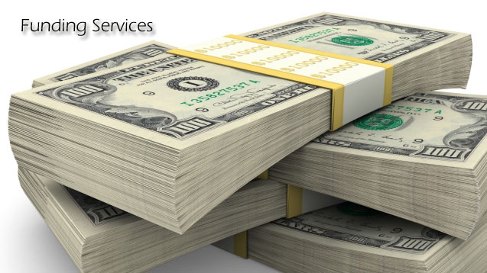
Rule C – Act Funded

Slide 6
Exercise 1. Corporate Essence
What 3 words best describe your company?
  Google?
  Starbucks?
  Amazon?
  Your company?

Slide 7
Exercises 2-5. Using your Essence
Does your name fit your corporate essence?
Does your logo fit your corporate essence?
What is your one sentence corporate pitch?
What is your 2-4 word “tag line”?

Slide 8
Exercises 6-10. Be Known
Your social media strategy?
Your SEO/SEM strategy?
Your mobile strategy?
Where are you listed? LinkedIn, Angel.co?
Where are the stories? Blogs, tweets, etc?

Slide 9
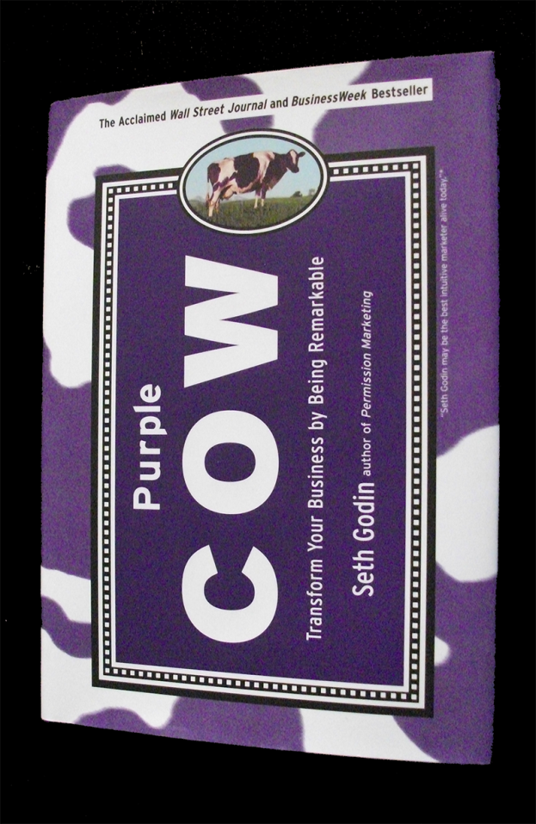
Exercise 11. Purple Cows?
What can you do to stand out?
  Novelties?
  Design?
  ???

Slide 10
“Purple Cow” by Seth Godin

Slide 11
A Purple Cow
Cows, after you’ve seen them for a while, are boring. There may be perfect cows, attractive cows, cows with great personalities, cows lit by beautiful light, but they’re still boring.
A purple cow, though. Now that would be interesting. (For a while.)

Slide 12
TV-Industrial Complex
Product
TV Ads
Sales
Profits

Slide 13
Before and After
TV-Industrial Age | Post-TV Age
Average Products | Remarkable Products
Advertise to Anyone | Advertise to the Early Adopter
Fear of Failure | Fear of Fear
Long Cycles | Short Cycles
Small Changes | Big Changes

Slide 14
Before and After
TV-Industrial Products | Post-TV Products
Tide / Cascade / Joy | Method soap
Prell / Head & Shoulders | Aveda
United Airlines | JetBlue
Budweiser | Sam Adams / Pyramid
Sears | Amazon
The Original Beetle | The New Beetle

Slide 15
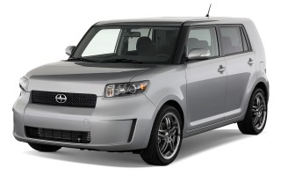
Idea That Spread, Win
How do you create an idea that spreads?
  Don’t make a product for everybody

Slide 16
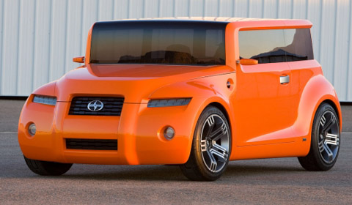
Idea That Spread, Win
Then keep innovating!

Slide 17
The Problem With the Cow
Fear
  Cows are rare because people are afraid
  No one wants to fail
  No one wants to look foolish
  No one wants to be criticized

Slide 18
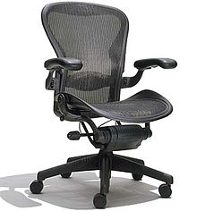
Taking a Risk
Herman Miller
  1994
  $750 office chair

Slide 19

Taking a Risk
Starbucks
  IPO in 1992
  Great coffee
  A “third place”
  Sustainable
  On (nearly) every corner

Slide 20
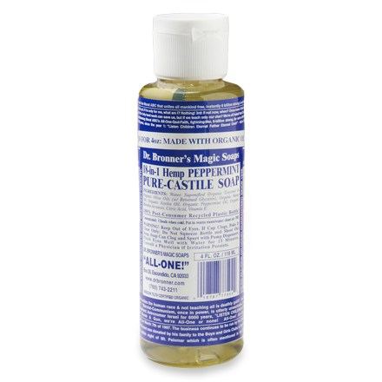
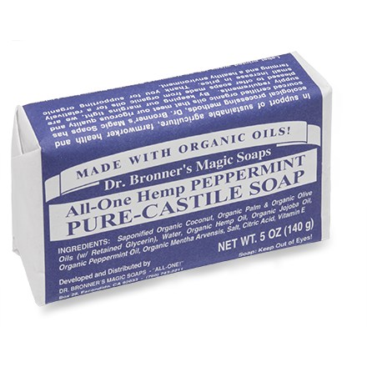
Be Remarkable

Slide 21
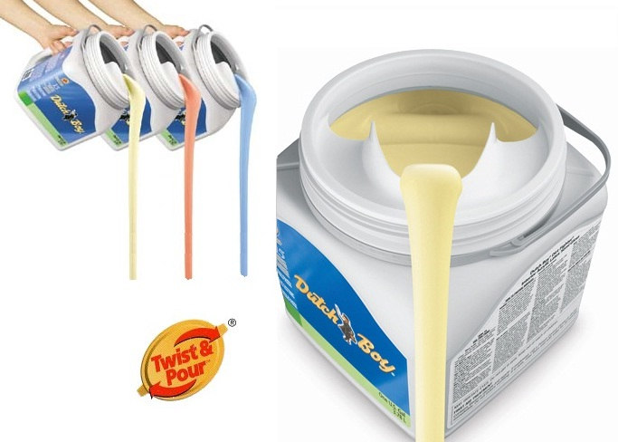
Be Inventive

Slide 22
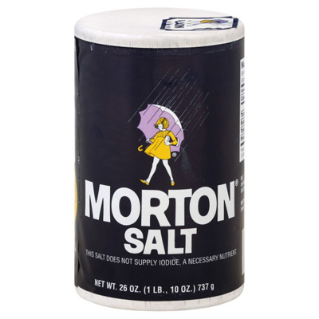
Reinvent

Slide 23
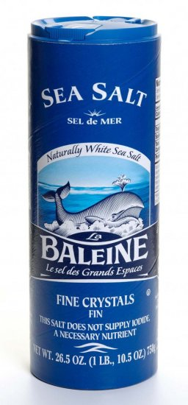
Reinvent

Slide 24

Reinvent

Slide 25
Your “Purple Cow”?

Slide 26
First Person
Write in 1st person, not 3rd person
  XYX produces…
  We sell…
  Our team…
  … us.
    You want the reader to feel part of the team

Slide 27
Tense
Tense | Reader’s belief
Future | Vision
Present | Action
Past | Experience

Slide 28
Future Tense
First-time entrepreneurs will tend to write about actions that will take place sometime unstated time in the future
  We will manufacture… → We produce…
  We will operate… → We operate…

Slide 29
The Beginning vs. Backstory
Business plans and pitches do not start with the founding of the company, they start with the statement of the problem

Slide 30
Example (Before)
Founded in December 2013, GreenChar is a for-profit social enterprise that ...
Founded in – Start with something important to the audience
for-profit social enterprise – Eliminate the irrelevant facts
Your pitch needs to grab the attention of the audience and make them eager to hear the other details that you think important enough to share

Slide 31
Example (After)
GreenChar turns sugarcane waste into charcoal briquettes, replacing deforestation with recycling…

Slide 32
Example (Before)
GreenChar is a for-profit social enterprise that provides affordable, efficient, and environmentally friendly energy solutions…
for-profit social enterprise – Eliminate the irrelevant facts
energy solutions – Eliminate the buzzwords and speak in simple English
Don’t try and sound like a marketer, pick simple words that explain what you do, why you do it, that are understandable by everyone

Slide 33
More About the Product
Err on the side of too much product information, too much detail walking through the customer experience
  Less on backstory
  Less on problem
  Less on everything else

Slide 34
Example (After)
GreenChar produces and distributes charcoal briquettes made from agricultural waste. Our briquettes are more affordable, nearly smokeless, higher energy, and longer lasting than conventional wood charcoal and firewood.

Slide 35
Clear and Direct Language
Few entrepreneurs get to the point as quickly as they can
Too many entrepreneurs think more words, with more syllables make companies sound more real
Wrong! Say it in as few words as possible.

Slide 36
Example (Before)
GreenChar’s future plans include sales of cookstoves and solar solutions to fulfill our overarching vision to become the ultimate provider of clean household energy solutions across East Africa.

Slide 37
Example (After)
Beyond briquettes, GreenChar’s future plans include cookstoves and solar panels, growing toward the ultimate provider of clean household energy across East Africa.
Still too long, but fewer words, no buzzwords, and easier to understand

Slide 38
Example (Before)
GreenChar dedicates itself to fight against the health and environmental problems that arise due to firewood and charcoal usage.
dedicates itself to the fight – Sounds like a nonprofit

Slide 39
Example (After)
GreenChar directly impacts the health and environmental problems that arise from cooking.
Simple fact. The next sentence could explain that 4 million women and children die annually due to smoke from cooking.

Slide 40
Example (Before)
GreenChar has laid the groundwork to generating more market presence by creating a website and social media platform.
laid the groundwork – Sounds like a political campaign or nonprofit advocacy
website and social media platform – Don’t waste time telling us commonplace tasks

Slide 41
Example (After)
GreenChar has 1,234 followers on Twitter and Facebook.
If you have to say something about social media, tout momentum. If you have no impressive stats to share, then don’t mention social media at all.

Slide 42
Then… then…
When describing a series, avoid using “then” over and over again
Either
  Use a set of bullets, or
  Use a series of short sentences.

Slide 43
Example (Before)
After production, the inventory will then be stocked. The briquettes will then be packaged and distributed through our distribution channels to vendors and retailers.

Slide 44
Example (After)
After production, the inventory is stocked. As orders arrive, the briquettes are packaged and distributed through our distribution channels to vendors and retailers.

Slide 45
Example (Bullets)
After the production process:
  The inventory is stocked
  Orders arrive
  The briquettes are packaged
  Distribution of packages to vendors and retailers.

Slide 46
Vision and Mission Statements
You don’t need two statements?
Mission-driven companies should have a 1-line or 1-paragraph mission.

Slide 47
Example (Before)
GreenChar’s vision is to build healthy, financially empowered communities by providing affordable, innovative, and clean household energy solutions .

Slide 48
Example (Focused)
GreenChar’s vision is to be the largest producer of green charcoal in East Africa.

Slide 49
Example (Larger Focus)
GreenChar’s vision is to be the largest producer of green charcoal and other green fuels in East Africa.

Slide 50
Marketing

