Slide 1


Slide 2

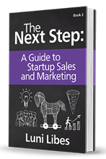





Sales

Slide 3



The Complete (Business) Plan
The
“Pitch”
Executive
Summary
Financial
Model
Marketing
Plan
Sales
Process

Slide 4
Marketing vs. Sales
Marketing
Sales
Company Awareness
Product Awareness
Sales Interest
  a.k.a. Generating Leads
Researching Market Needs
Defining Product Features
Validating Leads
Leads → Opportunities
Closing Opportunities
Learning from Customers
DIRECTLY
Too often a source of internal conflict

Slide 5
Sales is a big topic
Today
Next Time
Funnel
Motivations to sell
Channels
Team
  Organization
  Incentives
Projections
Tracking
Tactics
First Sale
Closing Sales
Post-Sales
Process

Slide 6
Sales
Funnel
Unqualified Lead
Qualified Lead
Prospect
Customer

Slide 7
Sales Funnel
Tele-sales
Retail
E-commerce
Unqualified lead
Qualified lead
Prospect
Customer
Follow-up
Re-purchase
Drive-by
Walk-by
Walk-in
Pick-up product
  (Try-on product)
Purchase product
  Return product
Re-visit
Re-purchase
Search
Visit site
  Bounce
Register
Login
Browse service
Purchase service
Re-visit
Re-purchase

Slide 8
Exercise #1
What is your sales pipeline?
  Name each step
What are three tactics to improve the depth and speed?

Slide 9

One Tough Job
http://www.youtube.com/watch?v=emzARZsJntw

Slide 10
Rejection
You are going to be rejected… repeatedly
  repeatedly
  repeatedly
  repeatedly
  repeatedly
  …
  REPEATEDLY

Slide 11
Why does anyone sell?
The thrill of the hunt
The interaction with outsiders
Solving others’ problems
…
A path to earn a lot of money

Slide 12
Sales “Channels”
Online
  Sales via the web site
Indirect
  “Channels” via other company’s sales forces
Direct
  Your employees

Slide 13
Organizing a Sales Team
Roles
Segments
Hunter-Farmers
Hunters & Farmers
Qualifiers & Hunters + Farmers
No segmentation
By product line
By customer segment
a.k.a. “vertical”
By geography
Geographies
Consolidated
Distributed

Slide 14
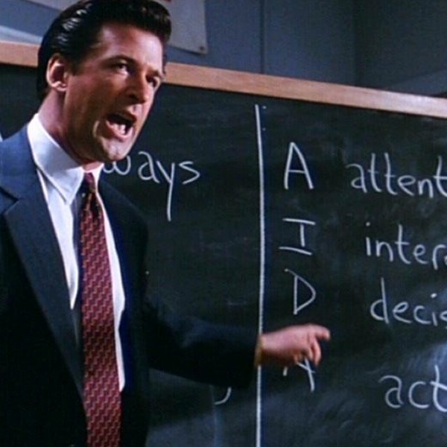
One Tough Job
https://www.youtube.com/watch?v=8kZg_ALxEz0

Slide 15
Motivating a Sales Team
Quotas
Commissions
  Flat, tiered, complex
Bonuses
  Consistency
  Extraordinary performance
Contests
  Simple, complex, fun
Culture
  Coach or overseer?
Underlying all off the incentives
Over-assign
Well designed quotas can drive any behavior

Slide 16
Exercise #2
Assume you are growing to 10 salespeople
How will you organize your sales force?
Create a commission/bonus/etc. structure for that team.

Slide 17
Sales Projections
Average Selling Price x Deal Flow
Upon success:
  ASP will go up
  Deal flow will speed up

Slide 18
Sales Price
Wrong choices
  COGS – Cost of Goods Sold x Margin
  SG&A – Sales and General Administrative Expenses
  Total burn, expected profitability, etc…
Right answer
  What is the value to the customer?

Slide 19
Deal Flow
How many customers?
How complex of a sale?
How important a problem?
  Pain killers outsell vitamins
How long to close the deal?

Slide 20
Exercise #3
Your sales projections
What is your estimated average price?
What is your estimated average sale cycle time?
What can you do to validate these hypothesis?
What can you do to increase the price and shorten the time?

Slide 21
Tracking your Pipeline
Use a contact management tool
  e.g. SalesForce.com
Cluster prospects (probability of closing)
  1% - 49% Qualified, but pure pipeline
  50% - 84% “Upside” opportunity for the quarter
  85% - 99% “Commitment” to the company that this deal will close this quarter

Slide 22
Sales Part 2

Slide 23
Recap
Unqualified Lead
Funnel
Motivations to sell
Channels
Team
  Organization
  Incentives
Projections
Tracking
Qualified Lead
Prospect
Customer

Slide 24
Today
Tactics
First Sale
Closing Sales
Post-Sales
Process

Slide 25
Sales Tactics
Remember: People make buying decisions, not companies
Roles
  Decision Makers
  Influencers
  Advocates
  Blockers
Motivations
  Understand differing reasons to support a decision
Who are you competing against?
  What other goals are important to your prospect?

Slide 26
Sales Tactics
Remember: People make buying decisions, not companies
You will win deals with inferior products/services and lose deals with superior products/services.
  How can that be?...is there no logic?
  There’s always a reason, your job is to understand it.
You have two ears and one mouth, so LISTEN!!!
Really good sales people care, and
their customers know it.

Slide 27
Your First Sale
Probably your most difficult sale…
Proof of concept – will the dogs eat the food?
  Target the right account, not the biggest or best
First sale establishes early value, not true value
  Findings may be equally as important as revenue
  The first sale is not a trend, just a point on a curve
Remember your internal sale
  Success drives motivation which drives success

Slide 28
Closing Sales
Buyer Interest ≠ Closed Purchase
Motivation to close?
  Why will the buyer buy now, vs. tomorrow?
Artificial motivations
  Free add-ons
  Discounts
  Price increases

Slide 29
After the Sale
What happens after the sale?
  Customer support.
    Must have from sale #1
  Recurring revenue opportunities
    Only possible with happy customers
  References are key to future sales
    Raving lunatic fans
  It is always best to view your customer relationships as long term partnerships

Slide 30
Exercise #1
Assume you have 100-1000 customers
What do you do after a sale?
What do you to delight your customers?

Slide 31
Sales Process
Create/Buy a list of leads
Qualify the leads
Determine needs
Determine value
Close
Deliver/Install/Set-up
Follow-up
Farm

Slide 32
Exercise #2
Create your sales process
  From pipeline
  Projections
  Pre-sales tactics
  Post-sales strategy

Slide 33
Finally… Remember…
“Everyone works
for sales”

Slide 34
The Complete (Business) Plan
The
“Pitch”
Executive
Summary
Financial
Model
Marketing
Plan
Sales
Process

Slide 35
Sales

