Slide 1


Slide 2








Slide 3
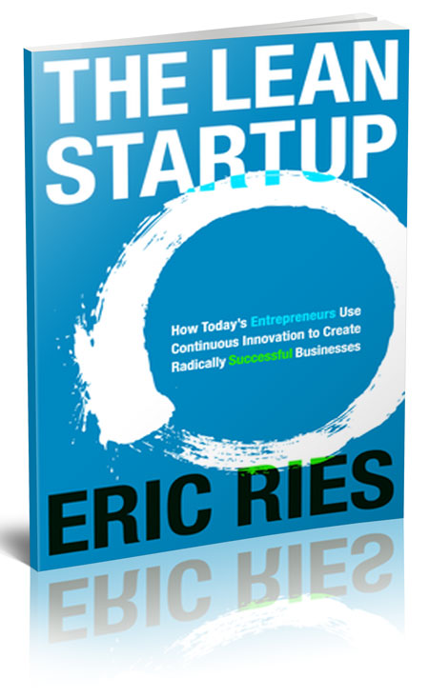

Slide 4
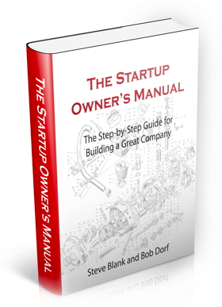

Slide 5
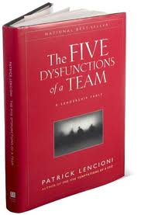

Slide 6
Corporate Culture
IDEA
Problem
Solution
Customer
Product
Market
Competition
Culture
Pricing
Uniqueness
Financials
Marketing
Team
The Pitch
Funding
The Launch
STARTUP

Slide 7
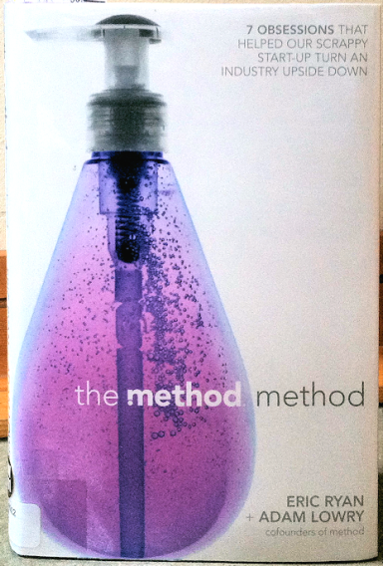


Corporate Culture: Case Studies

Slide 8
“the method method”
Eric Ryan and Adam Lowry

Slide 9
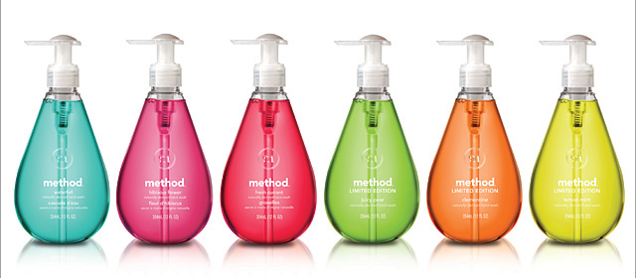
method soap

Slide 10
7 Obsessions
Create a Culture Club
Inspire Advocates
Be a Green Giant
Kick Ass at Fast
Relationship Retail
Win on Product Experience
Design Driven

Slide 11
The story
The book is worth its price for the opening story
  Ideation
  Struggle to start

Slide 12
The Elevator Pitch
“Aveda for the home”
  Bring a personal-care approach to cleaning

Slide 13
The Competition
P&G
Unilever
Colgate/Palmolive
5 other multinationals

Slide 14
1
CREATE A CULTURE CLUB

Slide 15
Creating a Culture
Culture wins over process
Word travels, and so does talent
The lines between personal and professional lives are blurring
Standards for culture are rising

Slide 16
How to Create a Culture
Part Logic, Part Magic
  When you are doing culture really well, you don’t notice you’re doing it at all.
No HR department
Pushback on creating processes
“The Ministry of Culture”
  Sat down and created the method corporate values…

Slide 17
Corporate Values
Keep Method weird
What would MacGyver do?
Innovate, don’t imitate
Collaborate, collaborate, collaborate
Care like crazy

Slide 18
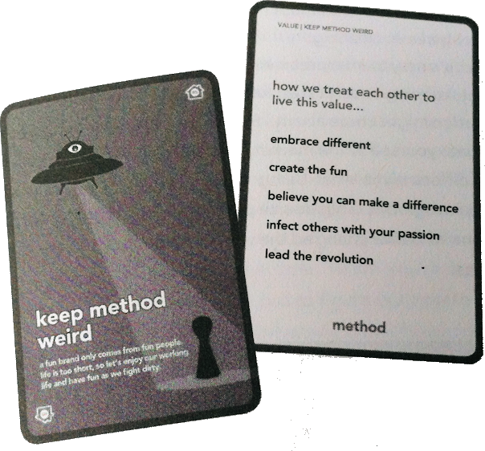

Slide 19
Hire Right
Is this a person that I’m excited to sit next to on a five-hour coast-to-coast plane ride?

Slide 20
Hire Right – Homework
One strategic question
One tactical question
How would you keep Method weird?

Slide 21
Monday Morning Huddles
Informal
Share information
Share personal news
Assign a different person each week to “take point”

Slide 22
2
INSPIRE ADVOCATES

Slide 23
Advocates
Don’t sell to customers, create advocates for your social mission

Slide 24
Advocates not Advertising
Can you recall the last advertisement you saw?
  Drawing a blank?
  Us too…

Slide 25
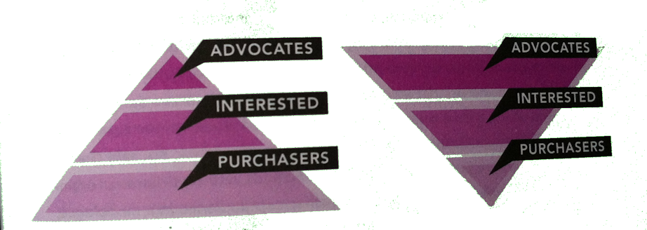
Flip the Pyramid

Slide 26
Frame your Communications
If you’re struggling to shift your brand from high interest, seek to reframe your communications from presenting the problem to projecting the desired end state and wrap that in a social mission
☹ PROBLEM
END STATE ☺

Slide 27
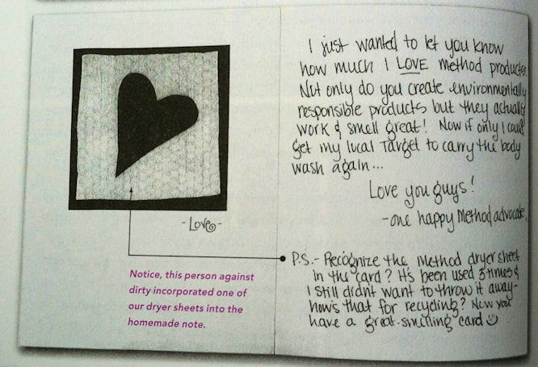

Slide 28
3
BE A GREEN GIANT

Slide 29
Small Steps
E.g. Refilling stations
  Bring in your bottle and refill it in the store
  Perfect/Ideal solution, but not enough reach
Solution:
  Refilling bags
    90% less plastic
    Works for everyone

Slide 30
Make it Selfish
Organic messaging
  1980’s
    Eat organic food because pesticides are bad for the environment
  Now
    Eat organic food because it’s bad to put pesticides in your body

Slide 31
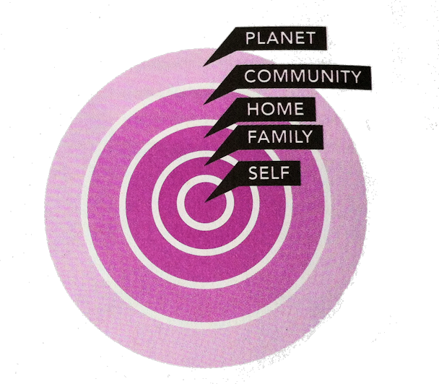
Make it Selfish
Save yourself. Save the world.

Slide 32
Sharing
Don’t share our profits, share our people.

Slide 33
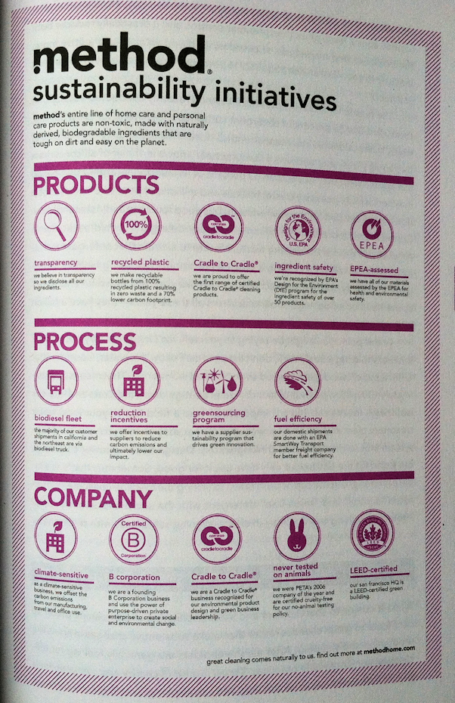
Method’s entire line of home care and personal care products are non-toxic, made with naturally derived, biodegradable ingredients that are tough on dirt and easy on the planet

Slide 34
4
KICK ASS FAST

Slide 35
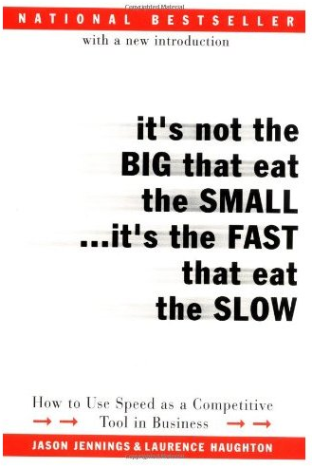
Fast
It’s not the big that eat the small, it’s the fast that eats the slow.
  Jason Jennings
  and Laurence Haughton

Slide 36
But not too fast…
The hazard of fast
  Growing too fast too early
  Thinking you can do everything
  Pursuing opportunities, because you can

Slide 37
Scaling Speed
Insource creativity
  Your culture is about creativity
Outsource production
  Hard assets
  Sunk capital
  Higher debt
  Less nimble

Slide 38
Be the Guinea Pig
Partners, not vendors
  Be first to market
  Let your vendors then benefit from your creativity

Slide 39
Anticipate, Don’t Follow
Anticipate the consumer
  Set trends, don’t follow them
  Consumer research is more like a rearview mirror than a crystal ball. After all, consumers gravitate toward what’s most familiar, so listening too closely will leave you with a record of what they’ve liked in the past.
  “Most people skate to where the puck is. I skate to where the puck is going” – Wayne Gretsky

Slide 40
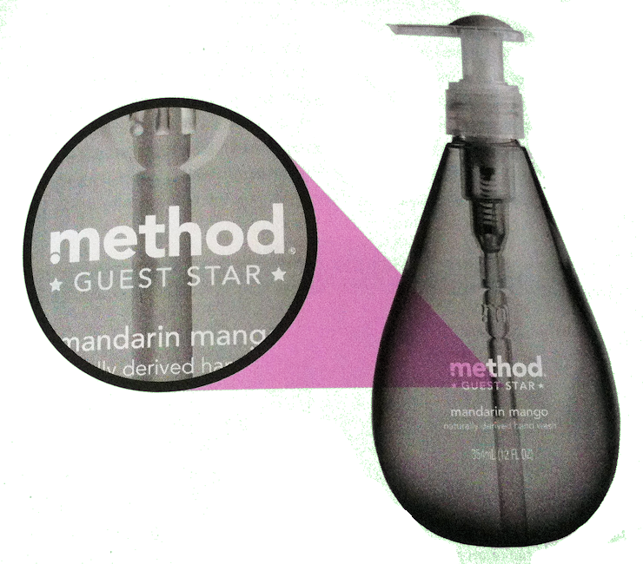
Fail Small, Fail Cheap

Slide 41
?
QUESTIONS

Slide 42
Netflix
A groundbreaking
corporate culture, based on
  Freedom, and
  Responsibility

Slide 43
Culture is How a Firm Operates
What practices give Netflix the best chance of continuous success for many generations of technology and people?

Slide 44
Need a culture that supports rapid innovation and excellent execution

Slide 45
Need a culture that supports effective teamwork of high-performance people

Slide 46
We’re a team, not a family
We’re like a pro sports team,
not a kid’s recreational team
Coaches’ job at every level of Netflix
to hire, develop and cut smartly,
so we have stars in every position

Slide 47
The Keeper Test Managers Use:
The other people should get a generous severance now,
so we can open a slot to try to find a star for that role
“Which of my people,
if they told me
they were leaving in two months
for a similar job at a peer company,
would I fight hard to keep at Netflix?

Slide 48
Responsible People
Thrive on Freedom, and are Worthy of Freedom

Slide 49
Our model is to increase employee freedom as we grow, rather than limit it, to continue to attract and nourish innovative people, so we have better chance of long-term continued success

Slide 50
Most Companies
Curtail Freedom as they get Bigger
# Employees
Employee Freedom

Slide 51
Growth Shrinks Talent Density in Most Firms
Complexity
% High Performance Employees

Slide 52
Example: Netflix Vacation Policy and Tracking
Until 2004 we had the standard model of N days per year

Slide 53
Netflix Vacation Policy and Tracking
“there is no policy or tracking”

Slide 54
Netflix Policies for Expensing, Entertainment,
Gifts & Travel:
“Act in Netflix’s Best Interests”
(5 words long)

Slide 55
The best managers figure out how to get great outcomes by setting the appropriate context, rather than by trying to control their people

Slide 56
Context, not Control
Provide the insight and understanding to enable sound decisions
Context
Control
Strategy
Metrics
Assumptions
Objectives
Clearly-defined roles
Knowledge of the stakes
Transparency around decision-making
Top-down decision-making
Management approval
Committees
Planning and process valued more than results

Slide 57
Managers: When one of your talented people does something dumb, don’t blame them.
Instead, ask yourself what context you failed to set.

Slide 58
Our culture is a work in progress
Every year we try to refine our culture further as we learn more

Slide 59
Further Reading
An “insiders” view of this and more…
http://perfcap.blogspot.com/2011/12/how-netflix-gets-out-of-way-of.html

Slide 60
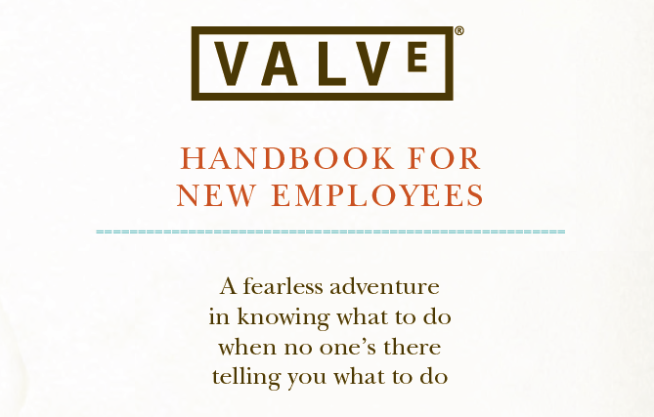



Slide 61
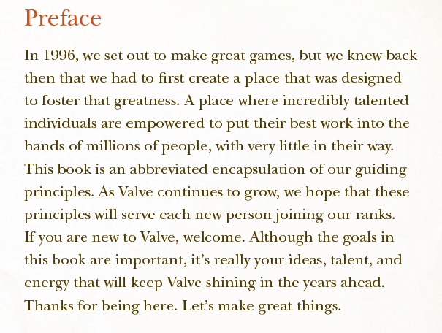

Slide 62
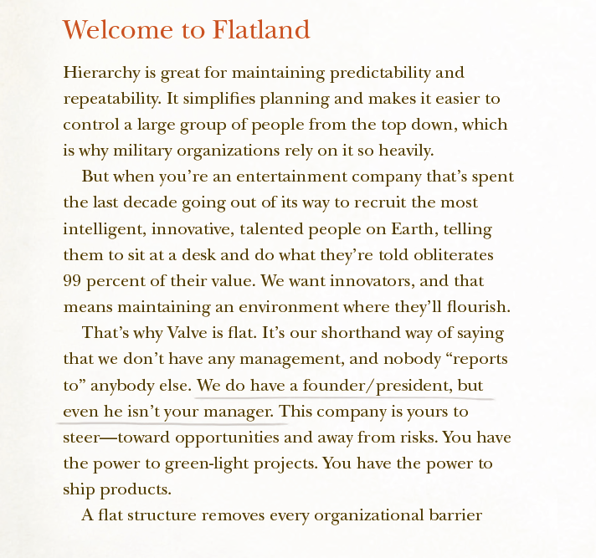

Slide 63
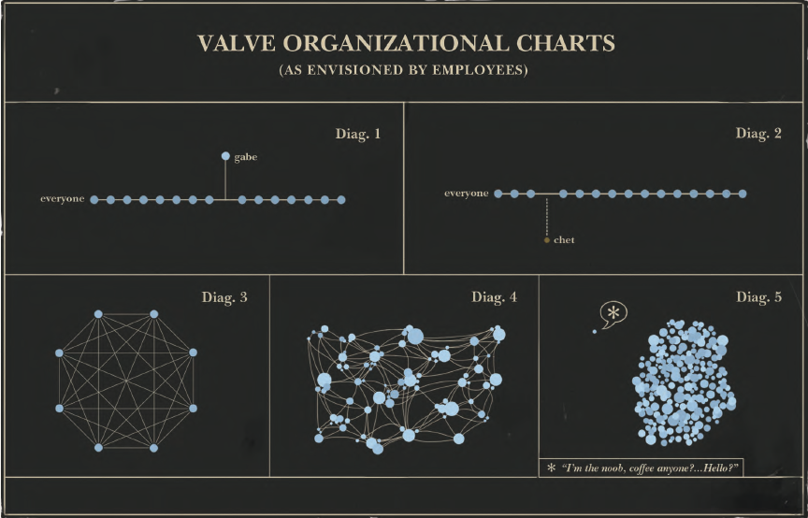

Slide 64
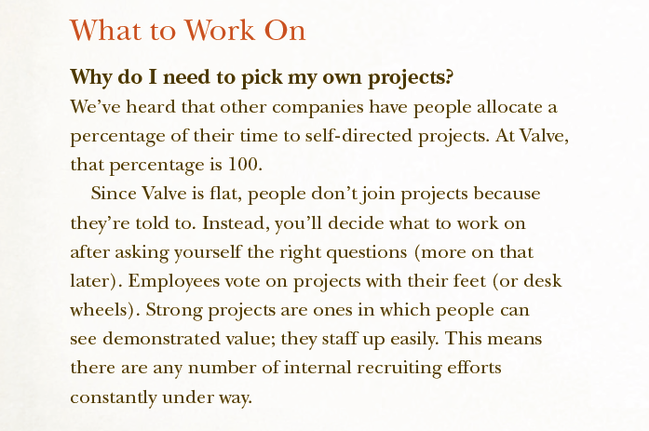

Slide 65
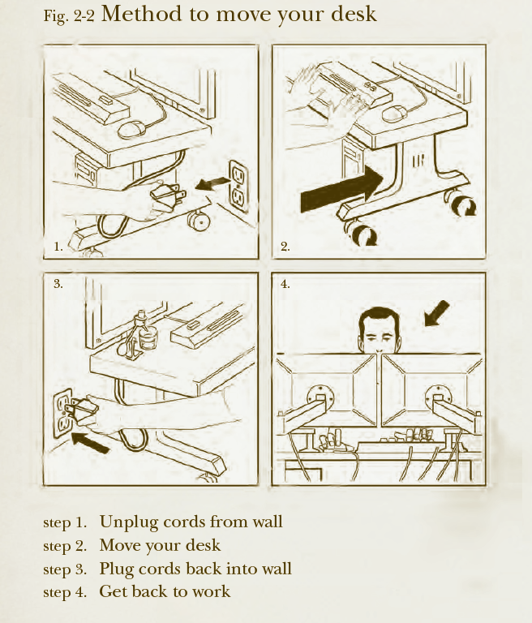

Slide 66
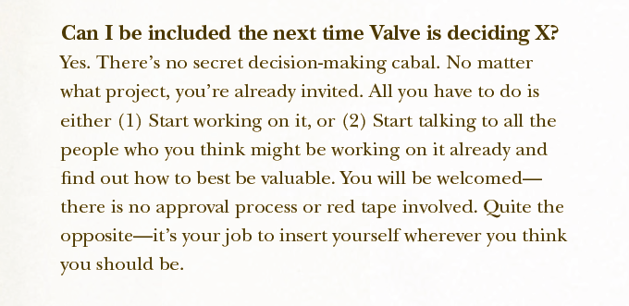

Slide 67
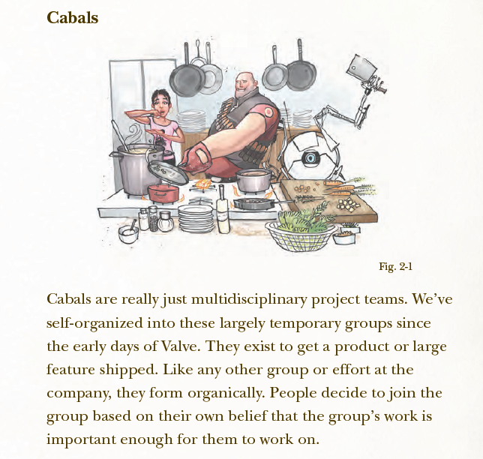

Slide 68
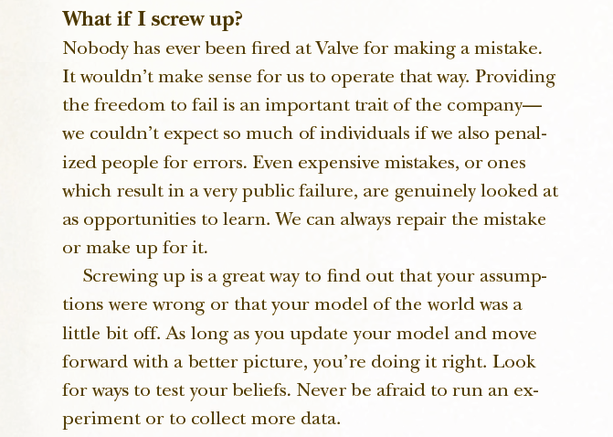

Slide 69
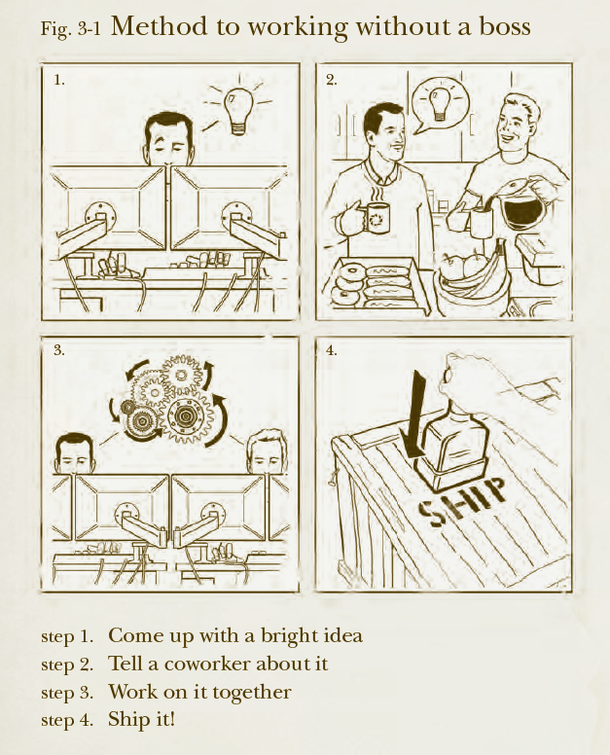

Slide 70
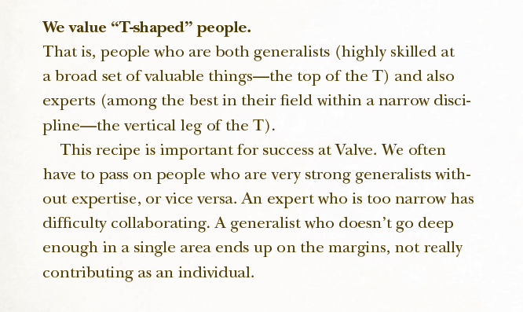

Slide 71
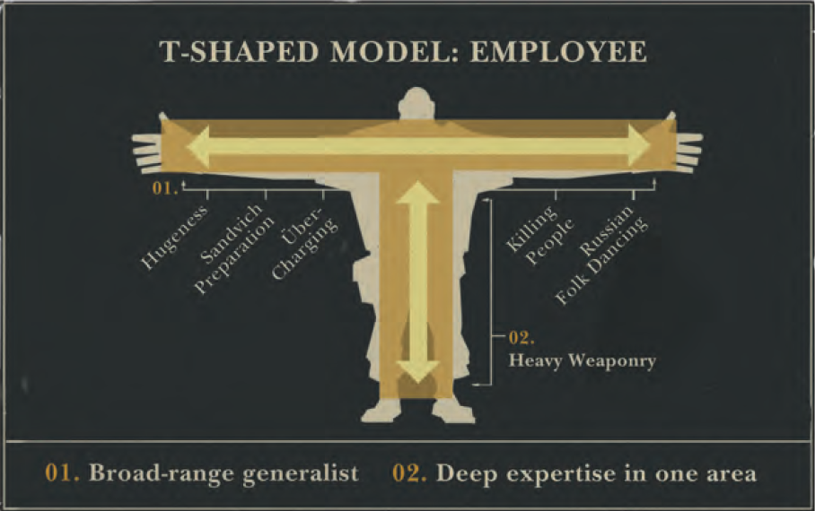

Slide 72
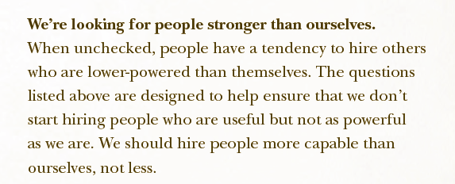

Slide 73
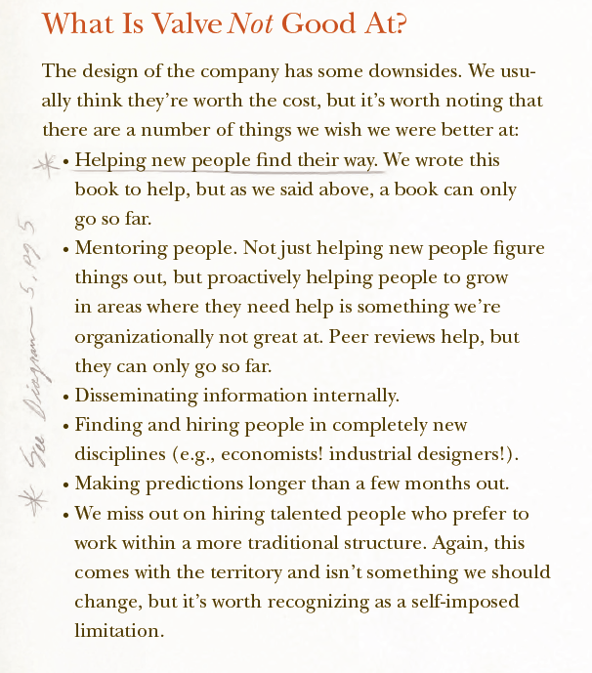

Slide 74
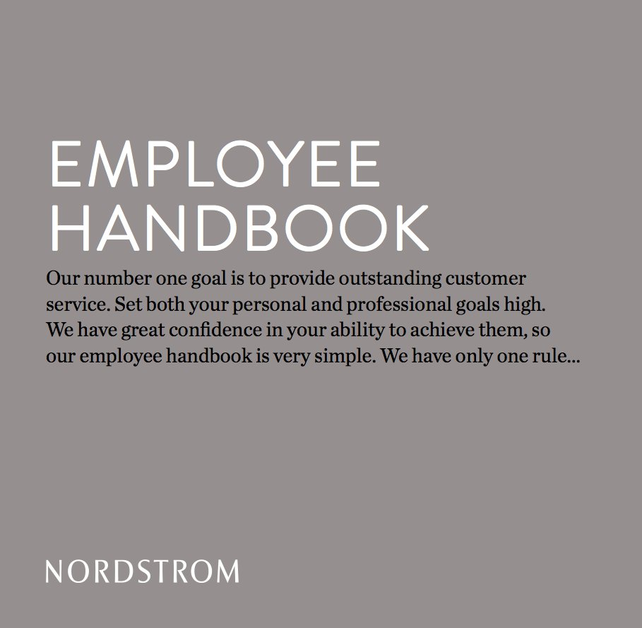

Slide 75
