Slide 1


Slide 2
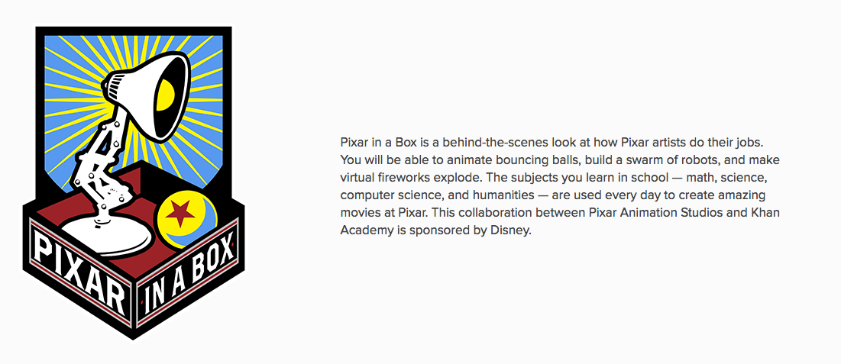
khanacademy.org/pixar
Notes:
If you want to learn how to tell a great story, ask a great story telling company. Pixar partnered up with Khan Academy to create “Pixar in a Box”

Slide 3
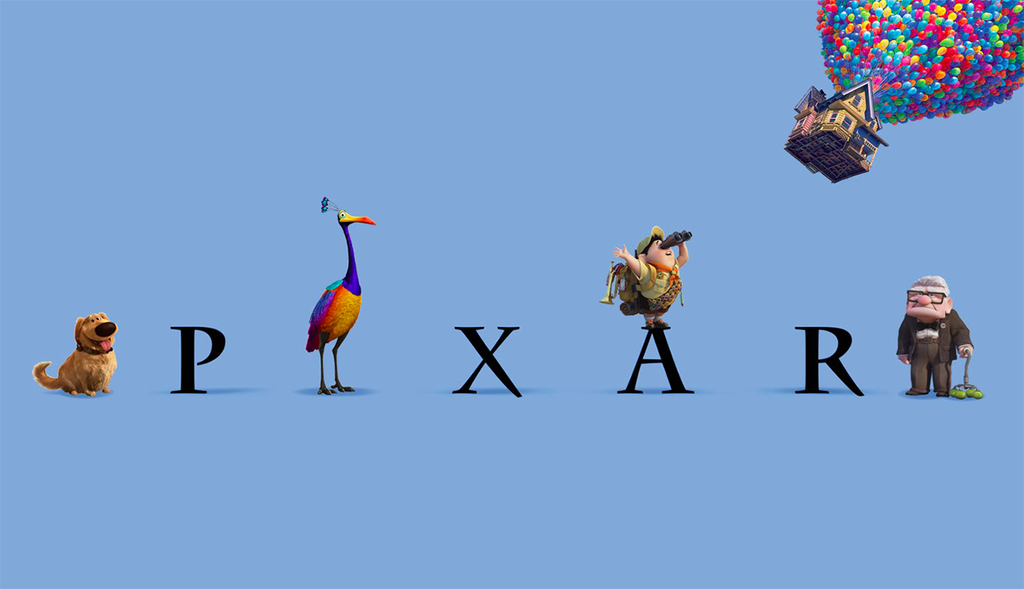
Notes:
In case you don’t’ recognize the brand, Pixar has made more than a dozen of the Top 50 all time grossing movies

Slide 4
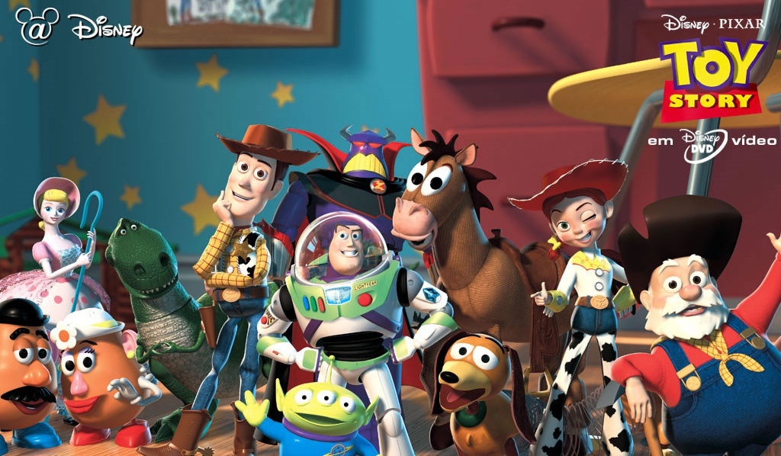
Notes:
These are the people who turned toys into billions of dollars of tickets and collectables

Slide 5
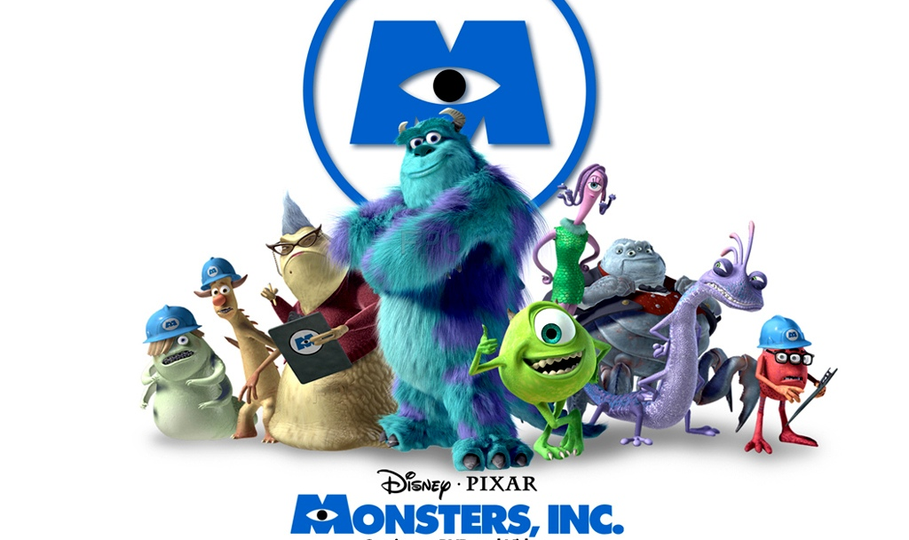
Notes:
And monsters

Slide 6
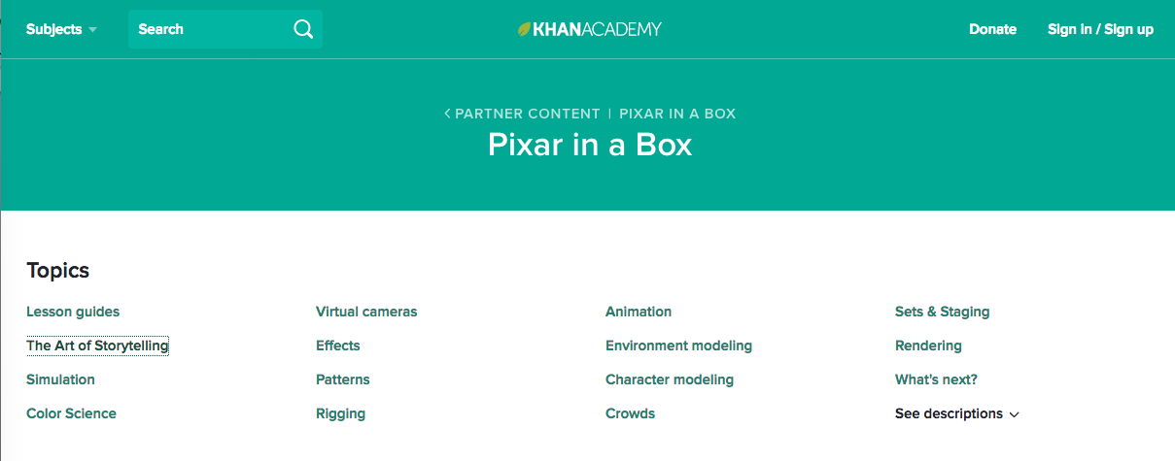
Notes:
Some of the content is irrelevant to Fledge, as the latter lessons talks specifically about animation and moviemaking. But the Art of Storytelling is quite useful.

Slide 7
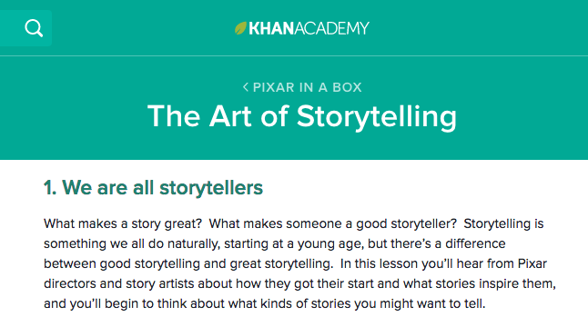
Notes:
Listen closely, as the lessons are told through anecdotes, not from teachers. But the lessons are in there if you watch for them.

