Slide 2
Is not like working at an established company
Life in a startup…
Notes:
A startup is not a small version of a big, established company. It’s something altogether different.

Slide 3
A Startup
Notes:
A startup is something new.

Slide 4
Clean Slate
Notes:
With no history, no tradition, and no baggage. It’s a clean slate. It can be anything you dream up.

Slide 5
All Possibilities are Possible
UP
This way
ϑΩ
That way
Notes:
The good news is that anything is possible. The bad news is that you don’t know which possibilities will work!

Slide 6
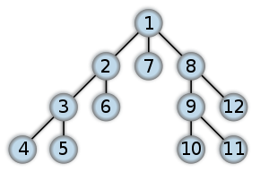
Depth or Breadth First?
Notes:
The other bad news is that there is simply not enough time, too much to do, and plans change constantly.
To deal with this, its best to work breadth-first instead of depth-first.
Specifically, don’t try and finish any of your big tasks. Instead, expect to work for a few hours (or a day) on one task, then switch to another. Work, switch, work, switch. This avoids working on something for a whole week only to find it is no longer relevant. This also helps get a lot of tasks moving forward at once.

Slide 7
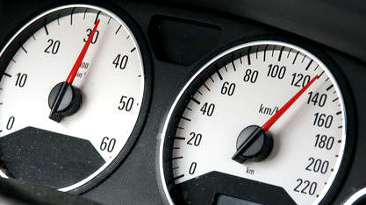
Speed
Notes:
Do note that the only advantage you have right now vs. those big, established companies (some of which are your competitors) is that you can make decisions quickly.
Your company can change direction instantly. You can launch products quickly. You can spot mistakes and make corrections before the big company can organize a meeting.
Your competitive advantage is speed, so focus on using that advantage as much as possible.

Slide 8
Forward Momentum
Notes:
Do a little bit each day and build some forward momentum.

