Slide 3
Who you Know
The old adage is true…
Who you know is more important than what you know

Slide 4
Who do you know?

Slide 5
Who do they know?

Slide 6
Networking

Slide 7
At a job…
Networking is a nice-to-have
It helps open career opportunities

Slide 8
At a startup…
Networking is a must-have
It opens sales, team, mentorship, and partnership opportunities

Slide 9
How do I start?
Meetup.com
LinkedIn.com
Conferences/Trade Shows
Email, email, email
Write, write, write

Slide 10
1. Meetup.com
Cities have dozens-hundreds of events
Seattle has at least one event per day
“Open Coffee”
“Lean Startup”
Co-working events

Slide 11
2. LinkedIn
Polish your profile
Make it obvious what you do
Create a company page
Get endorsed & ask for references
Join groups
Post interesting articles to group
Search & Link

Slide 12
3. Conferences & Trade Shows
Find relevant events
Attend before (thinking of) buying space
Get out of your shell
Plan on staying up late
Find the parties

Slide 13
4. Email… email… email
Whenever you meet someone, follow-up via email
Ask to meet (same city) or call (other city)
Ask for other people to connect
Ask for 2-3 names, so that each meeting leads to at least one other meeting and 2-3 new names
When provided repeat names, thank, but ask for more
Add everyone to your newsletter

Slide 14
Write… write… write
Write for your company’s blog
Write for other blogs
Submit articles to publications

Slide 15
Networking = Branding
Think of networking as a sales effort
You are the product
Turn yourself into a brand

Slide 16
Patience
Networking takes time to pay off
“Kiss a lot of frogs”

Slide 17
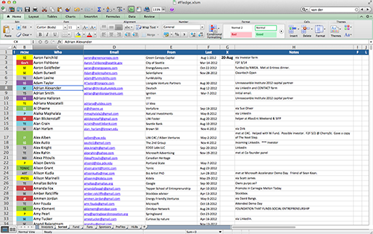
Keep Track

Slide 18
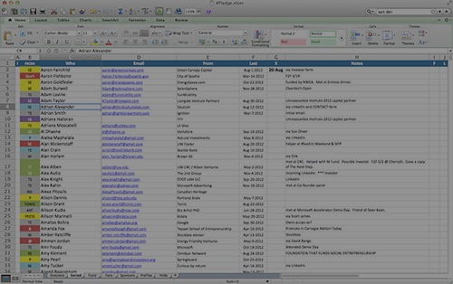
Keep Track
Category
Notes
Name
Last Contact Date
Email
Company

Slide 19
Keep Track
Everyone
Investors
Press

Slide 20
Keep trying new paths
Networking is a process
New tools arise
Some work… some don’t
Experiment, measure, learn, iterate

