Slide 1


Slide 2
Be Organized!
Notes:
You are going to have a long list of todo’s. How do you keep them organized?

Slide 3
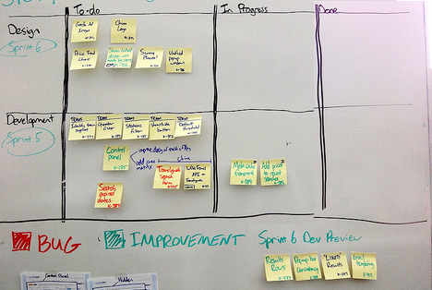
Be Organized!
Use a scrum board
Notes:
Use a scrum board.

Slide 4
Be Organized!
To Do
Working
Done
Notes:
The idea is rather simple. Put todos on PostIt notes. Organize the PostIts into three columns.
Column 1, items you’ve not yet started working on.
Column 2, items that are in progress.
Column 3, items that are complete.

Slide 5
Be Organized!
(Optional) Split by role, e.g.
  Validate
  Design
  Develop
  Pitch
Notes:
Optionally, you can split he board horizontally, by role or task or however works best for you.

Slide 6
Be Organized!
Today, make a To Do List
Notes:
When you think of a new todo, add it to the first column.

Slide 7
Be Organized!
Check-in daily and update
Notes:
When someone on the team starts working on the item, move the PostIt to the middle column.

Slide 8
Be Organized!
By Week 10, everything should be DONE
Notes:
When it’s done, move it to the rightmost column.

Slide 9
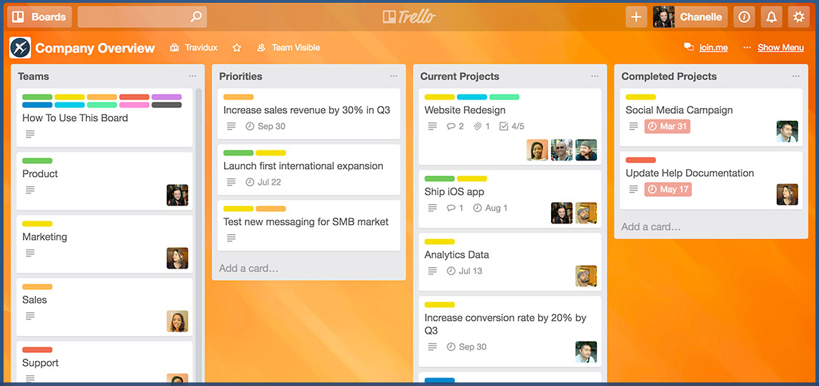
Trello
Notes:
Would you prefer to do this online instead of on paper? Trello is the most popular online scrum board. And it’s free for small groups.

Slide 10
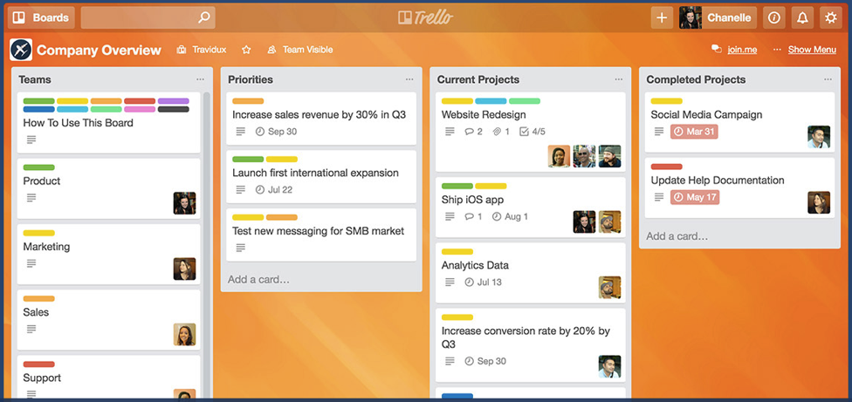
Be Organized
Notes:
Whether on paper or online, a scrum board not only lets you keep your tasks organized, it lets you visibly see the tasks being completed, and that helps keep the team motivated.

