Slide 1


Slide 2

Your plan is wrong flawed
Notes:
I hate to tell you, but your plan is wrong.

Slide 3
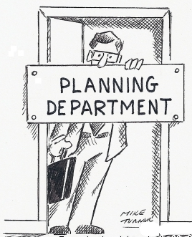
All plans
are flawed
Notes:
I know your plan is wrong because all plans are wrong. This is the big learning from the last few decades of startups. That all plans are flawed, and that it you recognize that fact, you can work toward fixing the flaws. Of course, the fixed plans are also flawed, but you knew that, because all plans are flawed.

Slide 4
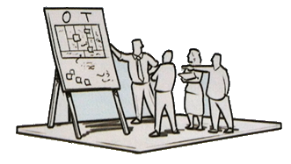
More help with help
Notes:
What you can do to help find and fix those flaws is to get some help. That’s why you are here. The mentors will help with this process. So will your fellow fledglings.

Slide 5

Plan for Failure
Notes:
What you can also do is to “plan for failure”. That doesn’t mean planning to fail, it means planning for the fact that your product or marketing campaign, or sales process or whatever it is you just launched is likely to not work as expected. It’s the opposite of planning to succeed. When you plan to succeed, you are surprised when things don’t go as planned. When you plan for failure, you are looking for them to fail and have Plan B, Plan C, and Plan D already ready to go.

Slide 6

Questions your Assumptions
Notes:
What also helps is to know all your assumptions. Quite often there are assumptions in the business plan that you are taking for granted.

Slide 7
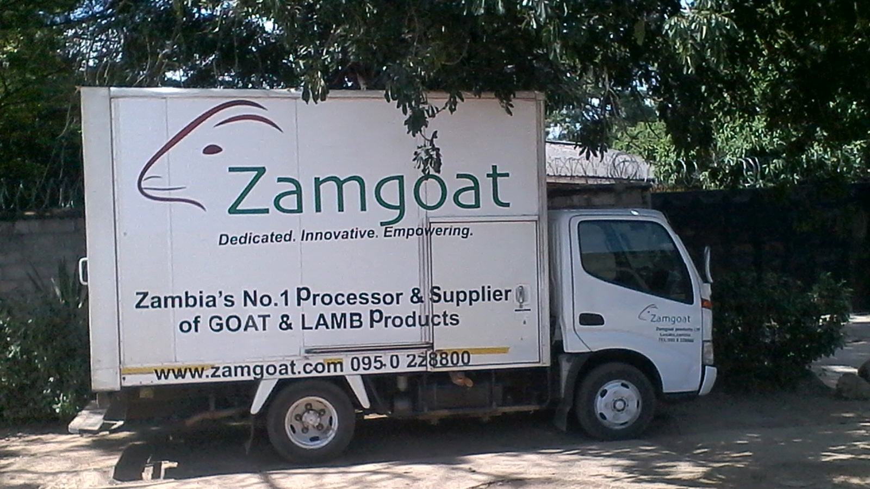
Questions your Assumptions
Notes:
One great example of this is from Fledge6, from a company called Zamgoat, based in Zambia. Goats are a delicacy in Zambia. Paul was certain he had an untapped market of 300 million Americans, in addition to his market back home. It took him weeks to understand that Americans prefer beef, chicken, pork, and lamb, and almost no Americans eat goat.

Slide 8
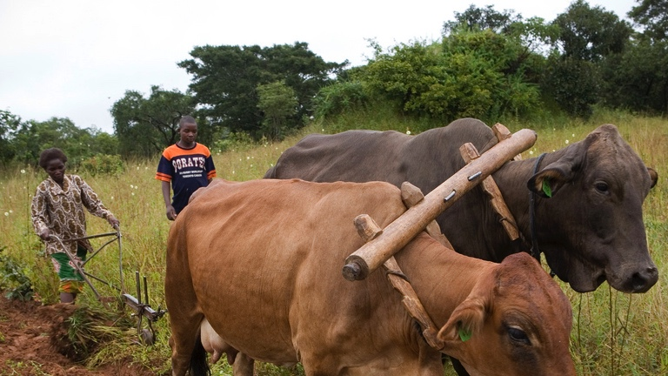
Questions your Assumptions
Notes:
But that wasn’t the amusing assumption. After researching animals in Zambia, Luni found that there were more cattle in Zambia than goats, and far more cattle and goats than chickens or pigs. Luni’s assumption was that this was a country that consumed beef. It was only in Week 8, when Paul presented the above image for his Demo Day talk that Luni discovered that all those cattle are really tractors, not food. Paul knew this, but hadn’t shared that fact, no matter how many times Luni said Zambians must eat beef. It turns out Zambians can’t afford to eat much meat, and those tiny few chickens, pigs, etc. are the meat they eat.

Slide 9

And let go…
Notes:
Planning for failure also means that you can’t hold on to your ideas too tightly, as what you think is your best idea probably won’t work.
Many entrepreneurs think they have the best idea ever. Few, if any, actually do. Most just have good ideas.
The good news is that many good ideas have great ideas hiding inside. The bad news is that you have to give up your good idea to find the great idea.

