Slide 2
Deals & Offers & Perks
It’s good to be a startup…
Notes:
Before you buy any online (or offline) service, take a moment to see if you can get it for a discount

Slide 3
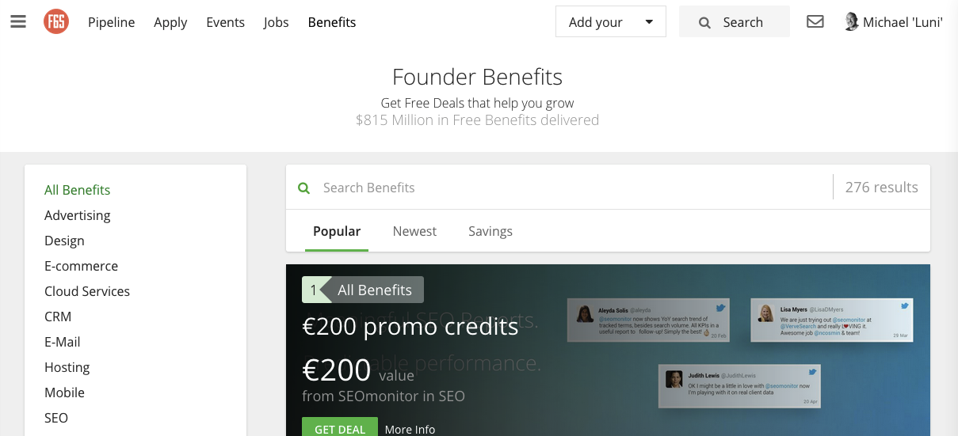
F6S.com
Notes:
You used F6S.com to apply to Fledge. Login, click on Benefits, and you’ll find hundreds of discounts for startups.

Slide 4
startup.deals
Notes:
Search on Google for “startup deals” and you’ll find many other sites too. They tend to come and go, but the discounts are often worth 15 minutes of searching.

Slide 5
startups.co
Not deals but a lot of useful tools
Notes:
In addition to deals, there are sites like startups.co which have freemium services than can be useful, e.g. launchrock.com can create you a 1-page landing page in minutes

