Slide 2
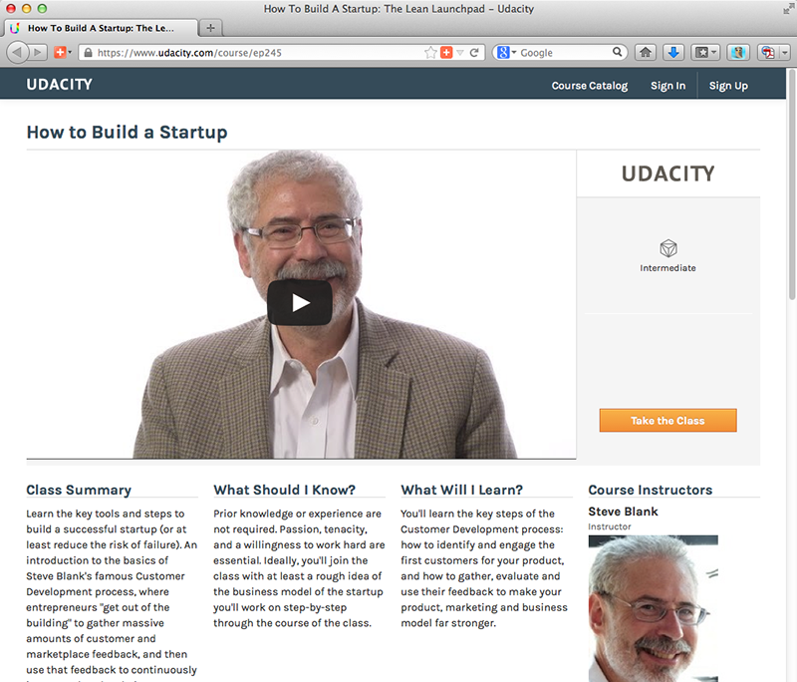
The Lean Launchpad
Steve Blank’s Free Online Class
https://www.udacity.com/course/ep245
Notes:
Remember how the more you put in the more you get out. If you want a second opinion on business planning, especially a second use for the Business Model Canvas, then go take Steve Blank’s online class, The Lean Launchpad. It’s free. It’s worth the 2-4 hours.

