Slide 1


Slide 2


Patterns

Slide 3
Details
All the conversations with potential customers
Your whole Business Model
All your Competition research
Your multi-tab, five year Financial Plan
Marketing plan
Sales plan
Etc.

Slide 4
What you share
All the conversations with potential customers
Your whole Business Model
All your Competition research
Your multi-tab, five year Financial Plan
Marketing plan
Sales plan
Etc.
One story with one potential customer, maybe two
How you make money
Three facts on a matrix
Proof that you can make money, when, financial needs
A bullet list of channels
Not much
Etc.

Slide 5
Simple
Keep the story

Slide 6
Questions
Let them ask

Slide 7
They don’t
Don’t be surprised when

Slide 8

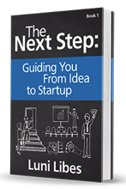



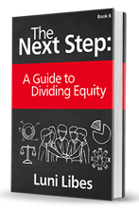
Funding

