Slide 1


Slide 2
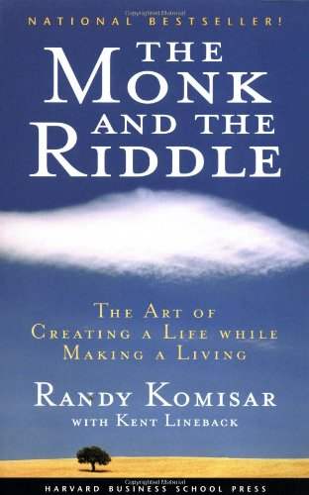
The distinction between drive and passion is crucial.

Slide 3
The distinction between drive and passion is crucial.
  Passion pulls you toward something you cannot resist.
  Drive pushes you toward something you feel compelled or obligated to do.

Slide 4
The distinction between drive and passion is crucial.
  If you know nothing of yourself, you can’t tell the difference.

Slide 5
  But it isn’t just the desire to achieve some goal or payoff, and it’s not about quotas or bonuses or cashing out. It’s not about jumping through someone else’s hoops. That’s drive.

Slide 6
  Is what you are doing today something you are eager to do for the rest of your life? Find your passion.

